Slide 1
 |  |  | Lec 11 | Lec 12
1 | 1921PH19 | SAUMYASHREE BARAL | p | p
2 | 2321PH02 | ARYA KUMAR SIDDHARTH | a | p
3 | 2321PH07 | NAINCY SHRIVASTAVA | p | p
4 | 2321PH09 | PRITAM SAMANTA | p | p
5 | 2321PH10 | REETU SAINI | p | p
6 | 2321PH13 | SOUBHIK MUKHERJEE | p | p
7 | 2321PH14 | NEHA CHOUDHARY | p | p
8 | 2321PH15 | RABI DAS | p | p
9 | 2321PH19 | SHRUTI SARSWAT | p | p
10 | 2212PH02 | AMAN KUMAR | p | p
11 | 2212PH10 | BINAYAK ROUT | p | p
12 | 2212PH11 | DARPAN SARKAR | p | p
13 | 2212PH13 | GAURAV JAISWAL | p | a
14 | 2212PH17 | KAUSHIP SAHA | p | a
15 | 2212PH20 | NEELLOHIT KARMAKAR | p | a
16 | 2212PH23 | RITIK PAL | p | p
17 | 2212PH26 | SOUMIK KARMAKAR | p | p
18 | 2212PH32 | KAUSTAB BHARASA | p | a

Slide 11
Force equation in a MOT

Slide 14
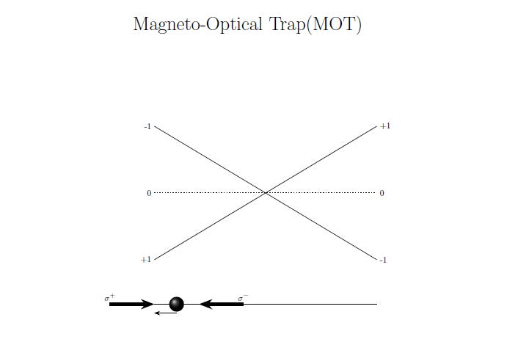
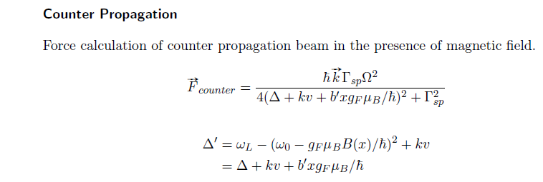

Slide 15
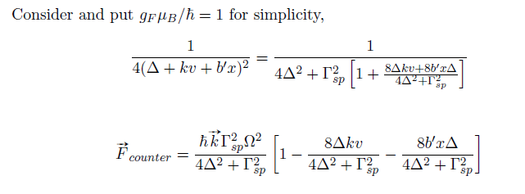
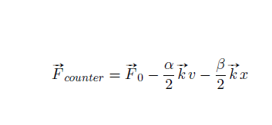

Slide 16
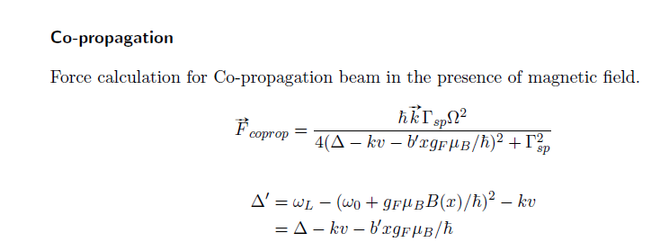
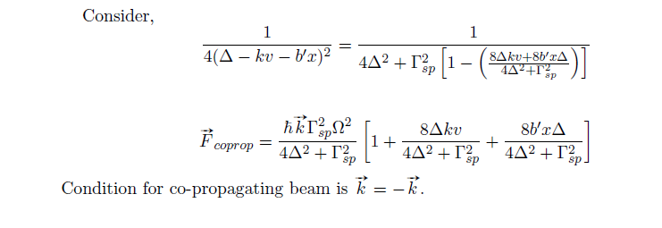

Slide 18
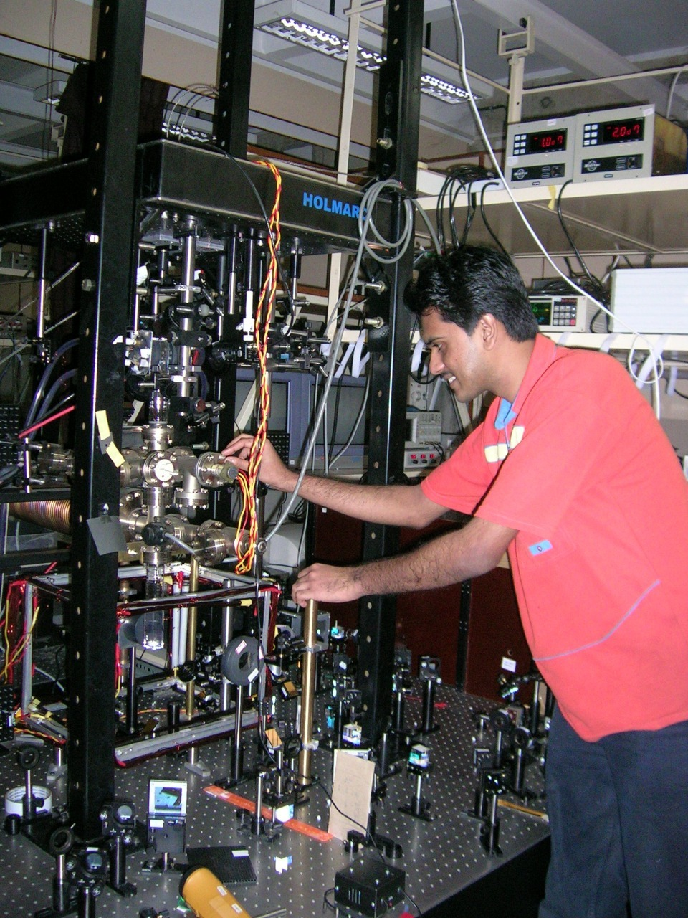
Double MOT system
Assembling of Vacuum chambers, Achieving UHV, Laser Alignment for MOT, Laser locking, Lab view automation, construction of QUIC coils for Magnetic trap etc
RRI Bangalore 2004

Slide 19
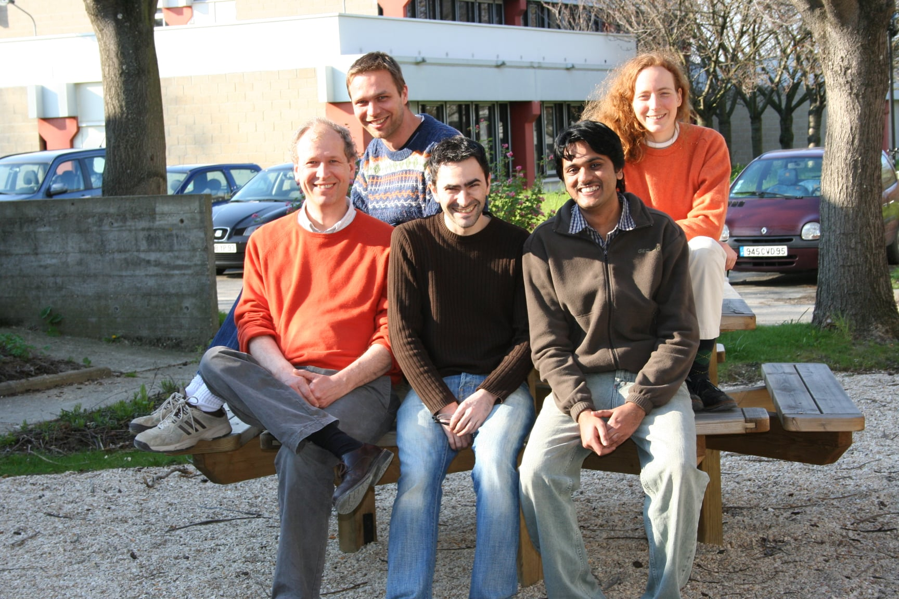
PhD: Ring BEC and RF Spectroscopy
ENS Paris-Institute Galilee / University of Paris13-FRANCE
Marie Curie Fellowship for PhD
2006

Slide 20
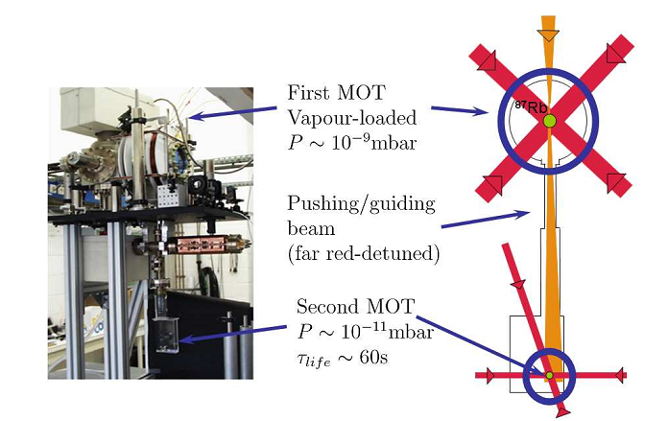
Double MOT Set up

Slide 21
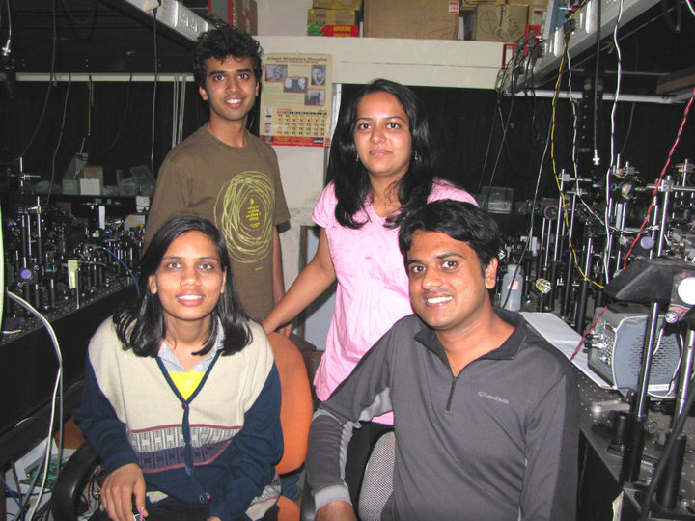
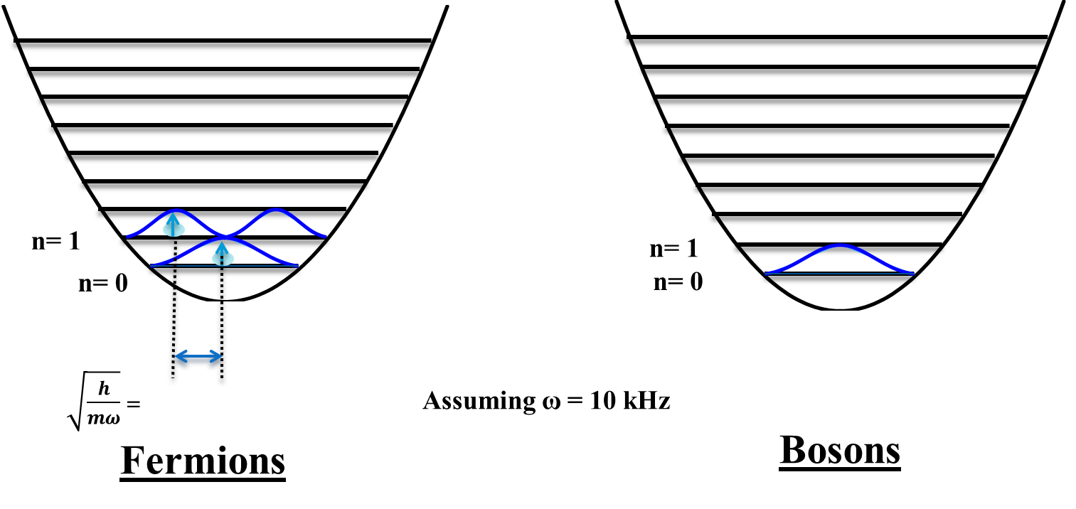
Post Doc 1:
2009
⁴⁰K (Fermionic)
³⁹K (Bosonic)

Slide 22
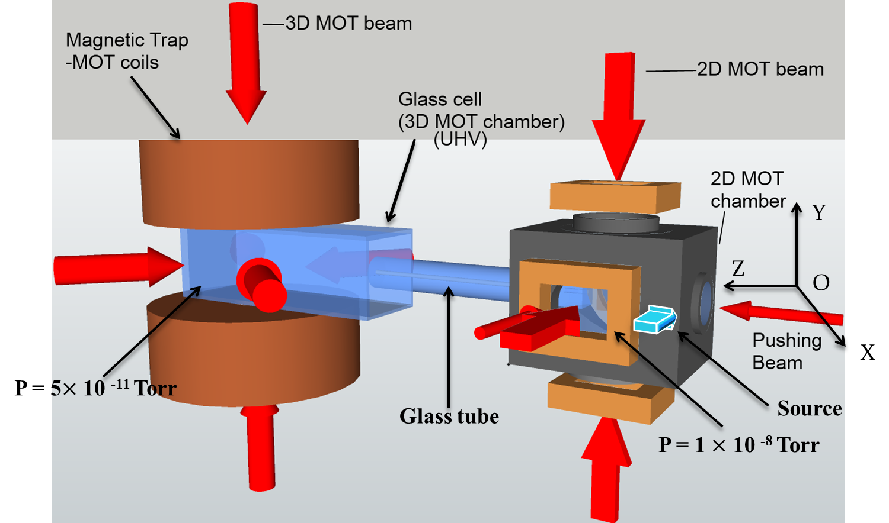
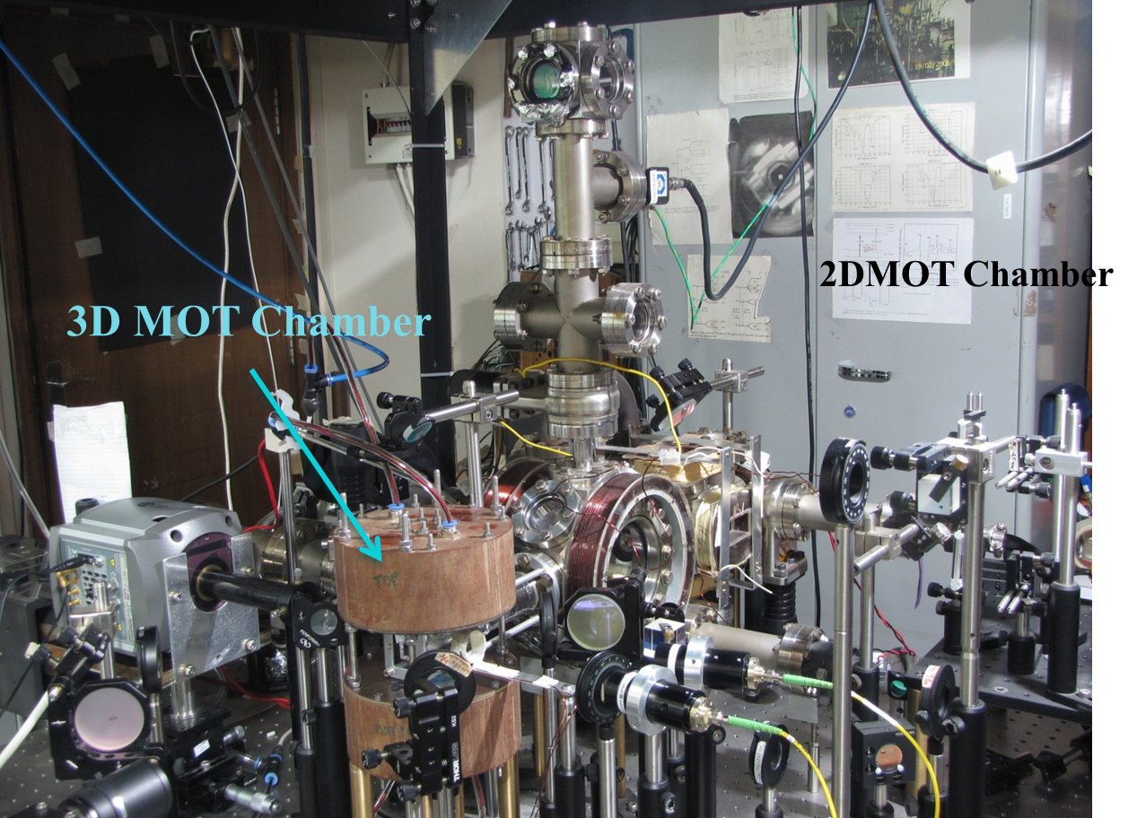
Post Doc 1: TIFR Mumbai

