Slide 1
Concept of LASER/Doppler Cooling of Atoms S4 L3

Slide 2
 |  |  | Lec2 | Lec 3
1 | 1921PH19 | SAUMYASHREE BARAL
2 | 2321PH02 | ARYA KUMAR SIDDHARTH
3 | 2321PH07 | NAINCY SHRIVASTAVA
4 | 2321PH09 | PRITAM SAMANTA
5 | 2321PH10 | REETU SAINI
6 | 2321PH13 | SOUBHIK MUKHERJEE
7 | 2321PH14 | NEHA CHOUDHARY
8 | 2321PH15 | RABI DAS
9 | 2321PH19 | SHRUTI SARSWAT
10 | 2212PH02 | AMAN KUMAR
11 | 2212PH10 | BINAYAK ROUT
12 | 2212PH11 | DARPAN SARKAR
13 | 2212PH13 | GAURAV JAISWAL
14 | 2212PH17 | KAUSHIP SAHA
15 | 2212PH20 | NEELLOHIT KARMAKAR
16 | 2212PH23 | RITIK PAL
17 | 2212PH26 | SOUMIK KARMAKAR
18 | 2212PH32 | KAUSTAB BHARASA

Slide 8
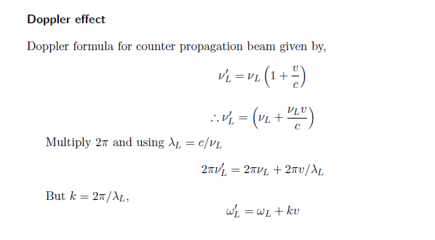
Doppler Effect

Slide 11
Red and blue detuning

Slide 12
Doppler effect in radiation pressure
Laser cooling in 1-D
v
e
δ
ω_{L}- kv
ω_{L}+ kv
ω_{L}
ω_{o}
ω_{L}
g

Slide 13
Atoms decelerate

Slide 15
Laser cooling in 3-D

Slide 16
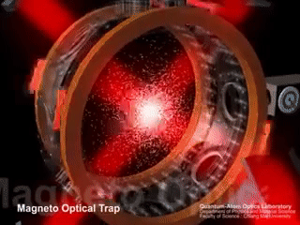

Slide 17
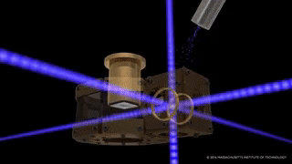

Slide 18
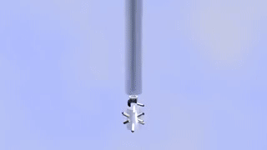

Slide 19
Some real experiments….

Slide 20
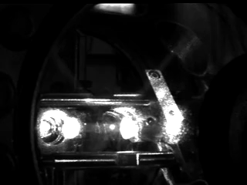

Slide 21
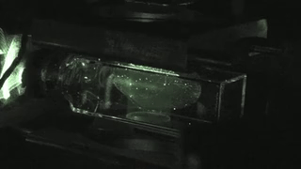

Slide 22
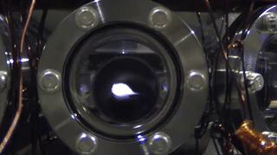

Slide 23
