Slide 1
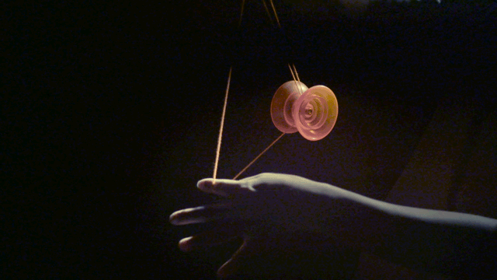
RIGID BODY IN MOTION
Chapter 4

Slide 2
Some weblink’s which might be useful
https://ocw.mit.edu/courses/mechanical-engineering/2-003sc-engineering-dynamics-fall-2011/angular-momentum-and-motion-of-rotating-rigid-bodies/lecture-11-mass-moment-of-inertia-of-rigid-bodies/
https://ocw.mit.edu/resources/res-18-009-learn-differential-equations-up-close-with-gilbert-strang-and-cleve-moler-fall-2015/differential-equations-and-linear-algebra/eigenvalues-and-eigenvectors/symmetric-matrices-real-eigenvalues-orthogonal-eigenvectors/

Slide 3
Another example to find principal axes
ROTATING DUMBBELL

Slide 4
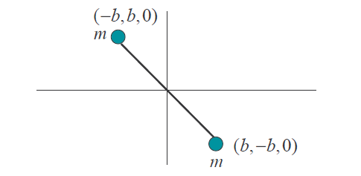
A. Find the Moment of Inertia Tensor
B. Find the principal axis corresponding to it
Y
m is a point mass, consider rod massless
45⁰
X
45⁰

Slide 5
Recollect….

Slide 6
A. Moment of Inertia Tensor

Slide 7
Finding the Eigenvalues

Slide 8
Eigenvalues

Slide 9
Moment of Inertia Tensor along principal axis

Slide 10
Eigen vector corresponding to
Y
X
Eigen vector:

Slide 11
Eigenvectors corresponding
Eigenvector corresponding to λ_{3:}
Verify orthogonality of eigenvectors

Slide 12
When Moment of Inertia Tensor becomes diagonal?
y
z
Principal axis

Slide 13
Find the principal axes of a cube with Side length L and mass M, with co-ordinate axis parallel to the edges of the cube and the origin at a corner.
Yet another example!
Y
L
L
L
X
Z

Slide 14
Moment of Inertia Tensor
(a)
Z
L
L
L
X
Y

Slide 15
Moment of Inertia Tensor

Slide 16
Moment of Inertia Tensor

Slide 17
Find principal axis
Y
L
L
L
β
X
Z

Slide 18
Find principal axis

Slide 19
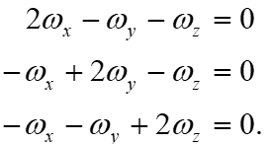
Finding eigen vector corresponding to λ₃
Eigenvector corresponding to λ_{3:}

Slide 20
y
L
L
L
X
Z

Slide 21
Finding eigen vectors
Any axis perpendicular to body diagonal, which satisfies

Slide 22
Any axis perpendicular to body diagonal, which satisfies
For example,
Y
Verify orthogonality of eigenvectors
L
L
L
-X
X
Z

