Slide 1
Lecture 6 Surface and Volume Integral: Practice Problems

Slide 2
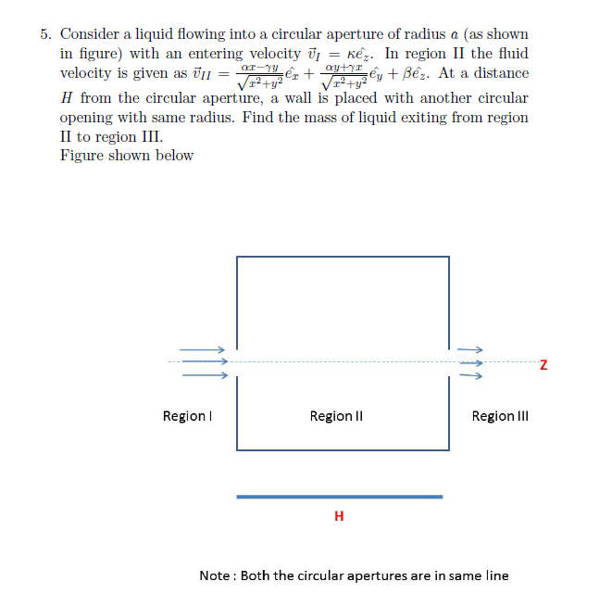
per unit time. Assume that the density of the liquid is σ
y
z
x

Slide 3
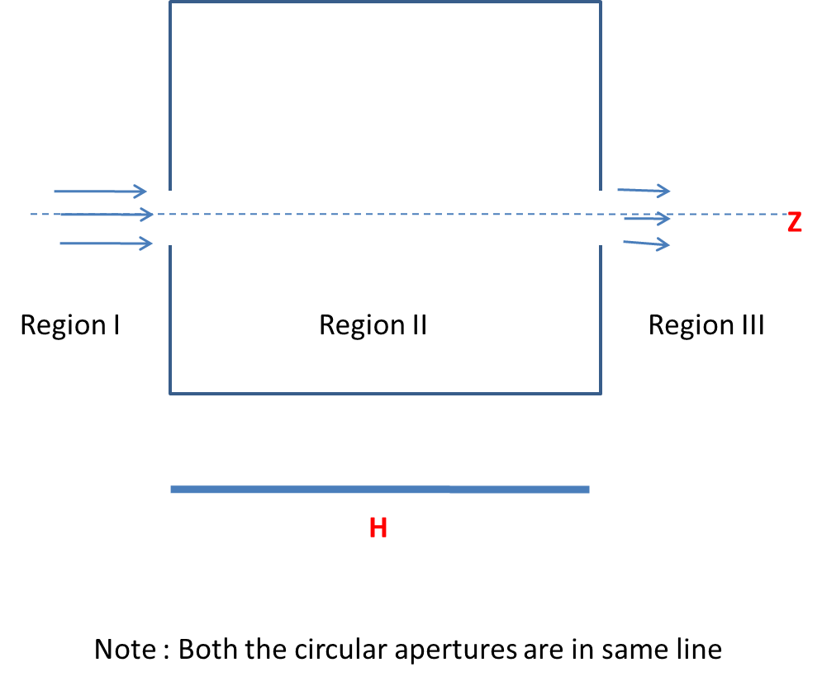
y
z
MASS OF LIQUID EXITING FROM REGION II TO REGION III PER UNIT TIME =
MASS OF LIQUID ENTERING FROM THE REGION I PER UNIT TIME –
MASS OF FLUID FROM THE SURFACE OF AN IMAGINARY CYLINDER OF RADIUS a AND LENGTH H PER UNIT TIME
x

Slide 4
MASS OF LIQUID ENTERING FROM THE REGION I
Mass of liquid entering per elemental area da per unit time =
σv.da
$$dρ$$
$$ρdφ$$
I
dφ
II
III
z

Slide 5
MASS OF FLUID LOST FROM THE SURFACE OF AN IMAGINARY CYLINDER OF RADIUS a AND LENGTH H
$$dz$$
a$dφ$
I
a
dφ
II
III
z

Slide 6
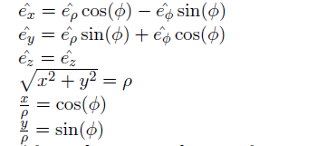

Slide 8
z
H
Ф = 0 to 2π
ρ = 0 to Rz/H
Z = 0 to H
R
ρ
z= (H/R) * ρ
SLOPE = H/R
ρ=R/H *z

