Slide 1
 |  |  | Lec8
1 | 1921PH19 | SAUMYASHREE BARAL | p
2 | 2321PH02 | ARYA KUMAR SIDDHARTH | p
3 | 2321PH07 | NAINCY SHRIVASTAVA | p
4 | 2321PH09 | PRITAM SAMANTA | p
5 | 2321PH10 | REETU SAINI | p
6 | 2321PH13 | SOUBHIK MUKHERJEE | p
7 | 2321PH14 | NEHA CHOUDHARY | p
8 | 2321PH15 | RABI DAS | a
9 | 2321PH19 | SHRUTI SARSWAT | p
10 | 2212PH02 | AMAN KUMAR | p
11 | 2212PH10 | BINAYAK ROUT | p
12 | 2212PH11 | DARPAN SARKAR | a
13 | 2212PH13 | GAURAV JAISWAL | a
14 | 2212PH17 | KAUSHIP SAHA | a
15 | 2212PH20 | NEELLOHIT KARMAKAR | a
16 | 2212PH23 | RITIK PAL | p
17 | 2212PH26 | SOUMIK KARMAKAR | a
18 | 2212PH32 | KAUSTAB BHARASA | a

Slide 2
Concept of Doppler Cooling of Atoms

Slide 3
Cooling phases
Doppler
Cooling
Milli Kelvin range
MOT
Atomic density
Increased
Magnetic Trapping
Need
Multi-Level
Treatment.
2 level model fails…
Quantum nature of atoms observed
Evaporative Cooling

Slide 4
Some Limitations of Doppler Cooling
Minimum Temperature attained in range of fraction of milli Kelvin ONLY…..
For seeing Quantum Behavior of atoms need to reach order of Nano Kelvin
Doppler Cooling has no position dependent force, atoms in periphery leave the cooling region. Force F take a form of F = -αV
Laser Light has some heating effect also for some frequencies for certain velocity class of atoms: Not all the atoms experience the right frequency for cooling effect some atoms gets heating effects from co-propagating light as well………
A competition between heating and cooling arise which leads to an equilibrium temperature.

Slide 5
Some tricks to improve Doppler Cooling Using Magnetic field on Atoms
Magneto Optical Trap (MOT)

Slide 20
Effects of magnetic field on 2 Level atom
Uniform B
Uniform magnetic field (Helmholtz coil)
ZEEMAN SPLITTING
+1
0
-1

Slide 23
Effects of magnetic field on 2 Level atom (Using anti-helmhlotz coil)
-1
+1
0
0
+1
-1
-B
0
+B

Slide 24
Effects of magnetic field on 2 Level atom (Using anti-helmhlotz coil)
-1
+1
0
0
+1
-1
-B
0
+B

Slide 25
Magneto optical trapping
Energy
m_{F} = -1
m_{F} = +1
F=1
m_{F} = 0
m_{F} = 0
o
m_{F} = +1
m_{F} = -1
σ⁺
σ⁻
Δm_{F} = +1
Δm_{F} = -1
F=0
0
Z’’
Z’

Slide 26
MOT
v
ω_{zeeman}
+1
ω₀
Counter propagating σ+ Light Absorb’s: ω₀ - ω_{zeeman} + kv
The atom emits: ω₀ - ω_{zeeman} in the perpendicular direction by spontaneous
Emission.
VICE VERSA FOR σ- LIGHT FOR THE ATOM IN OTHER SIDE

Slide 27
Effects of magnetic field on 2 Level atom (Using anti-helmhlotz coil)
σ+
Both these will see same energy gap
At identical locations
σ-
-1
+1
0
0
+1
-1
-B
0
+B

Slide 28
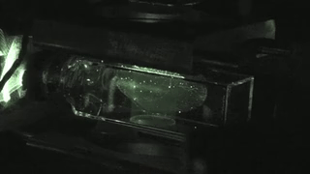

Slide 29
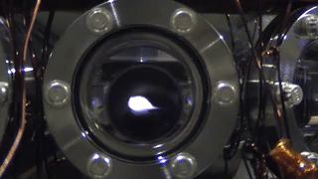

Slide 30
Some tricks to improve Doppler Cooling Using Magnetic field on Atoms
Magneto Optical Trap (MOT)

Slide 31
Effects of magnetic field on 2 Level atom
Uniform B
Uniform magnetic field (Helmholtz coil)
ZEEMAN SPLITTING
+1
0
-1

Slide 32
Effects of magnetic field on 2 Level atom (Using anti-helmhlotz coil)
-1
+1
0
0
+1
-1
-B
0
+B

Slide 33
Magneto optical trapping
Energy
m_{F} = -1
m_{F} = +1
F=1
m_{F} = 0
m_{F} = 0
o
m_{F} = +1
m_{F} = -1
σ⁺
σ⁻
Δm_{F} = +1
Δm_{F} = -1
F=0
0
Z’’
Z’

Slide 34
MOT
v
ω_{zeeman}
+1
ω₀
Counter propagating σ+ Light Absorb’s: ω₀ - ω_{zeeman} + kv
The atom emits: ω₀ - ω_{zeeman} in the perpendicular direction by spontaneous
Emission.
VICE VERSA FOR σ- LIGHT FOR THE ATOM IN OTHER SIDE

Slide 35
Effects of magnetic field on 2 Level atom (Using anti-helmhlotz coil)
σ+
Both these will see same energy gap
At identical locations
σ-
-1
+1
0
0
+1
-1
-B
0
+B

Slide 36
Experiment Sequence

Slide 37
Doppler
Cooling
MOT
Laser
Power
ω₀-kv_{d}
Laser
frequency
ω₀ - ω_{zeeman} + kv
Magnetic
field

Slide 38
Cooling phases
Doppler
Cooling
Milli Kelvin range
MOT
Atomic density
Increased
Magnetic Trapping
Need
Multi-Level
Treatment.
2 level model fails…
Quantum nature of atoms observed
Evaporative Cooling

Slide 39
Approximate Mathematical approach for Deriving Doppler Cooling Force

Slide 40
Force equation in a MOT

Slide 41
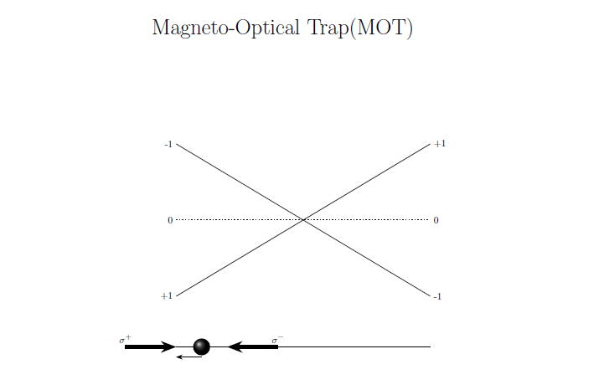
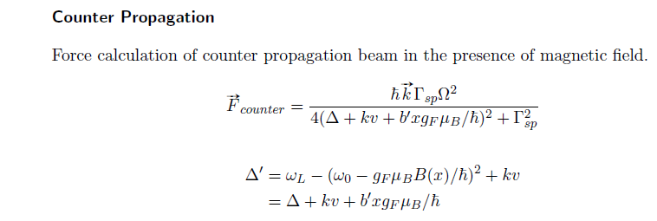

Slide 42
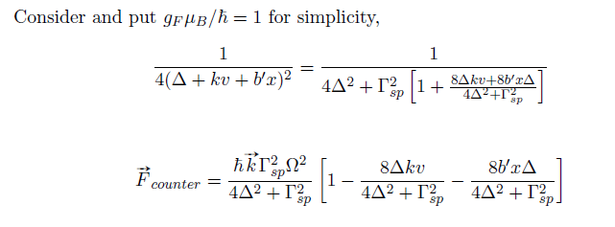
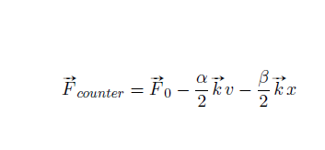

Slide 43
