Slide 1
1. Co-ordinate Systems
Introduction to
DIFFERENT CO-ORDINATE SYSTEMS
INFINITESIMAL LINE, AREA AND VOLUME ELEMENTS

Slide 2
Outline
Choice of Co-ordinate systems
Cartesian Co-ordinates: Line, area and volume element
Plane-Polar Co-ordinates: Unit vectors, transformations, Rate of change, velocity and acceleration, area element
Cylindrical Co-ordinates: Unit vectors and its transformations, Rate of change, velocity and acceleration, line, area and volume element
Spherical Polar Co-ordinates: Unit vectors and its transformations, Rate of change, velocity and acceleration, line, area and volume element

Slide 3


Why do we need different coordinate system?

Slide 4
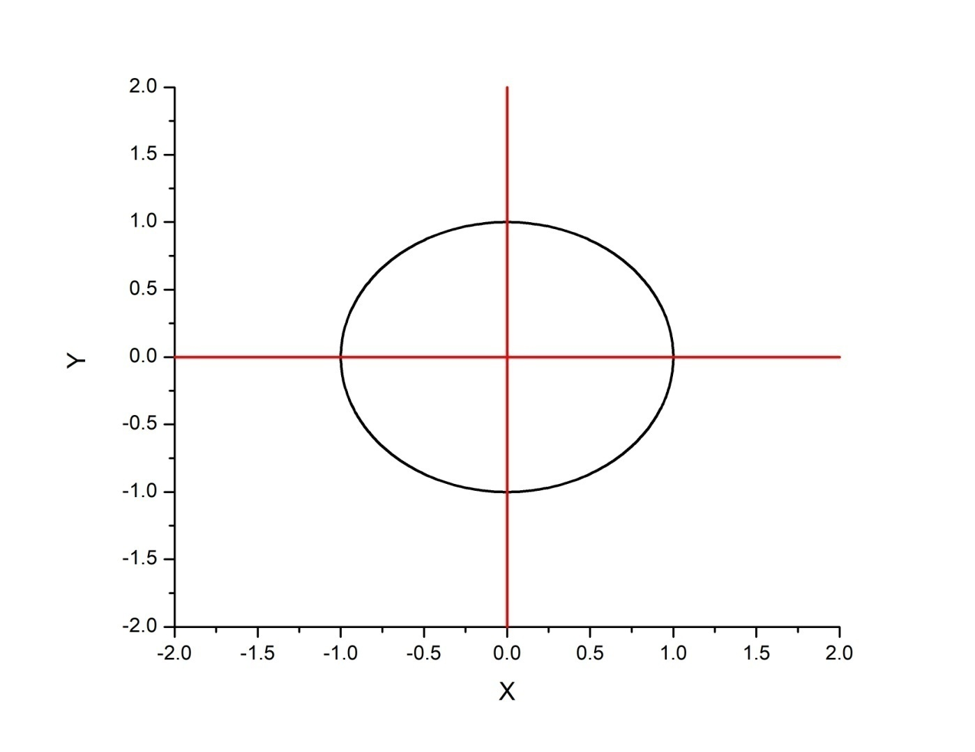
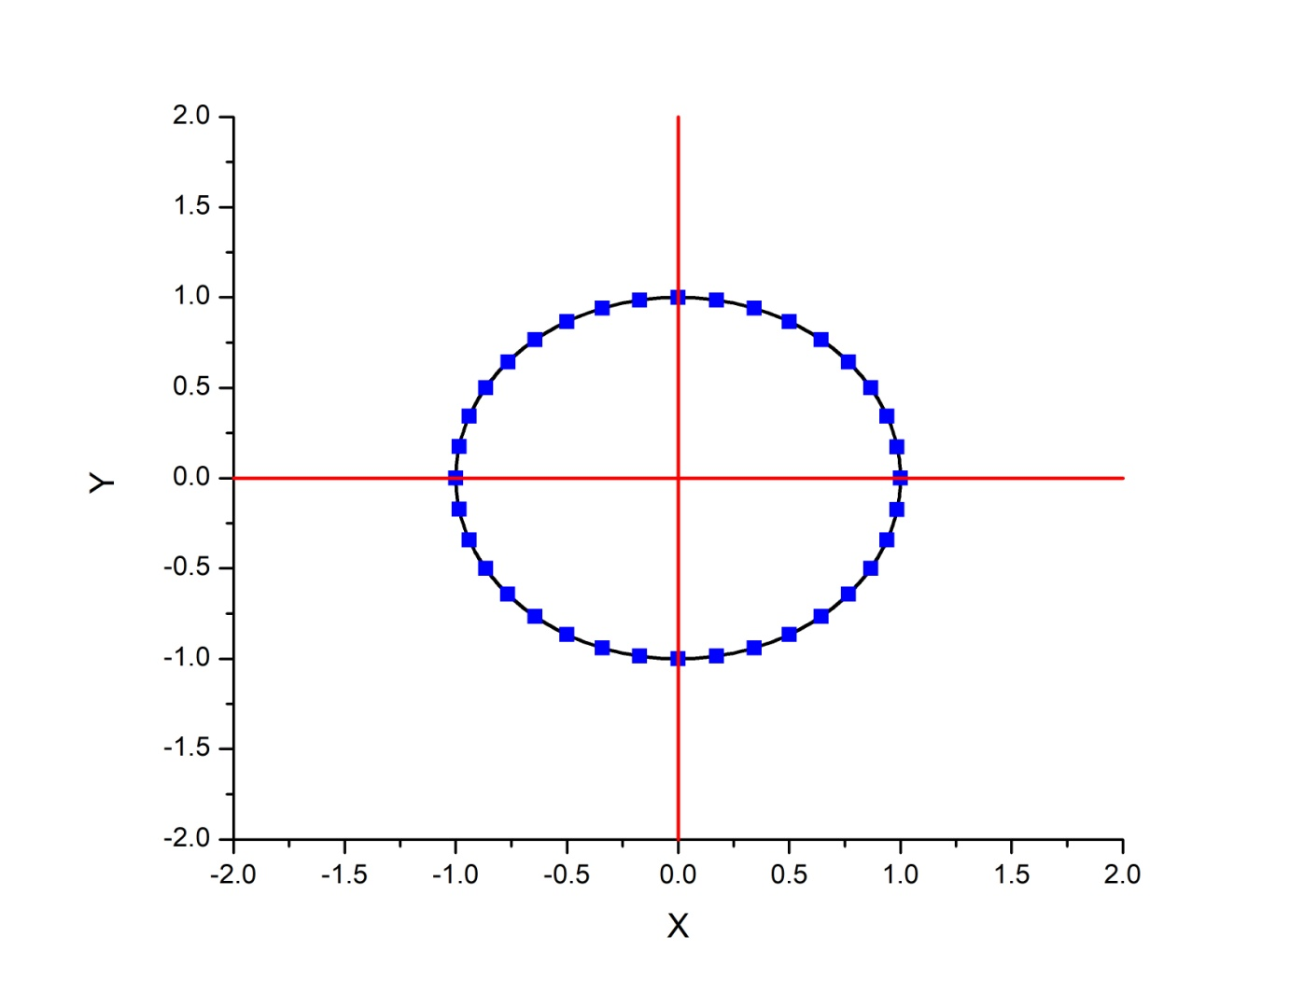
Why do we need different coordinate system?
X | Y
1 | 0
0.9397 | 0.34201
0.76606 | 0.64277
0.50003 | 0.86601
0 | 1
r
r
1 | 0
1 | 20
1 | 40
1 | 60
1 | 90
Proper choice of a
coordinate system can
vastly simplify a problem

Slide 5
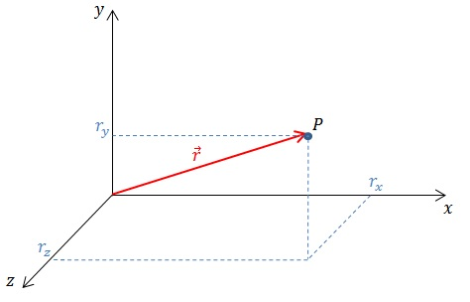
Cartesian Co-ordinates
A coordinate system consists of four basic elements:
Choice of origin (2) Choice of axes (3) Choice of positive direction for each axis (4) Choice of unit vectors for each axis

Slide 6
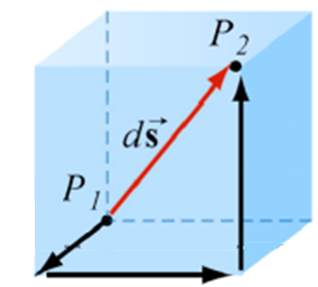
Cartesian Co-ordinates
y
Infinitesimal line element
x
z

Slide 7
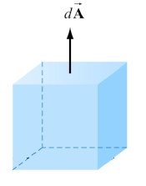
Cartesian Co-ordinates
Infinitesimal Area element
y
dz
dx
x
z
Notes:
Vector sign should be added for dx and dy

Slide 8
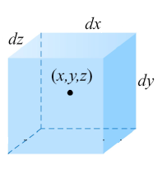
Cartesian Coordinates
Infinitesimal Volume element
y
x
z

Slide 9

Plane Polar Coordinates
e_{y}
e_{r}
Y
-e_{x}
(x,y)
e_{x}
r
e_{r}
X
What is and in terms of and ?
e_{x}
e_{y}
Verify that
$\hat{e}$_{ϴ}.$\hat{e}r$
= 0
Above vector in Polar Co-ordinates is
represented as
e_{x}
e_{y}
e_{r}
What is and in terms of and ?

Slide 10
Motion in Plane Polar Coordinates
e_{y}
Y
e_{y}
e_{r}
e_{r}
e_{x}
(x1,y1)
e_{x}
(x2,y2)
r₂
r₁
X
Cartesian coordinate system: Constant unit vectors
Plane polar coordinate system: Varying unit vectors

Slide 11
Velocity in Plane Polar Coordinates
Velocity in Cartesian Coordinates:
?
Velocity in Polar Coordinates:
?

Slide 12
Through a geometrical consideration
Y
e_{r2}
e_{r1}
-e_{r1}
(x1,y1)
(x2,y2)
r₂
r₁
X
Notes:
-er1 should be placed close to the blue vector.

Slide 13
Change in unit vectors in Plane Polar Coordinates
What about

Slide 14
Change in unit vectors in Plane Polar Coordinates
Change in unit vectors
Try Geometrical considerationalso

Slide 15
Back to Velocity……
Case 1:
Case 2:

Slide 16
Acceleration in polar coordinates

Slide 17
Acceleration in polar coordinates
Linear acceleration in the radial direction
Linear acceleration in the tangential direction
Centripetal acceleration in the radial direction
Coriolis acceleration

Slide 18
Acceleration in polar coordinates
Linear acceleration in the radial direction
Coriolis acceleration
Centripetal acceleration in the radial direction
Linear acceleration in the tangential direction
Acceleration due to change in radial direction alone….
Acceleration due to change in tangential direction alone...

