Slide 1
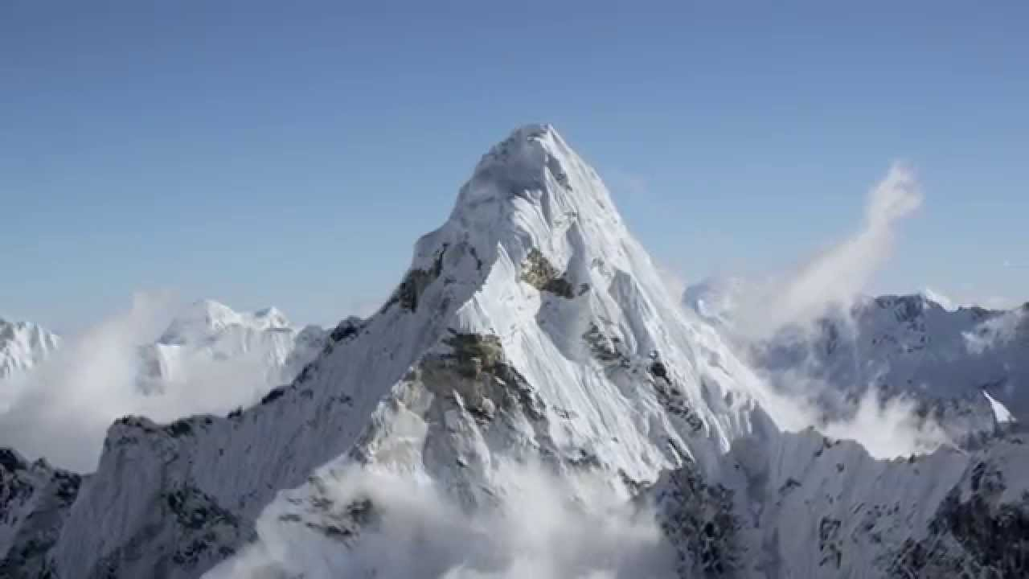
Chapter-2: Introduction to Vector Operators
Gradient, Divergence and Curl

Slide 2
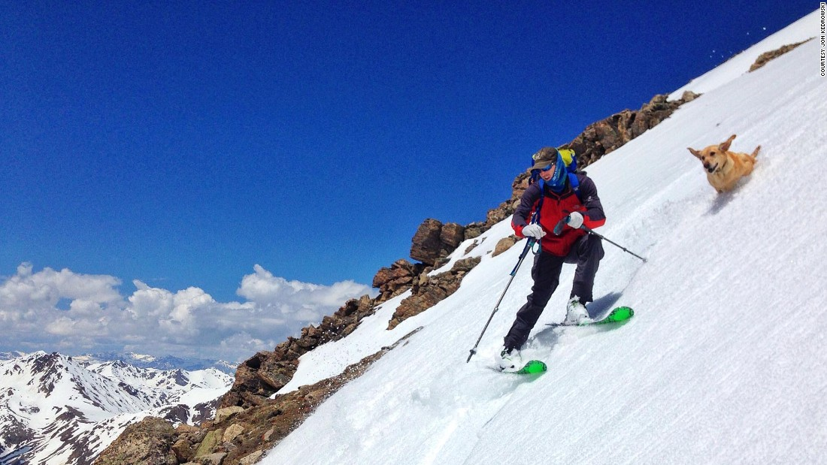
Ordinary Derivatives
Z
X

Slide 3
Ordinary Derivatives
f(x)
f(x)
x
x
?
RECOLLECT
(By Taylor
Series) for
Plane polar

Slide 4
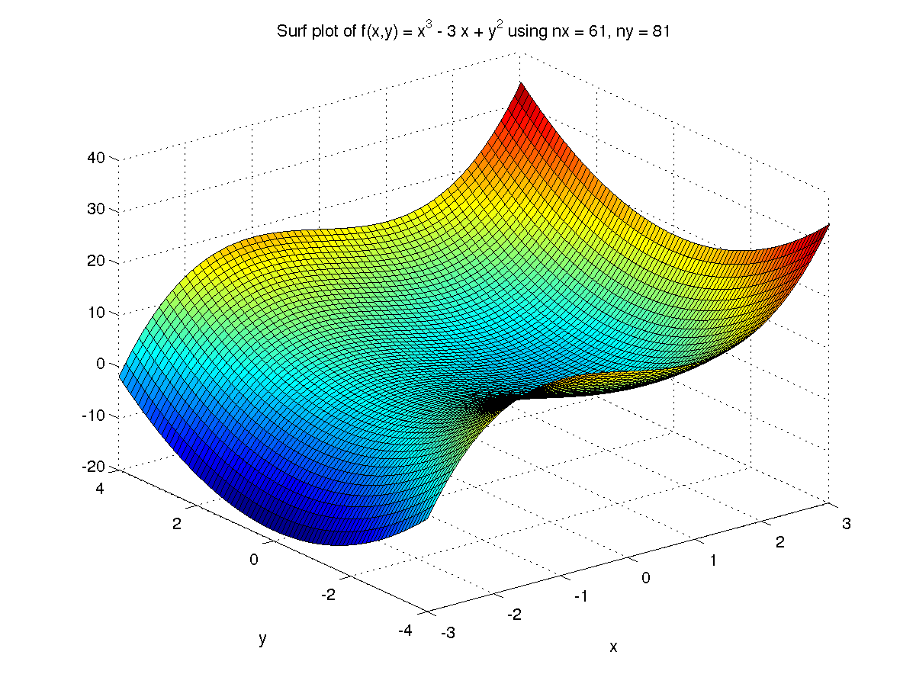
Derivative of a function in 3D
Derivative is directional!

Slide 5
Scalar Field Function
A function of space whose
value at each point is a
scalar quantity
Example: Temperature

Slide 6
Gradient of a scalar function
Partial derivative
Example
in spherical polar

Slide 7
Gradient of a function
Gradient

Slide 8
Gradient: Geometrical interpretation
The gradient points in the direction of maximum increase of the T.

Slide 9
Let’s do an example
Find the gradient of
What would it mean for the gradient to vanish?
Stationary point of f(x,y,z)

Slide 10
Vector operator (The del operator)
Three ways the operator can act:
The divergence and curl operates on a VECTOR FIELD .
Examples of vector fields are Velocity of fluid flow , Electric field, Magnetic field etc

Slide 11
Vector Field
A vector field in the plane is an assignment of a vector to every point (x,y) in the plane.
Algebraically a vector field is a function of (x, y) whose value is a vector
i.e. F(x, y) is a vector field if
Lets see some examples……………

Slide 12
Vector Field

Slide 13
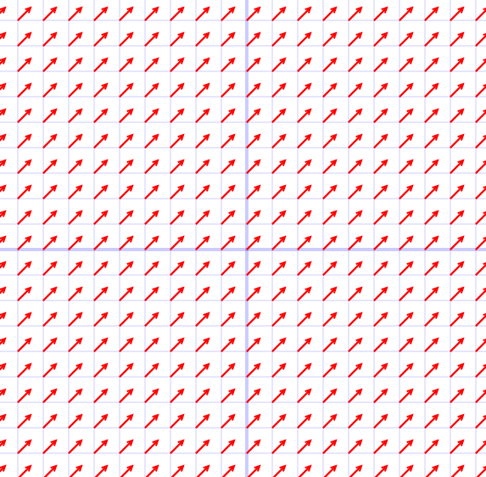
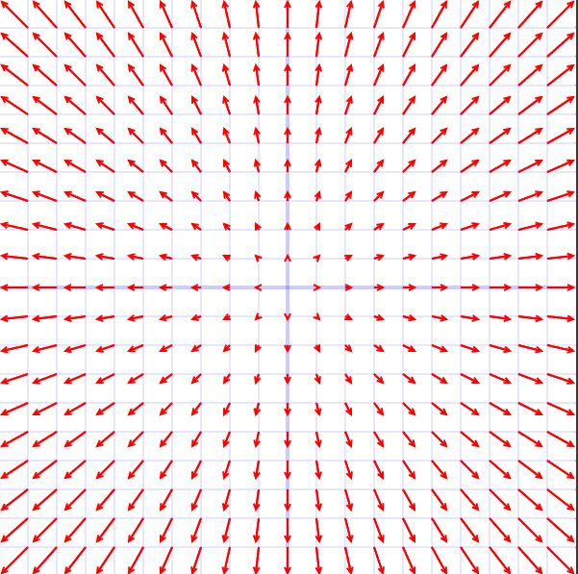
Vector Field

Slide 14
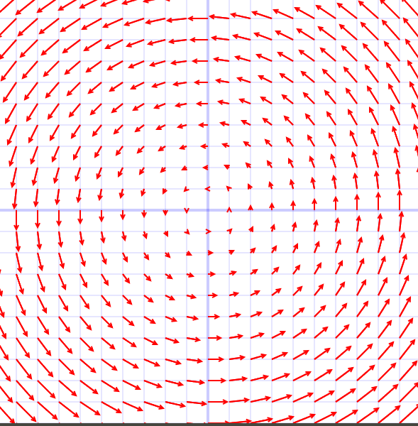
Vector Field
(4,0)
(4,4)
(0,4)

