Slide 1
Season 2, Lecture 31 (S2,L31):
Engineering Applications
Thermal Power Plant

Slide 6
Name | L21 | L22 | L23 | L24 | L25 | L27 | L28 | L29 | L30 | L31
"2201ph34_dolly" <2201ph34_dolly@iitp.ac.in>; | p | p | p | P | p | a | p | p | a
"Adhila Aslam" <2201ph01_adhila@iitp.ac.in>; | p | p | p | P | p | p | p | p | a
"Aditi Baghel" <2201ph31_aditi@iitp.ac.in>; | p | p | p | P | p | p | p | p | a
"Aditya Kumar" <2201ph02_aditya@iitp.ac.in>; | a | a | p | P | a | a | p | a | p
"Aditya Singh" <2201ph03_aditya@iitp.ac.in>; | p | p | p | P | a | p | p | a | a
"Animesh Sharma" <2201ph05_animesh@iitp.ac.in>; | p | p | p | P | a | p | a | p | p
"Arun Mishra" <2201ph06_arun@iitp.ac.in>; | a | p | p | P | p | a | p | p | p
"Aryan Raj" <2201ph32_aryan@iitp.ac.in>; | p | p | p | P | p | p | p | p | a
"Boda Vishnuwardhan" <2201ph08_boda@iitp.ac.in>; | p | p | a | P | p | a | p | a | p
"Chanchal Tolani" <2201ph09_chanchal@iitp.ac.in>; | p | p | p | P | p | p | p | p | p
"Gaurav Verma" <2201ph10_gaurav@iitp.ac.in>; | a | p | p | A | p | a | p | p | p

Slide 7
Name | L21 | L22 | L23 |  | L24 | L25 | L27 | L28 | L29 | L30 | L31
"Gourav Jha" <2201ph11_gourav@iitp.ac.in>; | p | p | P |  | P | p | p | p | p | a
"Gurinder Dhillon" <2201ph12_gurinder@iitp.ac.in>; | p | p | p | ch | P | a | a | a | p | a
"Harsh Joshi" <2201ph13_harsh@iitp.ac.in>; | p | p | p |  | P | p | a | a | p | a
"Himanshu Patel" <2201ph35_himanshu@iitp.ac.in>; | m | m | p | ch | A | a | a | p | p | a
"Khushal Yadav" <2201ph14_khushal@iitp.ac.in>; | a | p | p |  | P | p | p | p | p | p
"Krishnakant Chourey" <2201ph15_krishnakant@iitp.ac.in>; | p | a | p |  | A | p | a | p | a | p
"Manas Gupta" <2201ph16_manas@iitp.ac.in>; | p | a | p |  | P | a | p | p | p | a
"Mohit Saini" <2201ph17_mohit@iitp.ac.in>; | p | a | p |  | P | p | a | a | a | p
"Mude Naik" <2201ph18_mude@iitp.ac.in>; | P | p | a |  | P | p | p | a | p | a
"Murari Kumar" <2201ph19_murari@iitp.ac.in>; | p | p | p |  | A | p | a | a | p | a
"Nishant Yadav" <2201ph20_nishant@iitp.ac.in>; | p | p | a |  | P | p | a | p | a | p
"Pranitha Moluguri" <2201ph21_pranitha@iitp.ac.in>; | p | p | p |  | P | [ | p | p | p | p

Slide 8
Name | L21 | L22 | L23 | L24 | L25 | L27 | L28 | L29 | L30 | L31
"Premanandh Sigamala" <2201ph22_premanandh@iitp.ac.in>; | a | p | a | P | p | a | p | p | a
"Ruchi Thakur" <2201ph23_ruchi@iitp.ac.in>; | p | p | p | P | p | p | p | a | p
"Satyam Sahoo" <2201ph25_satyam@iitp.ac.in>; | p | p | p |  | p | a | a | p | a
"Satyam Shandilya" <2201ph24_satyam@iitp.ac.in>; | a | a | p | P | p | p | p | p | a
"Shyam Hembram" <2201ph26_shyam@iitp.ac.in>; “ | p | p | p | P | a | a | a | p | p
Sougata Saha" <2201ph27_sougata@iitp.ac.in>; | p | p | p | P | a | a | a | p | p
"Sumit Rajpoot" <2201ph28_sumit@iitp.ac.in>; | p | p | p | P | p | p | p | a | p
"Suprajit Dewanji" <2201ph29_suprajit@iitp.ac.in>; | p | p | p | P | p | a | p | a | p
Attendance: 75% mandatory

Slide 13
Engineering application 1: Thermal Power Plant using Vapor Cycle

Slide 14
Recollect….
1
isothermal
2
Q_{in}
1
2
T
P
Q=0
T_{hot}
Q=0
adiabatic
adiabatic
T_{cold}
4
3
Q_{out}
isothermal
4
3
S
V

Slide 15
Carnot Efficiency

Slide 24
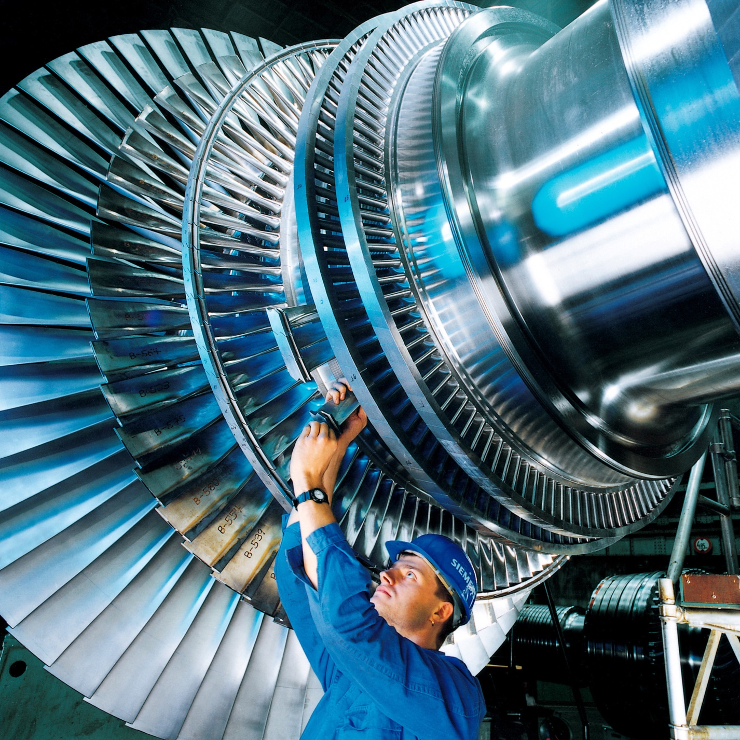

Slide 25
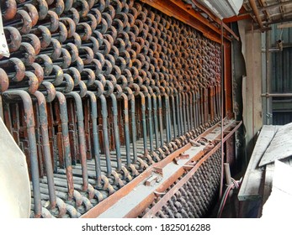
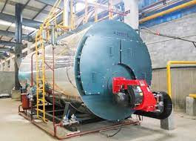
Boiler
Condenser

Slide 26
https://en.wikipedia.org/wiki/List_of_power_stations_in_India

