Slide 1
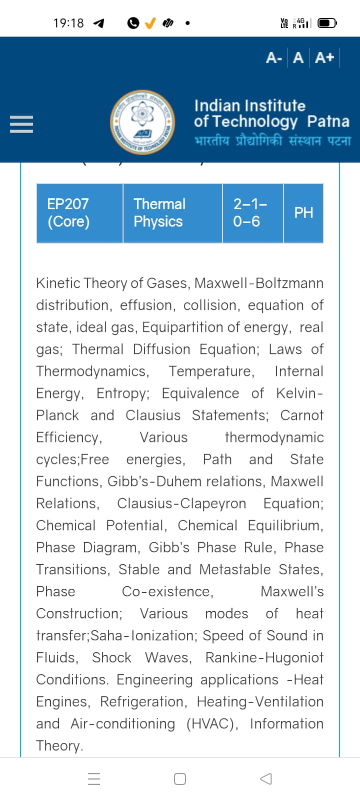
Season 5, Lecture 7 (S5,L7):
EP2104 Thermal physics with engineering applications
3-1-0-4

Slide 2
Time | 11:11:55 | 12-12:55 | 3-3:55 | 4- 4:55 | 02-02:55
Day
Monday |  | R103
Tuesday |  |  | R103
Wednesday |  |  |  | R103
Thursday | R101

Slide 3
 |  | L1 | L2 | L3 | L4 | L5 | L6 | L7
 | "Anirudh Karthikeyan" <anirudh_2501ph19@iitp.ac.in>; | p | p | p | p | p | p | q
2. | "Anshita Meena" <anshita_2501ph08@iitp.ac.in>; | p | p | p | p | p | p | q
3. | "Aritro Ghosh" <aritro_2501ph03@iitp.ac.in>; | p | a | p | p | p | p | a
4. | "Arunya Guha" <arunya_2501ph28@iitp.ac.in>; | p | p | a | p | p | p | a
5. | "Avala Venkata Hemanth" <avala_2501ph37@iitp.ac.in>; | a | a | a | p | p | p | p
6. | "Ayush Kumar" <ayush_2501ph24@iitp.ac.in>; | p | p | a | p | p | p | a
7. | "Badavath Madhulatha" <badavath_2501ph38@iitp.ac.in>; | p | p | a | p | p | p | q
8. | "Banothu Somanna" <banothu_2501ph36@iitp.ac.in>; | p | p | p | p | p | p | a
9. | "Chenche Shankara Suman" <chenche_2501ph07@iitp.ac.in>; | p | p | p | p | p | a | a
10. | "Davala Bhuvana Karthik" <davala_2501ph25@iitp.ac.in>; | p | p | p | p | p | p | a

Slide 4
 |  | L1 | L2 | L3 | L4 | L5 | L6 | L7
11. | "David Pratap Singh" <david_2501ph26@iitp.ac.in>; | p | p | q | p | p | p | p
12. | "Deepak Kumar" <deepak_2503ph03@iitp.ac.in>; | p | p | q | p | p | p | p
13. | "Dekka Nivas" <dekka_2501ph29@iitp.ac.in>; | p | p | q | p | p | p | p
14. | "Gamit Marlon Maheshbhai" <gamit_2501ph21@iitp.ac.in>; | p | p | q | p | p | p | p
15. | "Himesh Katare" <himesh_2501ph33@iitp.ac.in>; | p | p | q | p | p | p | p
16. | "Jadhav Vedant Rajesh" <jadhav_2501ph06@iitp.ac.in>; | p | p | q | p | p | p | p
17. | "Johaan Peter Thekkan" <johaan_2501ph05@iitp.ac.in>; | p | p | q | p | p | p | p
18. | "Karri Akshara" <karri_2501ph13@iitp.ac.in>; | p | p | q | p | p | p | p
19. | "Kashvi Mehta" <kashvi_2501ph32@iitp.ac.in>; | p | p | q | p | p | p | p
20. | "Kirti Chandra" <kirti_2501ph35@iitp.ac.in>; | p | p | q | a | p | p | p

Slide 5
 |  | L1 | L2 | L3 | L4 | L5 | L6 | L7
21 | "Krishna Mule" <krishna_2501ph04@iitp.ac.in>; | p | p | q | p | p | p | p
22. | "Kummetha Sai Darshan Reddy" <kummetha_2501ph17@iitp.ac.in>; | a | a | a | a | a | a | a
23. | "Maddirala Bhanu Kiran" <maddirala_2501ph31@iitp.ac.in>; | p | p | q | a | a | a | p
24. | "Manish" <manish_2501ph22@iitp.ac.in>; | p | p | q | p | p | p | p
25. | "Mohammad Owais Ansari" <mohammad_2501ph18@iitp.ac.in>; | p | p | q | p | p | p | p
26. | "Muhammed Rehaan Sharafudheen" <muhammed_2501ph20@iitp.ac.in>; | p | p | q | p | p | p | p
27. | "Nikhil" <nikhil_2501ph34@iitp.ac.in>; | p | p | q | p | p | p | p
28. | "Poodari Shivani" <poodari_2503ph04@iitp.ac.in>; | p | p | q | p | p | p | p
29. | "Rahul Yadav" <rahul_2501ph23@iitp.ac.in>; | p | p | q | p | p | p | p
30. | "Rohit David Paul" <rohit_2501ph11@iitp.ac.in>; | p | p | a | p | a | a | a

Slide 6
 |  | L1 | L2 | L3 | L4 | L5 | L6 | L7
31 . | "Ronak Jakhar" <ronak_2501ph10@iitp.ac.in>; | p | p | p | p | p | p | P
32. | "Rudraneel Shee" <rudraneel_2501ph15@iitp.ac.in>; | p | p | p | p | p | p | P
33. | "S Ragul Raagav" <s_2503ph02@iitp.ac.in>; | p | p | p | p | p | p | P
34. | "Sara Khan" <sara_2501ph30@iitp.ac.in>; | p | p | p | p | p | p | P
35. | "Shaik Jabeer Sulthan" <shaik_2501ph16@iitp.ac.in>; | p | p | p | p | p | p | a
36. | "Shourya Sharma" <shourya_2503ph01@iitp.ac.in>; | p | p | a | a | p | a | a
37. | "Shreyas Saraswatiprasad Waikar" <shreyas_2501ph02@iitp.ac.in>; | p | p | p | p | p | p | p
38. | "Snehardra Das" <snehardra_2501ph14@iitp.ac.in>; | p | p | p | a | p | p | a
39. | "Tejeswin R" <tejeswin_2501ph09@iitp.ac.in>; | p | p | a | p | p | a | p
40. | "Varkatam Akshaya" <varkatam_2501ph12@iitp.ac.in>; | p | p | p | p | p | p | p

Slide 7
 |  | L1 | L2 | L3 | L4 | L5 | L6 | L7
41. | "Vivanshu Chauhan" <vivanshu_2501ph01@iitp.ac.in>; | p | p | p | p | p | p | a
42. | "Yogesh Kumar" yogesh_2501ph27@iitp.ac.in | p | p | p | p | p | p | a
Attendance: 75% mandatory

Slide 8
Problem 5

Slide 10
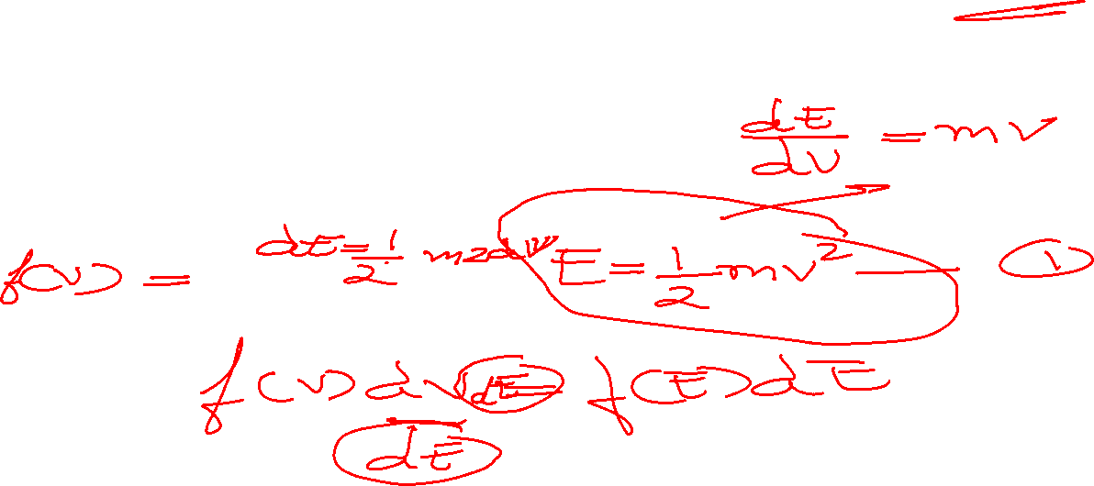
Problem 5

Slide 11
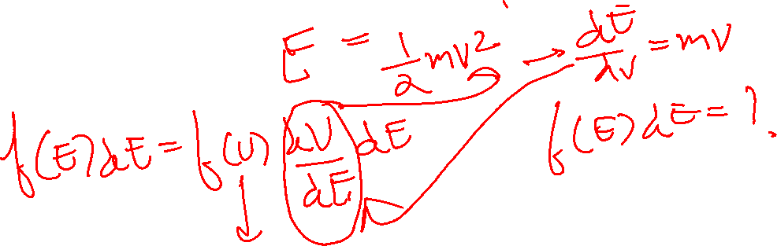
Problem 5

Slide 12
Solution
1

Slide 13
Solution

Slide 14
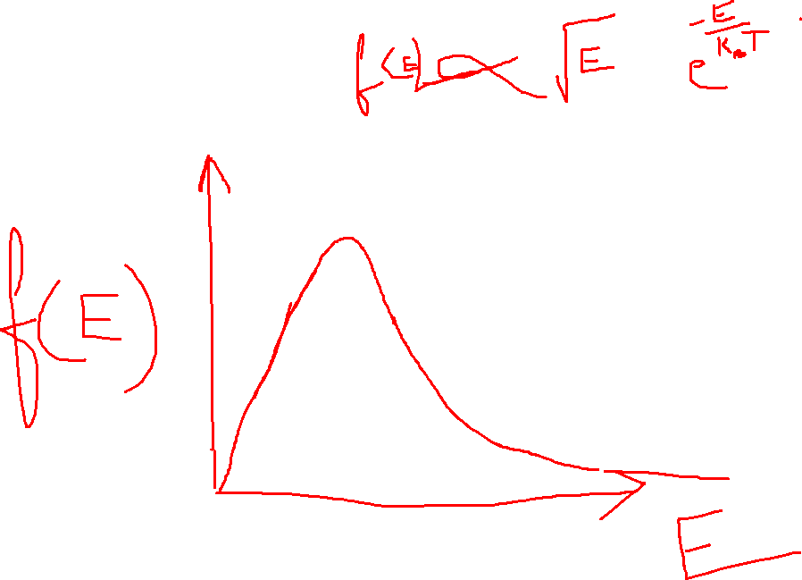

Slide 15
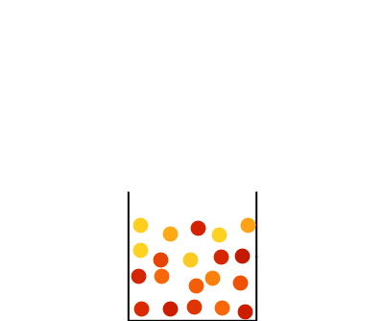

Slide 16
Problem 6

Slide 17
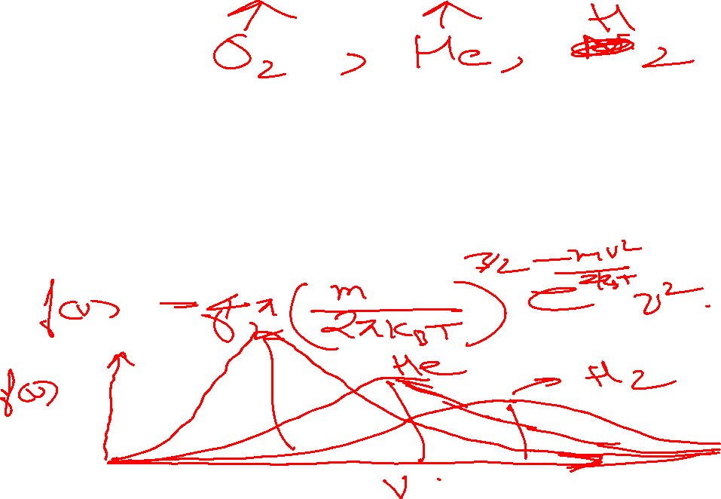
Problem 6

Slide 18
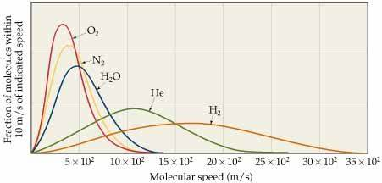
Solution

Slide 19

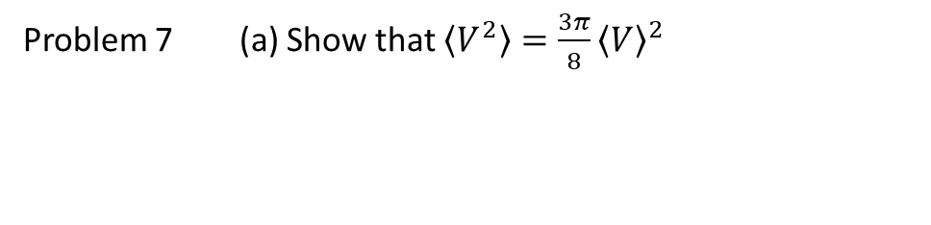
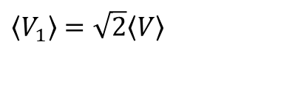
Problem 7 (a) Show that $\left\langle V^{2}\right\rangle =\frac{3π}{8}{\left\langle V\right\rangle }^{2}$
(a) Prove that if
$\left\langle {V_{1}}^{2}\right\rangle =2\left\langle V^{2}\right\rangle$
then
$$\left\langle V_{1}\right\rangle =\sqrt{2}\left\langle V\right\rangle$$

Slide 20
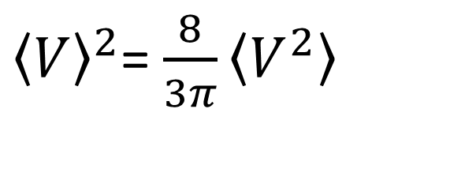
Problem 7 (a) Show that $\left\langle V^{2}\right\rangle =\frac{3π}{8}{\left\langle V\right\rangle }^{2}$
(a) Prove that if
$\left\langle {V_{1}}^{2}\right\rangle =2\left\langle V^{2}\right\rangle$
then
$$\left\langle V_{1}\right\rangle =\sqrt{2}\left\langle V\right\rangle$$
${\left\langle V\right\rangle }^{2}$= $\frac{8}{3π}\left\langle V^{2}\right\rangle$

Slide 21
Concept of Mean free path

Slide 22
Knowledge of mean free path in engineering:
Gas transport:
Determines how gases flow and diffuse, which is crucial in designing piping, ventilation, and combustion systems.
Heat transfer:
Used to calculate the rate of heat transfer between surfaces, impacting heat exchanger and insulation performance.
Thermal conductivity:
Influences the efficiency of conductivity
Vacuum technology and Vacuum design:
Dictates the behavior of gases at low pressures, affecting the operation of pumps and the design of vacuum chambers

Slide 23
Free paths
…………………
Target Molecule
Assumption: All other molecules are static

Slide 24
Mean free path: Definition
“Average distance travelled by a gas molecule between two successive collisions”

