Slide 1
Co-ordinate Systems
Introduction to Vector Operators
Work , Energy and Conservation laws
Rigid body in motion
Oscillations and Waves
Quantum Physics

Slide 2
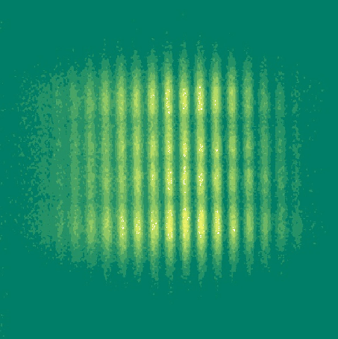
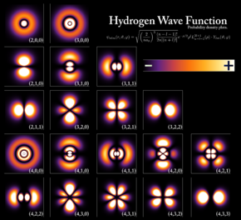
Chapter 6 Quantum Physics

Slide 3
Quantum Physics
Historical Overview:
Particle nature of Light
Wave nature of Particle
De Broglie hypothesis and its experimental proof
Uncertainty principle
Quantum nature of energy in light and matter

Slide 4
Few surprises/Contradictions in the beginning of 19th Century!
Particle nature of light

Slide 5
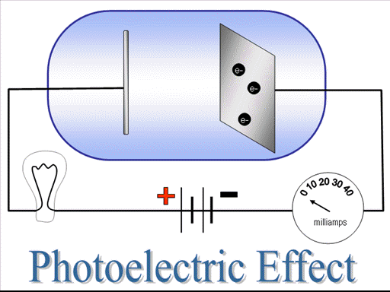
Photoelectric Effect

Slide 6
The Black-Body Radiation
Spectrum of sun
Ultraviolet Catastrophe
Corrected by Planck’s Radiation Formula
Compton Effect

Slide 7
Few surprises/Contradictions in the beginning of 19th Century!
Wave nature of particle

Slide 8
De Broglie hypothesis
Velocity 5m/s
Mass=70 kg
Find the De-broglie wavelength!

Slide 9
De Broglie hypothesis
Velocity 5m/s
Mass=9.1X10⁻³¹ kg
e
Find the De-broglie wavelength!

Slide 10
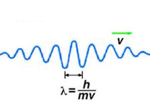
How do we understand the motion?
e

Slide 11
Confirmation of De Broglie hypothesis 1. Electron beam Interference

Slide 12
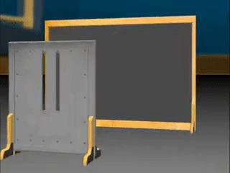
Confirmation of De Broglie hypothesis

Slide 13
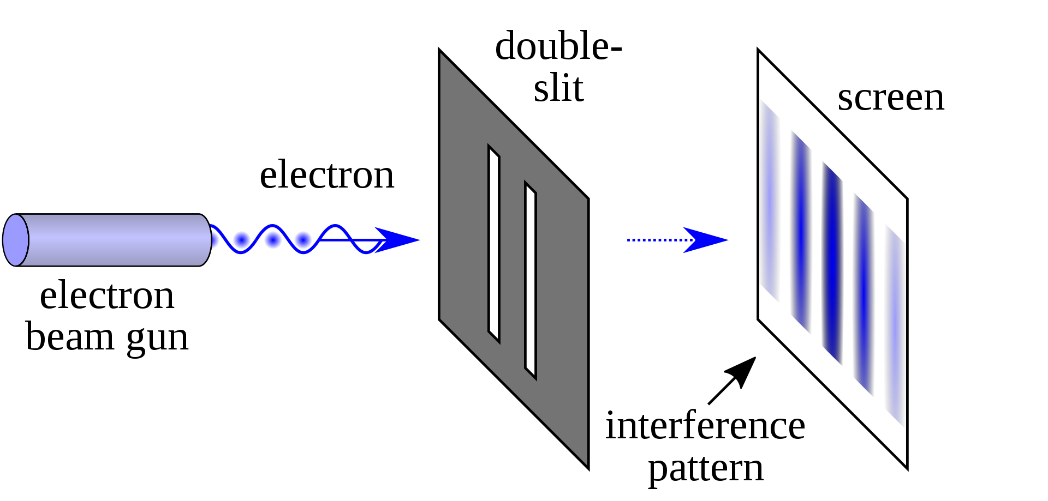
Confirmation of De Broglie hypothesis

Slide 14
Confirmation of De Broglie hypothesis Davisson Germer Experiment

Slide 15
How does this wave nature of particle effect the measurements of position and momentum?
UNCERTAINITY PRINCIPLE

Slide 16
Lets look at moving electron a quantum particle
Δx: large, means measurement of position is not accurate
Measurement of λ will be more precise, which means momentum p would be more accurate

Slide 17
Lets look at a localized electron a quantum particle
Δx: small, means measurement of position is accurate
Position and momentum of a particle can not be determined simultaneously and accurately

Slide 18
All these experiments confirm dual nature of sub atomic particles and light
Light as PHOTON and electron as MATTER WAVES
Classical or Newtonian Mechanics could not explain all these
New field called Quantum Physics emerged
What is “Quantum” here?

Slide 19
Quantum
Discrete entity
Photon picture of light defines energy as
quantized entity: E = hν
Quantum Nature of Light
Some experiments showed energy of matter is also quantized

Slide 20
A thought experiment
Throwing a ball
One can throw ball
to any height
K.E is converted to P.E
Classical Experiment

Slide 21
Quantum nature of energy of matter

Slide 22
Shining light to a matter
LIGHT
SOURCE
Only
Discrete Energies
are absorbed
Something Quantum inside Matter?

Slide 23
What happens Inside?
Matter
is
Quantized
P.E. of atom is increased for a selective frequency by absorption
RECOLLECT HARMONIC OSCILLATOR: RESONANT FREQUENCY

