Slide 1
Season 2, Lecture 17 (S2,L17):
Tutorial 5/Engineering Problems

Slide 2
Tutorial 5 (Continued)

Slide 3
3
3
P₃
P
Adiabatic
P₂
1
2
V₂
V
V₁

Slide 4
1 to 2
2 to 3

Slide 5
3 to 1
Adiabatic
Also

Slide 6
S

Slide 7
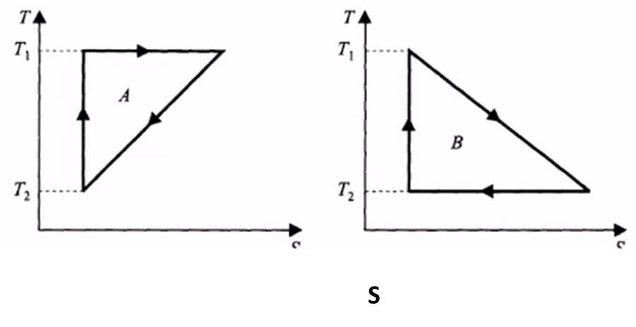
Isothermal expansion
3
2
Adiabatic
1
S1
S2

Slide 8
S1
S2

Slide 9
Entropy change of the System

Slide 13
Engineering Problems

Slide 14
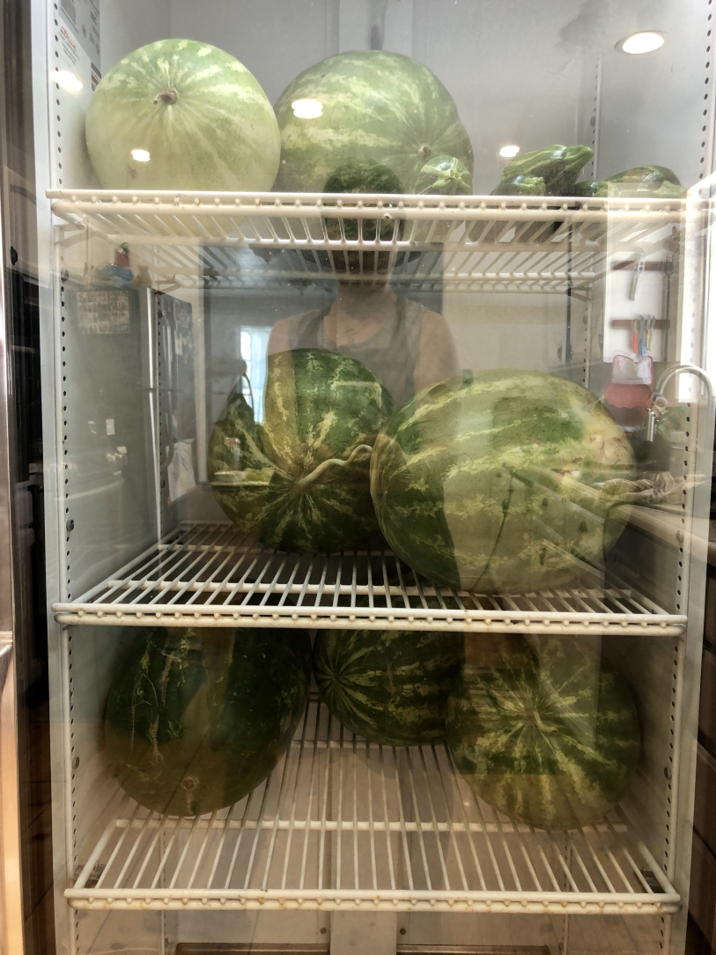
“Cooling Watermelons”

Slide 15
COP=2.5
500 W

Slide 16
COP=2.5
500 W

Slide 17
Name | L9 | L10 | L11 | L12 | L13 | L14 | L15 | L16 | L17
"2201ph34_dolly" <2201ph34_dolly@iitp.ac.in>; | p | P | p | A | p | p | p | P | p
"Adhila Aslam" <2201ph01_adhila@iitp.ac.in>; | p | P | p | p | p | p | p | P | p
"Aditi Baghel" <2201ph31_aditi@iitp.ac.in>; | p | P | p | p | p | p | p | A | p
"Aditya Kumar" <2201ph02_aditya@iitp.ac.in>; | p | A | A | A |  | p | p | P | a
"Aditya Singh" <2201ph03_aditya@iitp.ac.in>; | p | P | p | p | p | p | p | P | a
"Animesh Sharma" <2201ph05_animesh@iitp.ac.in>; | p | P | p | p | P | p | p | P | p
"Arun Mishra" <2201ph06_arun@iitp.ac.in>; | a | P | p | p | P | p | p | A | p
"Aryan Raj" <2201ph32_aryan@iitp.ac.in>; | p | P | p | p | P | p | p | A | a
"Boda Vishnuwardhan" <2201ph08_boda@iitp.ac.in>; | p | A | A | p | P | a | p | P | p
"Chanchal Tolani" <2201ph09_chanchal@iitp.ac.in>; | p | P | p | p | P | p | p | P | a
"Gaurav Verma" <2201ph10_gaurav@iitp.ac.in>; | p | P | p | A | A | a | a | A | a

Slide 18
Name | L9 | L10 | L11 | L12 | L13 | L14 | L15 | L16 | L17
"Gourav Jha" <2201ph11_gourav@iitp.ac.in>; | a | P | p | p | A | a | p | A | p
"Gurinder Dhillon" <2201ph12_gurinder@iitp.ac.in>; | p | P | A | A | A | a | a | P | p
"Harsh Joshi" <2201ph13_harsh@iitp.ac.in>; | p | P | p | p | P | a | p | P | a
"Himanshu Patel" <2201ph35_himanshu@iitp.ac.in>; | p | P | p | A | P | p | p | P | a
"Khushal Yadav" <2201ph14_khushal@iitp.ac.in>; | p | P | p | P | P | p | a | P | p
"Krishnakant Chourey" <2201ph15_krishnakant@iitp.ac.in>; | p | A | A | p | P | p | p | P | a
"Manas Gupta" <2201ph16_manas@iitp.ac.in>; | a | P | p | P | P | p | p | P | a
"Mohit Saini" <2201ph17_mohit@iitp.ac.in>; | a | P | p | p | P | p | p | A | p
"Mude Naik" <2201ph18_mude@iitp.ac.in>; | p | P | p | p | P | p | a | P | p
"Murari Kumar" <2201ph19_murari@iitp.ac.in>; | p | P | A | p | P | a | a | A | p
"Nishant Yadav" <2201ph20_nishant@iitp.ac.in>; | p | P | A | p | P | p | p | P | a
"Pranitha Moluguri" <2201ph21_pranitha@iitp.ac.in>; | p | P | p | p | P | p | p | P | a

Slide 19
Name | L9 | L10 | L11 | L12 | L13 | L14 | L15 | L16 | L17
"Premanandh Sigamala" <2201ph22_premanandh@iitp.ac.in>; | p | P | A | p | A | a | a | P | a
"Ruchi Thakur" <2201ph23_ruchi@iitp.ac.in>; | p | P | p | p | P | p | p | P | p
"Satyam Sahoo" <2201ph25_satyam@iitp.ac.in>; | p | P | p | p | P | p | a | P | p
"Satyam Shandilya" <2201ph24_satyam@iitp.ac.in>; | p | P | A | p | P | p | p | P | p
"Shyam Hembram" <2201ph26_shyam@iitp.ac.in>; “ | p | P | p | p | P | a | a | P | p
Sougata Saha" <2201ph27_sougata@iitp.ac.in>; | a | p | p | p | P | p | p | A | a
"Sumit Rajpoot" <2201ph28_sumit@iitp.ac.in>; | p | P | p | p | P | p | a | P | p
"Suprajit Dewanji" <2201ph29_suprajit@iitp.ac.in>; | a | P | p | p | A | p | p | P | p
Attendance: 75% mandatory

