Slide 1
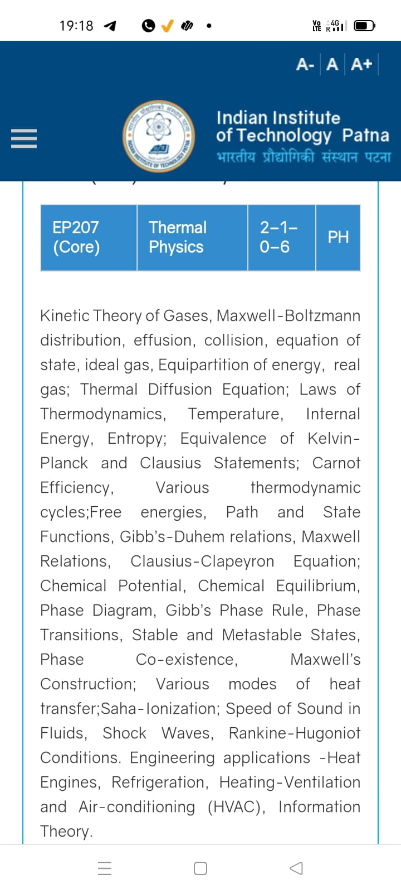
Season 5, Lecture 1 (S5,L1): Orientation
and
Introduction
EP2104 Thermal physics with engineering applications
3-1-0-4

Slide 2
Course Instructor for Thermal Physics
Dr. Raghavan K Easwaran
PhD (France, Paris) PDF(Nottingham, UK), UG (IIT Madras)
Marie Curie Fellow (PhD) European Union (EU), IFRAF, Paris
Associate Professor and Former Head of the department
Department of Physics
MPI, National Quantum Mission
Quantum Communication HUB,
Indian Institute of Technology Madras
Indian Institute of Technology Patna
www.raghavanke.com

Slide 3
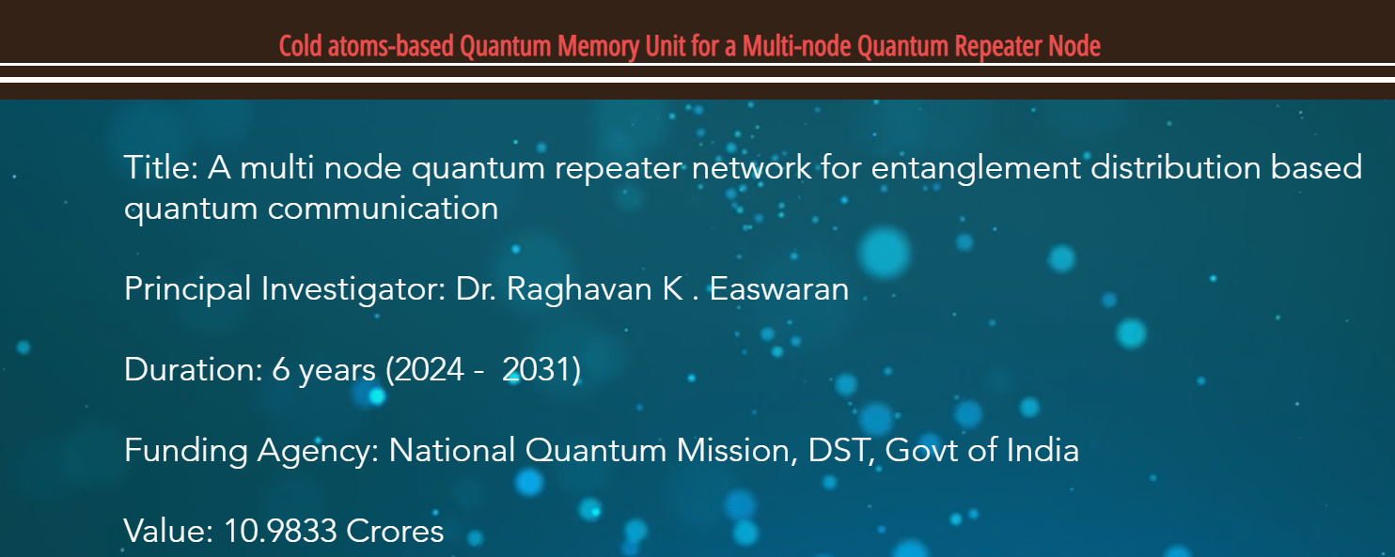
MPI, National Quantum Mission
Quantum Communication HUB,
Indian Institute of Technology Madras

Slide 4
EP2104 Thermal physics with engineering applications
3-1-0-4
Syllabus
Course Outline Kinetic Theory of Gases, Maxwell-Boltzmann distribution, effusion, collision, equation of state, ideal gas, Equipartition of energy, real gas; Thermal Diffusion Equation; Laws of Thermodynamics, Temperature, Internal Energy, specific heat, Entropy;
Carnot engine, Various thermodynamic cycles; Thermodynamic potentials, Path and State Functions, Gibb’s-Duhem relations, Maxwell Relations; Clausius-Clapeyron Equation; Chemical Potential, Chemical Equilibrium, Phase Diagram, Gibb’s Phase Rule, Phase Transitions, Stable and Metastable States, Phase Co-existence, Maxwell’s Construction; Various modes of heat transfer; Saha-Ionization; Speed of Sound in Fluids, Shock Waves, Rankine-Hugoniot Conditions. Engineering applications -Heat Engines, Joule-Thompson effect and applications to cryogenics, Refrigerators, Heating-Ventilation and Air-conditioning (HVAC), Exergy analysis of engineering systems, Information Theory.
Additional Topics: Thermal Physics and Quantum Memory for Quantum Communication.
Suggested Readings: Textbooks:
1. Stephen J. Blundell and Katherine M. Blundell, Concepts in Thermal Physics, 3rd Ed, Oxford University Press, 2014.
2. R. H. Dittman and M. W. Zemansky, Heat and Thermodynamics, McGraw-Hill College; Subsequent Ed, 1996.
3. M. A. Boles, Y. A. Cengel, M. Kanoglu, Thermodynamics: An Engineering Approach
4. Finn’s Thermal Physics, Andrew Rex
5. Thermal Physics, C. Kittel, H. Kroemer, W. H. Freeman, 2nd ed., 2012
References:
1. M. N. Saha and B. N. Srivastava, Treatise on Heat, 3rd Edition, The Indian Press, Allahabad, 1950.
2. R.Baierlein, Thermal Physics, Cambridge University Press, 2005.

Slide 5
Time | 11:11:55 | 12-12:55 | 3-3:55 | 4- 4:55 | 02-02:55
Day
Monday |  | R103
Tuesday |  |  | R103
Wednesday |  |  |  | R103
Thursday | R103

Slide 6
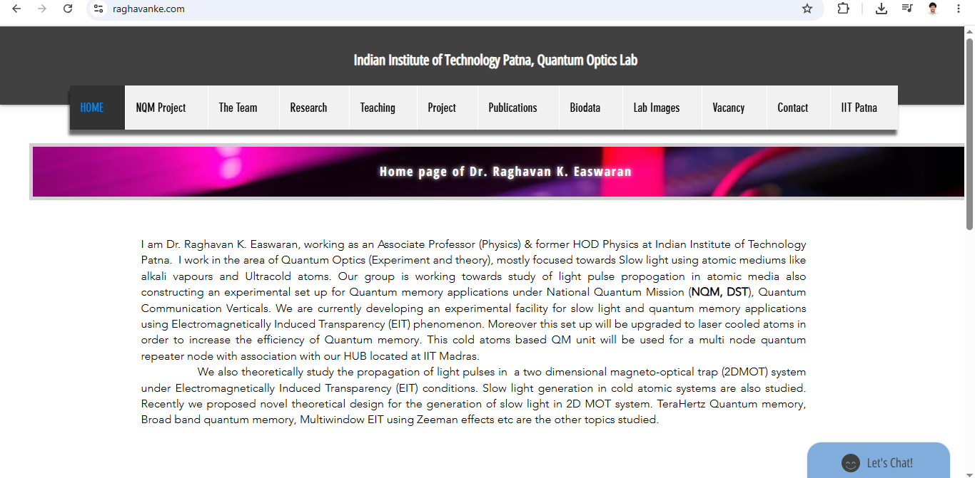

Slide 7
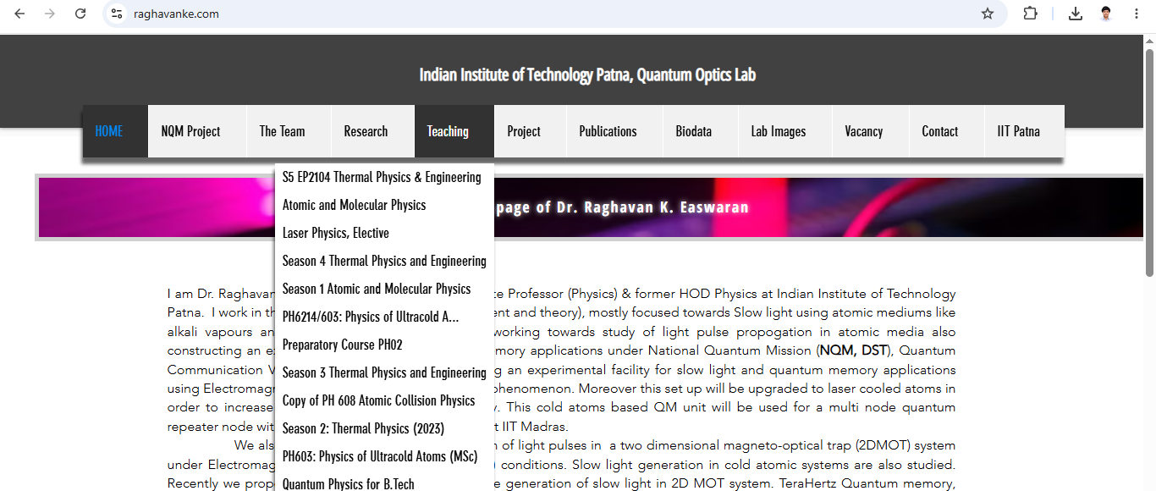

Slide 8
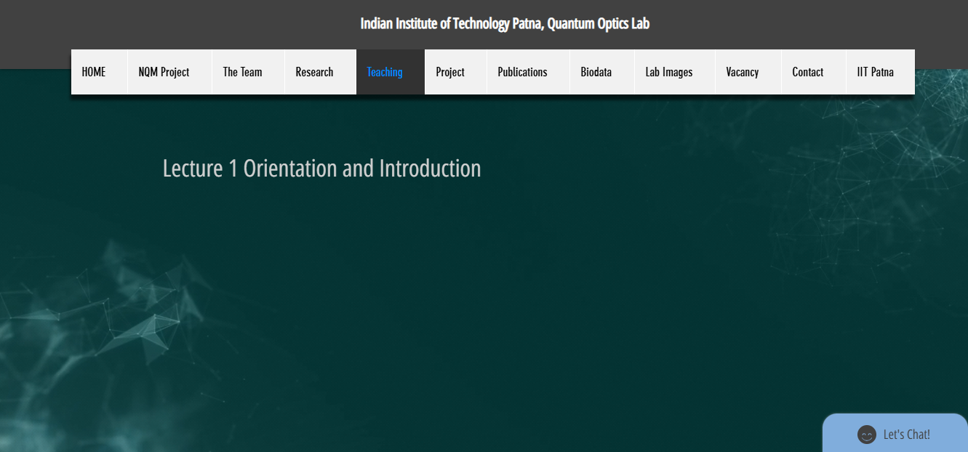

Slide 9
 |  | L1 | L2 | L3
 | "Anirudh Karthikeyan" <anirudh_2501ph19@iitp.ac.in>; | p
2. | "Anshita Meena" <anshita_2501ph08@iitp.ac.in>; | p
3. | "Aritro Ghosh" <aritro_2501ph03@iitp.ac.in>; | p
4. | "Arunya Guha" <arunya_2501ph28@iitp.ac.in>; | p
5. | "Avala Venkata Hemanth" <avala_2501ph37@iitp.ac.in>; | a
6. | "Ayush Kumar" <ayush_2501ph24@iitp.ac.in>; | p
7. | "Badavath Madhulatha" <badavath_2501ph38@iitp.ac.in>; | p
8. | "Banothu Somanna" <banothu_2501ph36@iitp.ac.in>; | p
9. | "Chenche Shankara Suman" <chenche_2501ph07@iitp.ac.in>; | p
10. | "Davala Bhuvana Karthik" <davala_2501ph25@iitp.ac.in>; | p

Slide 10
 |  | L1 | L2 | L3
11. | "David Pratap Singh" <david_2501ph26@iitp.ac.in>; | p
12. | "Deepak Kumar" <deepak_2503ph03@iitp.ac.in>; | p
13. | "Dekka Nivas" <dekka_2501ph29@iitp.ac.in>; | p
14. | "Gamit Marlon Maheshbhai" <gamit_2501ph21@iitp.ac.in>; | p
15. | "Himesh Katare" <himesh_2501ph33@iitp.ac.in>; | p
16. | "Jadhav Vedant Rajesh" <jadhav_2501ph06@iitp.ac.in>; | p
17. | "Johaan Peter Thekkan" <johaan_2501ph05@iitp.ac.in>; | p
18. | "Karri Akshara" <karri_2501ph13@iitp.ac.in>; | p
19. | "Kashvi Mehta" <kashvi_2501ph32@iitp.ac.in>; | p
20. | "Kirti Chandra" <kirti_2501ph35@iitp.ac.in>; | p

Slide 11
 |  | L1 | L2 | L3
21 | "Krishna Mule" <krishna_2501ph04@iitp.ac.in>; | p
22. | "Kummetha Sai Darshan Reddy" <kummetha_2501ph17@iitp.ac.in>; | a
23. | "Maddirala Bhanu Kiran" <maddirala_2501ph31@iitp.ac.in>; | p
24. | "Manish" <manish_2501ph22@iitp.ac.in>; | p
25. | "Mohammad Owais Ansari" <mohammad_2501ph18@iitp.ac.in>; | p
26. | "Muhammed Rehaan Sharafudheen" <muhammed_2501ph20@iitp.ac.in>; | p
27. | "Nikhil" <nikhil_2501ph34@iitp.ac.in>; | p
28. | "Poodari Shivani" <poodari_2503ph04@iitp.ac.in>; | p
29. | "Rahul Yadav" <rahul_2501ph23@iitp.ac.in>; | p
30. | "Rohit David Paul" <rohit_2501ph11@iitp.ac.in>; | p

Slide 12
 |  | L1 | L2 | L3
31 . | "Ronak Jakhar" <ronak_2501ph10@iitp.ac.in>; | p
32. | "Rudraneel Shee" <rudraneel_2501ph15@iitp.ac.in>; | p
33. | "S Ragul Raagav" <s_2503ph02@iitp.ac.in>; | p
34. | "Sara Khan" <sara_2501ph30@iitp.ac.in>; | p
35. | "Shaik Jabeer Sulthan" <shaik_2501ph16@iitp.ac.in>; | p
36. | "Shourya Sharma" <shourya_2503ph01@iitp.ac.in>; | p
37. | "Shreyas Saraswatiprasad Waikar" <shreyas_2501ph02@iitp.ac.in>; | p
38. | "Snehardra Das" <snehardra_2501ph14@iitp.ac.in>; | p
39. | "Tejeswin R" <tejeswin_2501ph09@iitp.ac.in>; | p
40. | "Varkatam Akshaya" <varkatam_2501ph12@iitp.ac.in>; | p

Slide 13
 |  | L1 | L2 | L3
41. | "Vivanshu Chauhan" <vivanshu_2501ph01@iitp.ac.in>; | p
42. | "Yogesh Kumar" yogesh_2501ph27@iitp.ac.in | p
Attendance: 75% mandatory

Slide 14
Evaluation Scheme
Exam | Marks (100)
Quiz 1 | 10
Mid semester | 30
Quiz 2 | 10
End Semester | 50

Slide 15
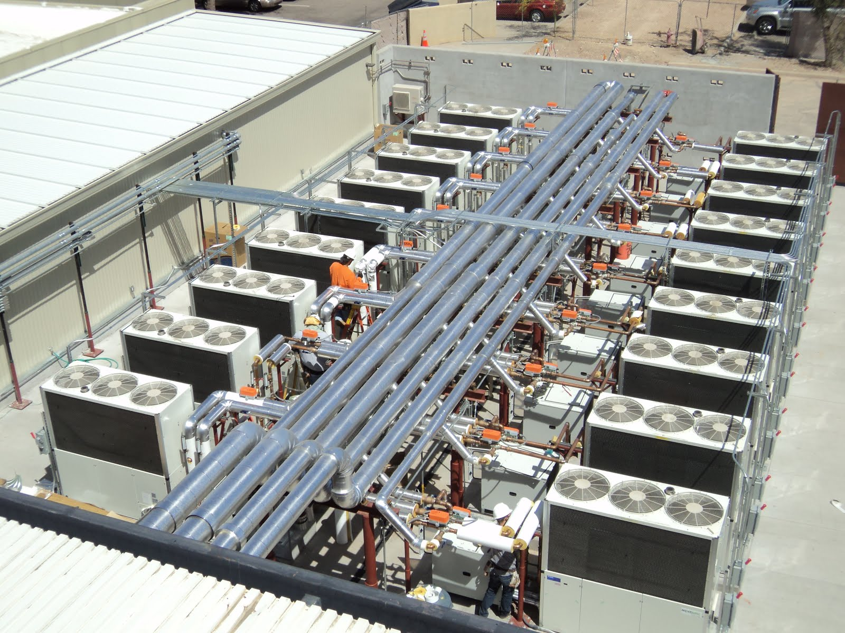
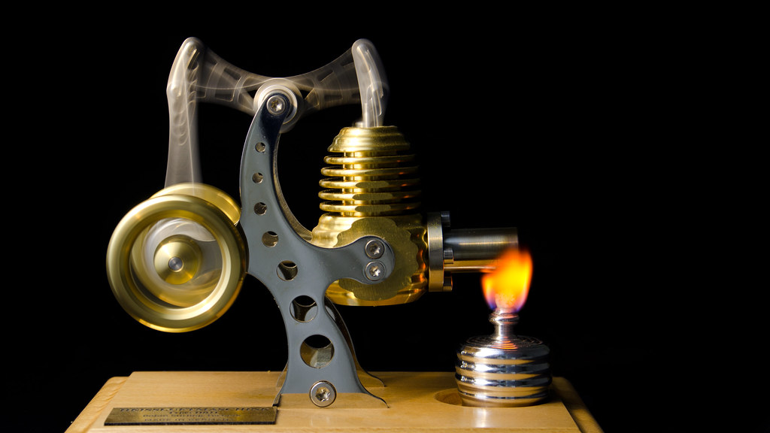

Focus on concepts and Cutting edge engineering Applications

Slide 16
Plan
Kinetic Theory of gases
Thermodynamics
Engineering applications

Slide 17
What is heat?
What is Temperature?

Slide 18
What is heat?
Mechanical energy converted

Slide 19
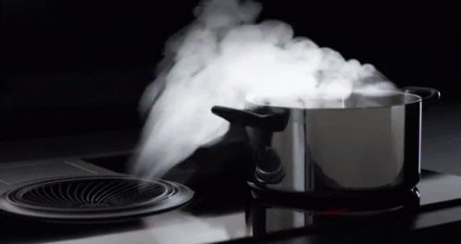

Slide 20
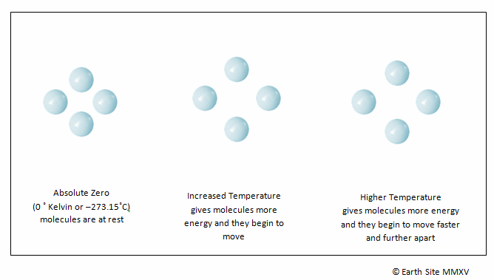

Slide 21
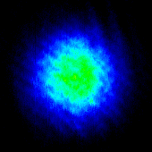
Hotter to colder
Imaging
Of
Atomic gas
Temperature of atomic gas is reduced as a function of time

Slide 22
Will deal with only gases now
What is Temperature?
From Kinetic Theory of gases

Slide 23
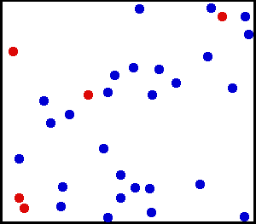
Huge number of particles

Slide 24
Necessity of Kinetic Theory and Thermodynamics
What is “Kinetic Theory”?
What is “Thermodynamics”?

Slide 25
Approach of “Kinetic Theory”
Distribution
Gas molecules
Classical Microscopic Theory

Slide 26
Approach of “Thermodynamics”
Macroscopic level
Measurable quantities
Extensive and Intensive variables

Slide 27
What is an “Ideal Gas”?
Point particles
Non-interaction
Only Kinetic energy
Only Elastic collisions
Is there an ideal gas in practice?

Slide 28
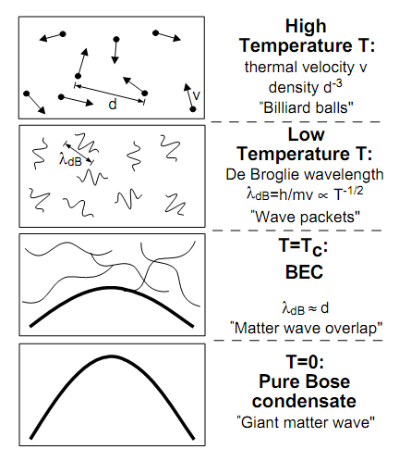
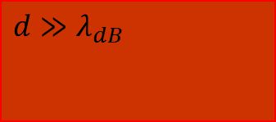
Ideal gas and Real gas
Classical gas
The Approximation
Quantum gas
Larger T
$$d≫λ_{dB}$$
Lower density

