Slide 1
Quiz 1
Solutions

Slide 2
Q1. Find the flux of a vector field given by coming out through the total surface as shown in the figure below. Top surface is spherical, with radius R centred at the origin. The cone makes an angle 30º with z axis.
Flux of the vector field E coming out through the region is
Limits of the integration are
R: 0 to R
: 0 to
: 0 to

Slide 5
B

Slide 6
Alternative Method
S₁
S₂

Slide 7
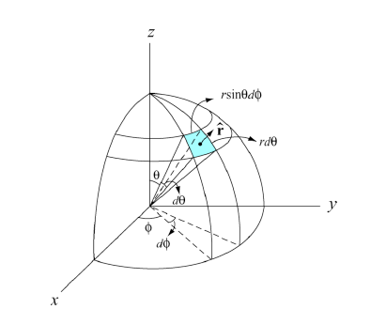
Integration through S₁
Limits of the integration are
: 0 to
: 0 to

Slide 8
Integration through S₂
Limits of the integration are
: 0 to
: 0 to

Slide 9
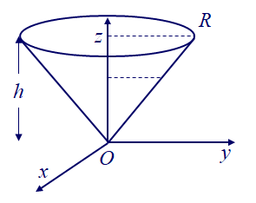
Q2. What is the component of the moment of inertia tensor I_{zz} for a top that is a uniform solid cone (mass M, density ρ, height h, and base radius R)? Choose the z axis along the axis of symmetry of the cone, as shown in the figure.

Slide 10
Limits of the integration:

Slide 11
Volume of Cone

Slide 12
D

Slide 13
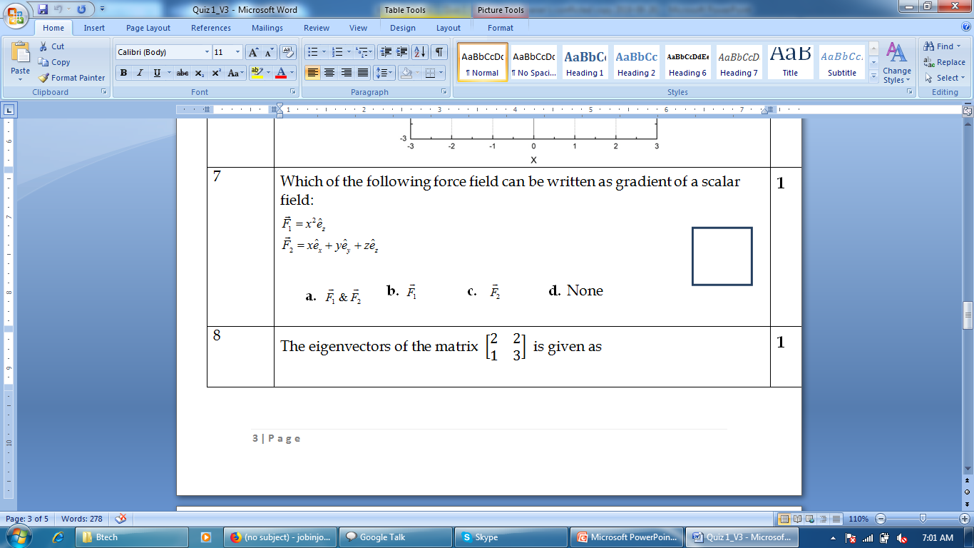
Q3
C
If
Then force field is conservative

Slide 14

Q4
Step1: Eigenvalues λ
$\left|\begin{matrix}2−λ & 2 \\ 1 & 3−λ\end{matrix}\right|$ = 0
λ=1,4

Slide 15


Finding eigen vectors
Eigen vectors are found as follows for each values of λ
For λ = 1
$\left[\begin{matrix}2−1 & 2 \\ 1 & 3−1\end{matrix}\right]\left[\begin{aligned}x \\ y\end{aligned}\right]$ = 0
x= -2y
Eigen vector is $\left[\begin{aligned}1 \\ −1/2\end{aligned}\right]$

Slide 16


Finding eigenvectors
For λ = 4
$\left[\begin{matrix}2−4 & 2 \\ 1 & 3−4\end{matrix}\right]\left[\begin{aligned}x \\ y\end{aligned}\right]$ = 0
x= y
C
Eigen vector is $\left[\begin{aligned}1 \\ 1\end{aligned}\right]$

Slide 17
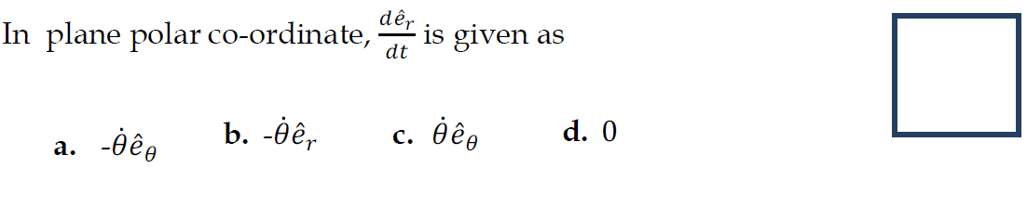
C

Slide 18
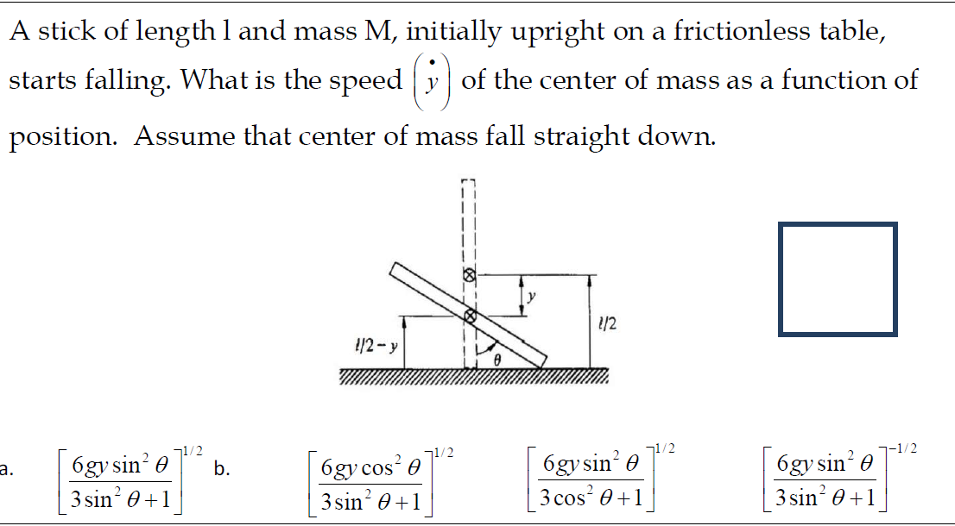

Slide 19
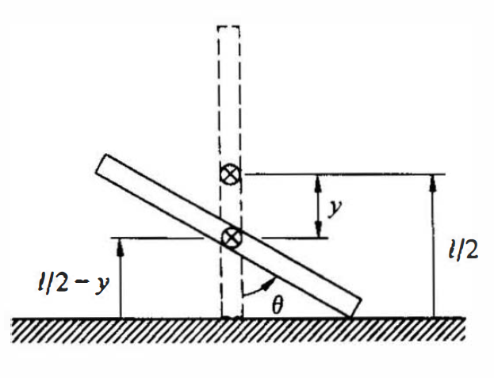
The falling stick (Rotation and translation)
A stick of length l and mass M, initially upright on a frictionless table, starts falling. The problem is to find the speed of the center of mass as a function of position. Assume that center of mass fall straight down.

Slide 20
a

Slide 21
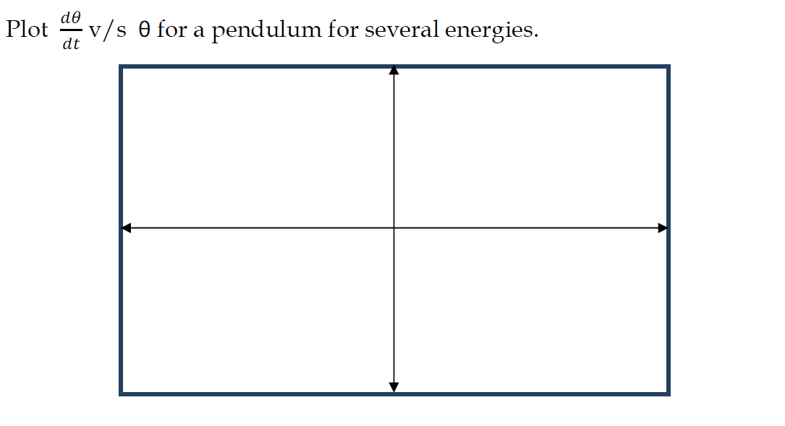
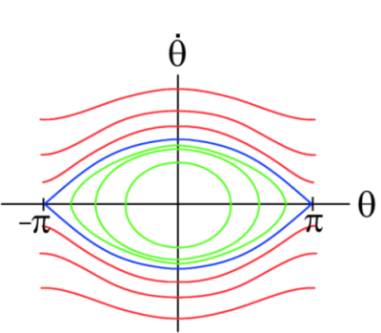

Slide 22
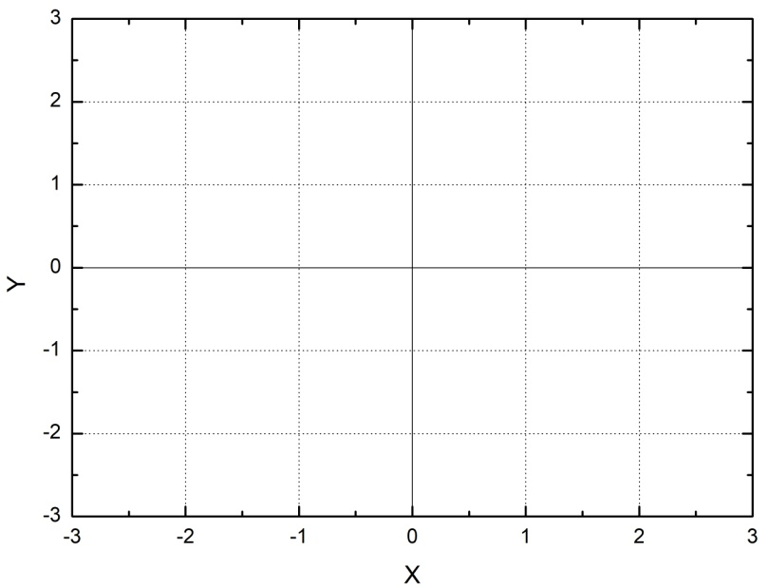
Quiz Q6
Plot the vector field for

Slide 23
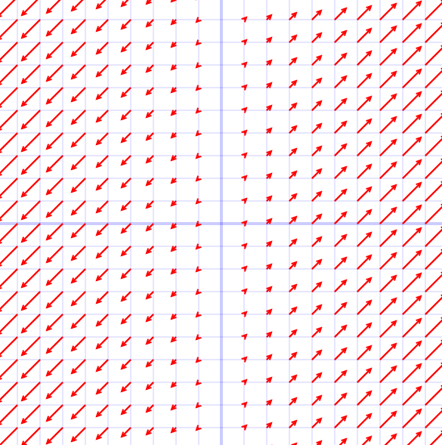
Plot the vector field for
Y
Correct
X

Slide 24
Plot the vector field for
Correct
X
Y

Slide 25
MID SEM EXAM

Slide 26
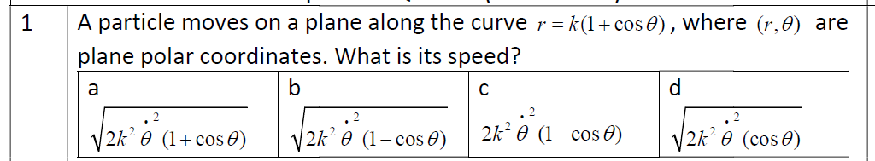

Slide 27



Speed
V = $\sqrt{V.V}$
We know
A
Speed =

Slide 28
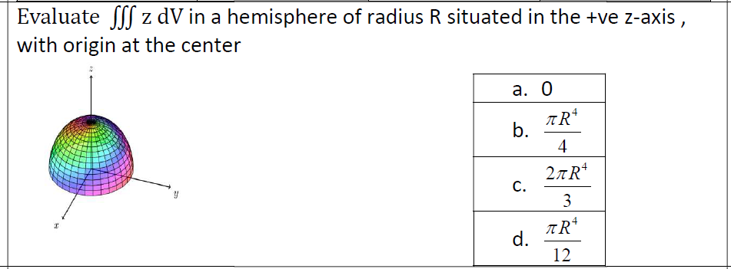

Slide 29

$$\iiint{zdV}$$
For hemisphere limits of Integration are:
R: 0 to R
θ: 0 to π/2
φ: 0 to 2π
Also, we know
z = rcosθ, dV=r²drsinθdθdφ

Slide 30
$$\iiint{zdV}$$
B

Slide 31
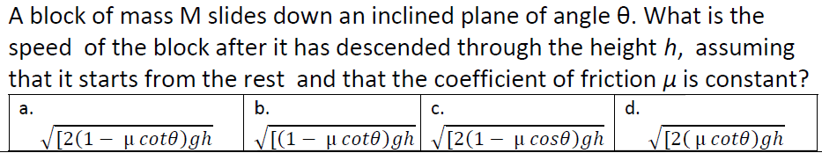
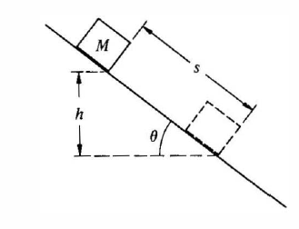

Slide 32
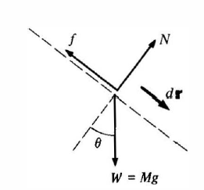
Initially the block is at rest at height h, finally
the block is moving with speed v at height 0
Final energy – Initial Energy = Work done due to friction
From diagram
Initial Energy E_{i} = Mgh
Final Energy E_{f} = ½ Mv²
s = h/sinθ
Work done due to friction after it moved a distance s = -fs
=-µNs
=-µMgcosθs
Work done due to friction = - µMghcotθ

Slide 33

Final energy – Initial Energy = Work done due to friction
Speed =
A

Slide 34
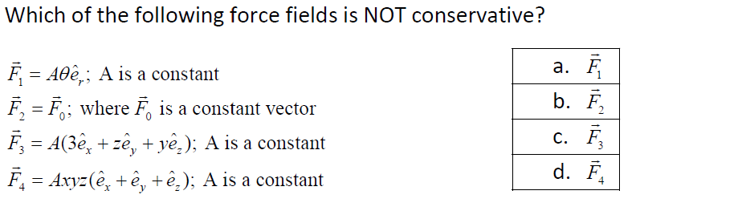
If the force field is conservative
A and D

Slide 35
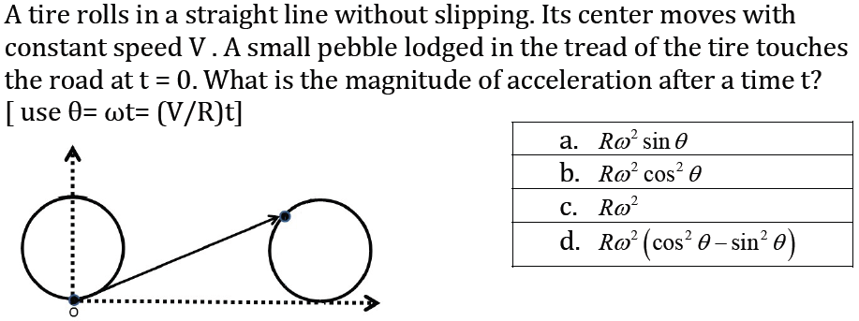

Slide 36
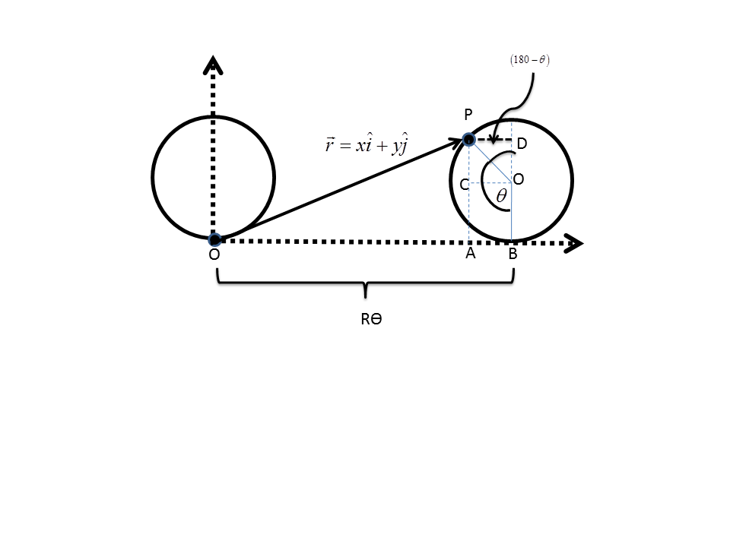

Slide 37
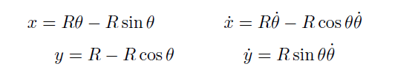
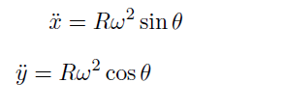
C

Slide 38
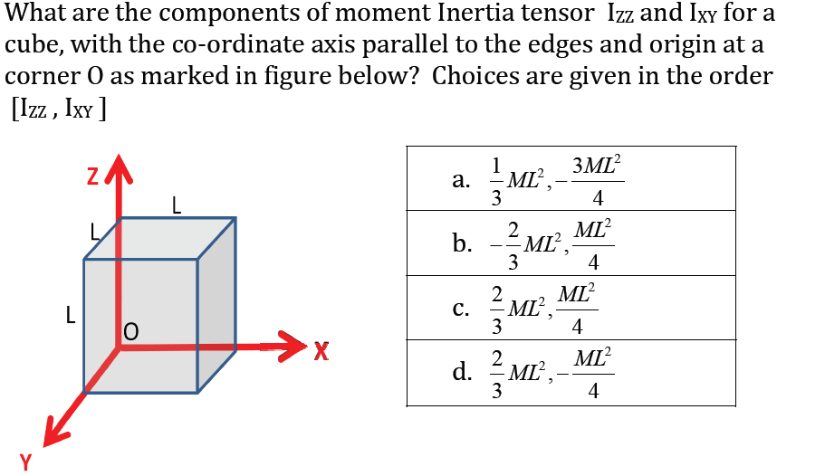

Slide 39
Moment of Inertia Tensor
Z
L
L
L
X
Y

Slide 40
Moment of Inertia Tensor
D

Slide 41
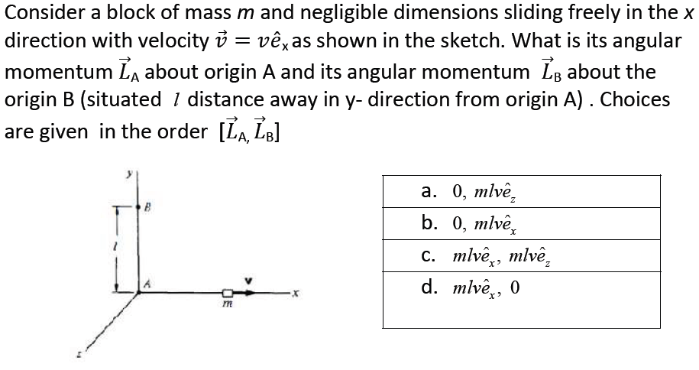

Slide 42
A

Slide 43
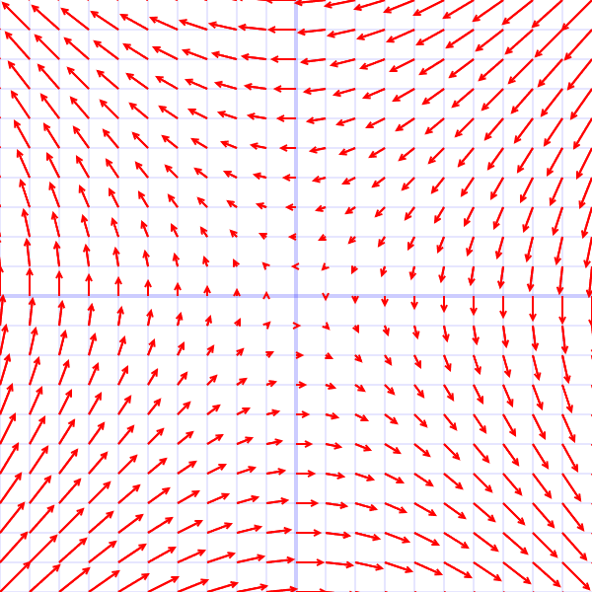
Y
X

Slide 44
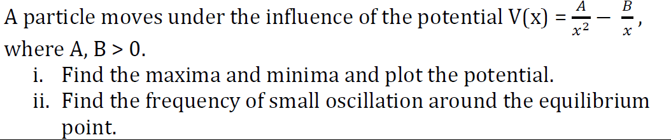
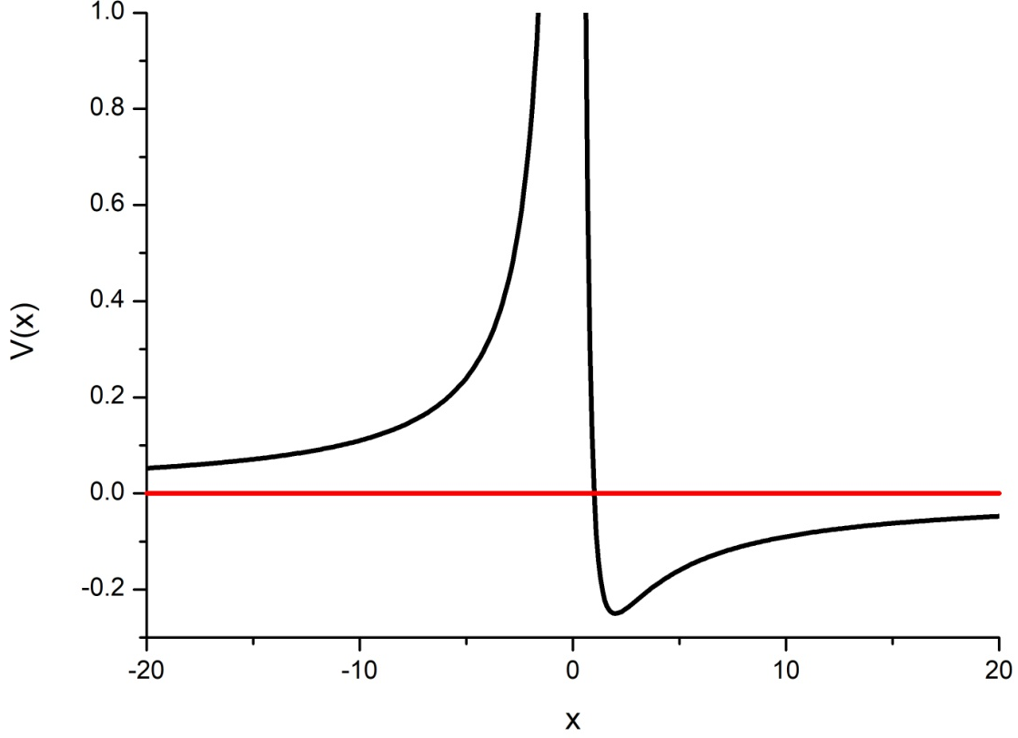

Slide 46
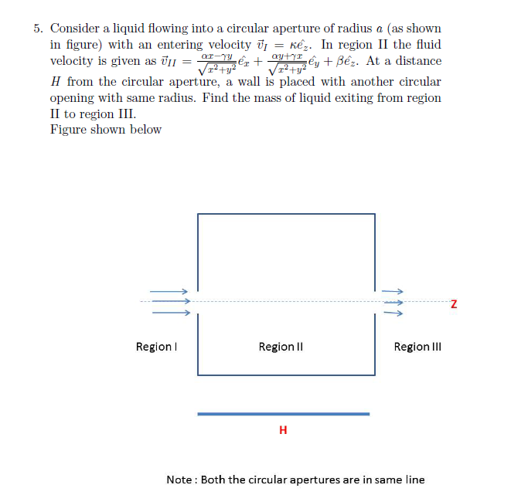

Slide 47
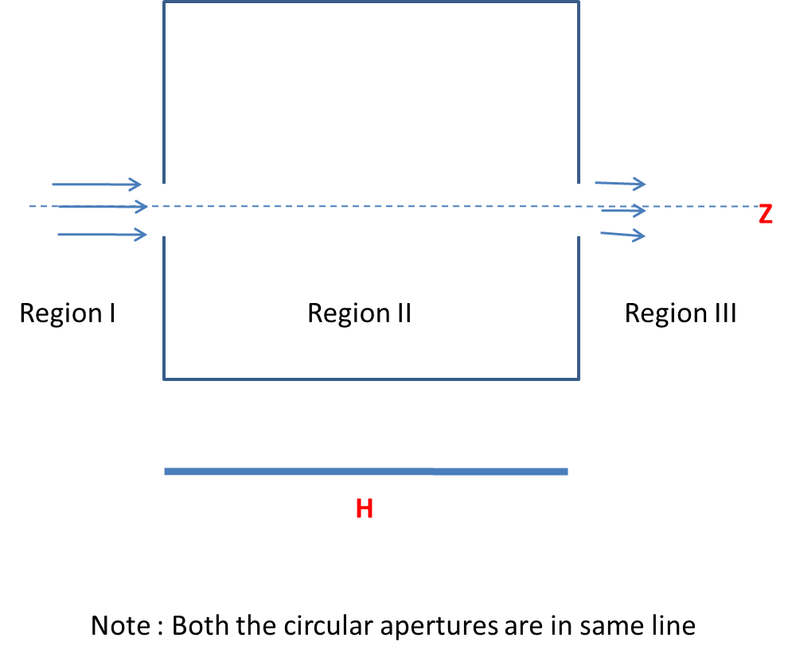
MASS OF LIQUID EXITING FROM REGION II TO REGION III =
MASS OF LIQUID ENTERING FROM THE REGION I –
MASS OF FLUID FROM THE SURFACE OF AN IMAGINARY CYLINDER OF RADIUS a AND LENGTH H

Slide 48



MASS OF LIQUID ENTERING FROM THE REGION I
Mass of liquid entering per elemental area da per unit time =
σv.da
$$dρ$$
$$ρdφ$$
I
II
III
z

Slide 49
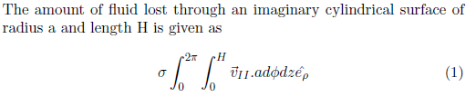


MASS OF FLUID LOST
FROM THE SURFACE OF AN IMAGINARY CYLINDER OF RADIUS a AND LENGTH H
$$dz$$
a$dφ$
I
II
III
z

Slide 50

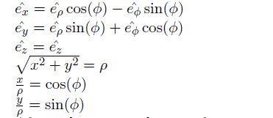
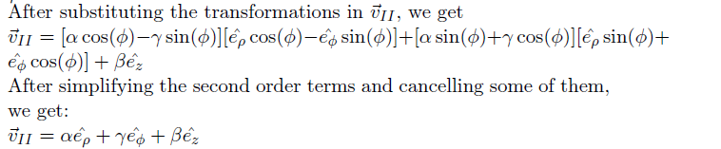

Slide 51


Slide 52

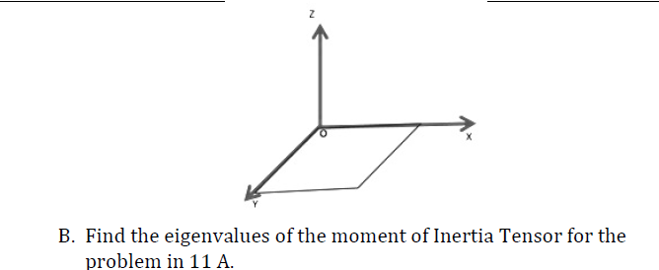

Slide 53
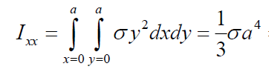
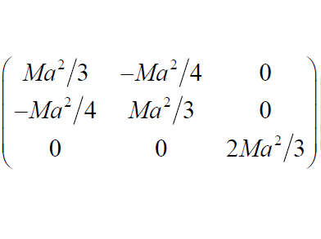
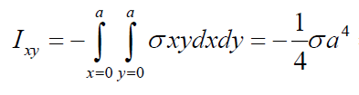


Rotation of a square plate
What is the Moment of Inertia Tensor?

Slide 54
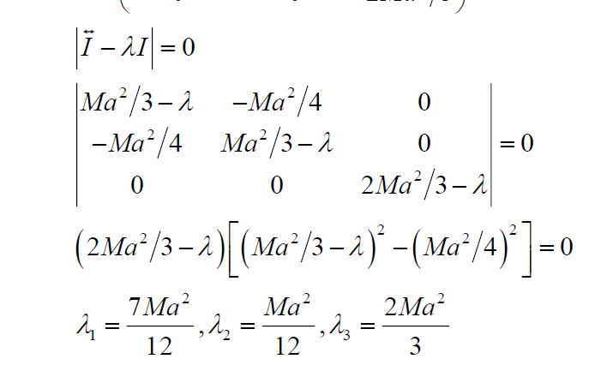
(b) What are the Eigenvalues?

