Slide 1
Concept of Doppler Cooling of Atoms

Slide 2
 |  |  | Lec5 | Lec 6
1 | 1921PH19 | SAUMYASHREE BARAL | p | p
2 | 2321PH02 | ARYA KUMAR SIDDHARTH | p | p
3 | 2321PH07 | NAINCY SHRIVASTAVA | p | p
4 | 2321PH09 | PRITAM SAMANTA | p | p
5 | 2321PH10 | REETU SAINI | p | p
6 | 2321PH13 | SOUBHIK MUKHERJEE | p | p
7 | 2321PH14 | NEHA CHOUDHARY | p | p
8 | 2321PH15 | RABI DAS | p | p
9 | 2321PH19 | SHRUTI SARSWAT | p | p
10 | 2212PH02 | AMAN KUMAR | p | p
11 | 2212PH10 | BINAYAK ROUT | p | p
12 | 2212PH11 | DARPAN SARKAR | p | p
13 | 2212PH13 | GAURAV JAISWAL | p | a
14 | 2212PH17 | KAUSHIP SAHA | p | a
15 | 2212PH20 | NEELLOHIT KARMAKAR | p | a
16 | 2212PH23 | RITIK PAL | p | p
17 | 2212PH26 | SOUMIK KARMAKAR | p | p
18 | 2212PH32 | KAUSTAB BHARASA | a | p

Slide 8
PH 603 Physics of ultracold atoms
Force experienced by atoms

Slide 11
Model: Force on a Hypothetical two level atom under motion interacting with
two lights (Co-prop and Counter Prop) simultaneously in 1-D

Slide 13
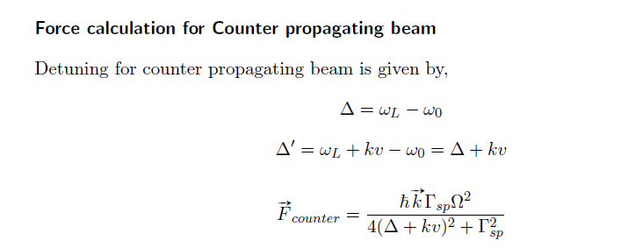

Slide 14
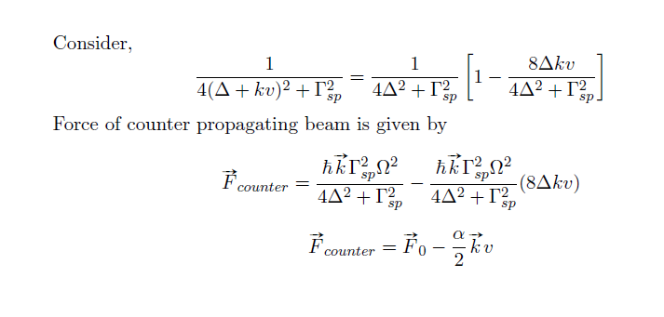

Slide 15
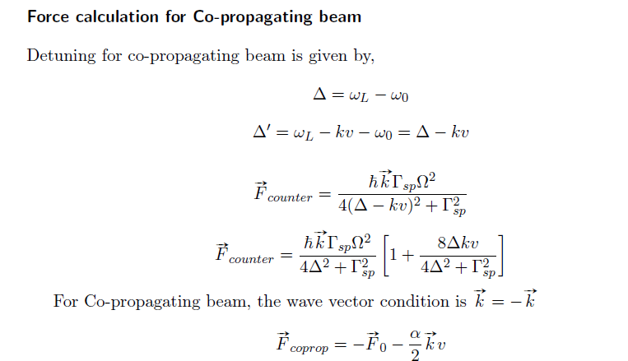

Slide 18
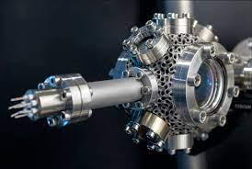
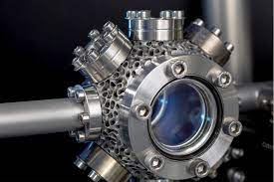
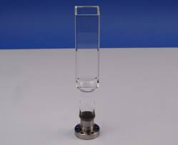

Slide 20
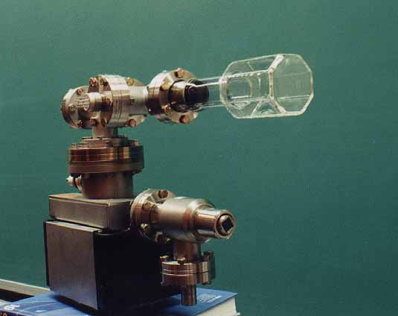

Slide 24
Laser cooling in 3-D

Slide 26
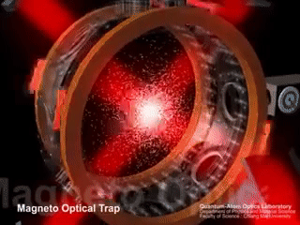

Slide 27
Some real experiments….

Slide 28
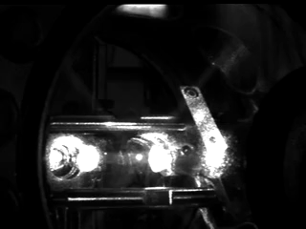

Slide 29
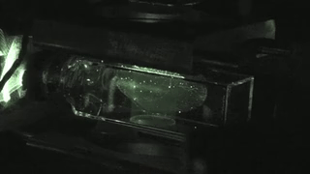

Slide 30
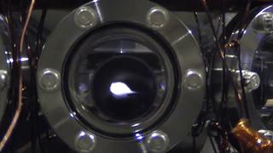

Slide 31
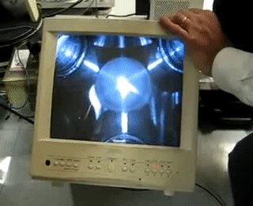

Slide 32
Some Limitations of Doppler Cooling
Minimum Temperature attained in range of fraction of milli Kelvin ONLY…..
For seeing Quantum Behavior of atoms need to reach order of Nano Kelvin
Doppler Cooling has no position dependent force, atoms in periphery leave the cooling region. Force F take a form of F = -αV
Laser Light has some heating effect also for some frequencies for certain velocity class of atoms: Not all the atoms experience the right frequency for cooling effect some atoms gets heating effects from co-propagating light as well………
A competition between heating and cooling arise which leads to an equilibrium temperature.

Slide 35
Experimental sequence of laser cooling

Slide 38
Some Limitations of Doppler Cooling
Minimum Temperature attained in range of fraction of milli Kelvin ONLY…..
For seeing Quantum Behavior of atoms need to reach order of Nano Kelvin
Doppler Cooling has no position dependent force, atoms in periphery leave the cooling region. Force F take a form of F = -αV
Laser Light has some heating effect also for some frequencies for certain velocity class of atoms: Not all the atoms experience the right frequency for cooling effect some atoms gets heating effects from co-propagating light as well………
A competition between heating and cooling arise which leads to an equilibrium temperature.

Slide 39
Some tricks to improve Doppler Cooling Using Magnetic field on Atoms
Magneto Optical Trap (MOT)

