Slide 1
Practice Problems

Slide 2
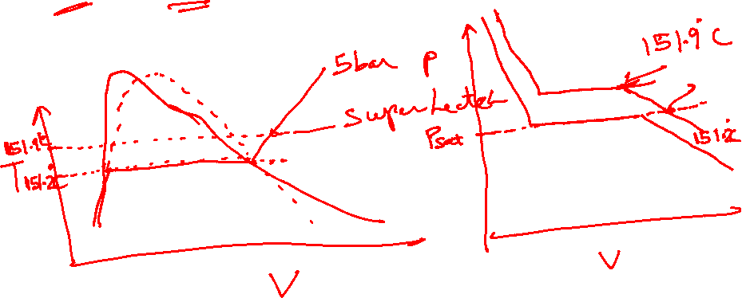

Slide 3
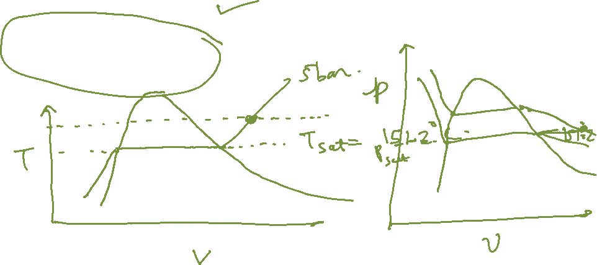
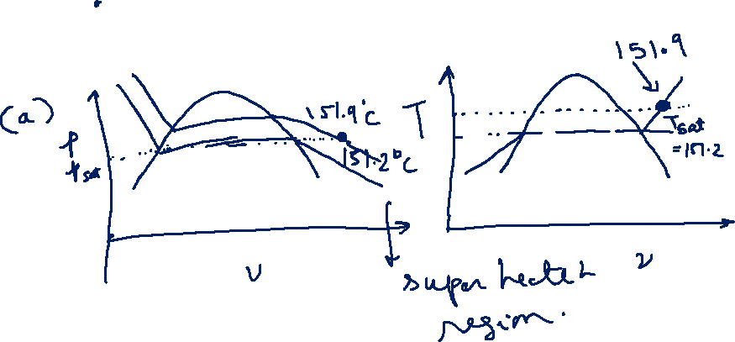

Slide 6
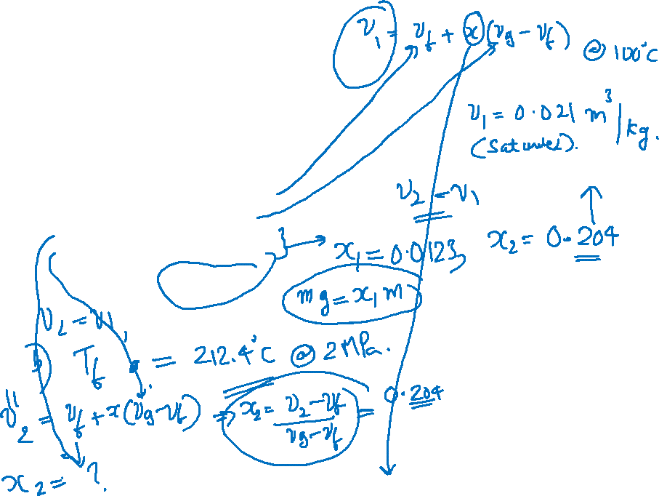
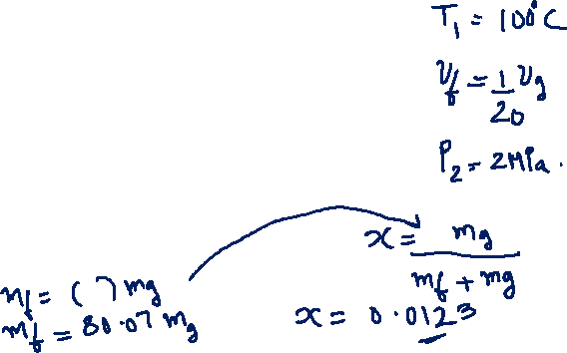

Slide 7
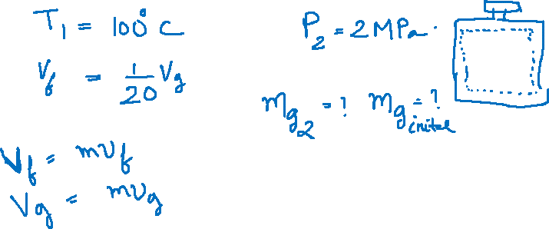
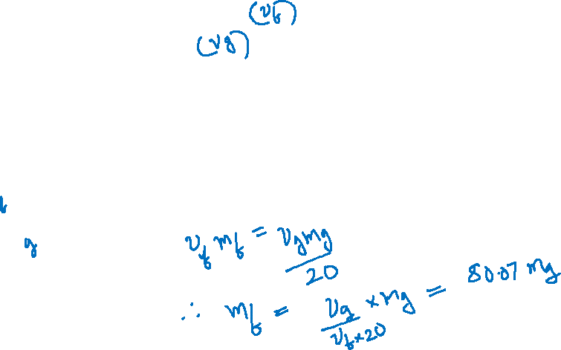

Slide 8
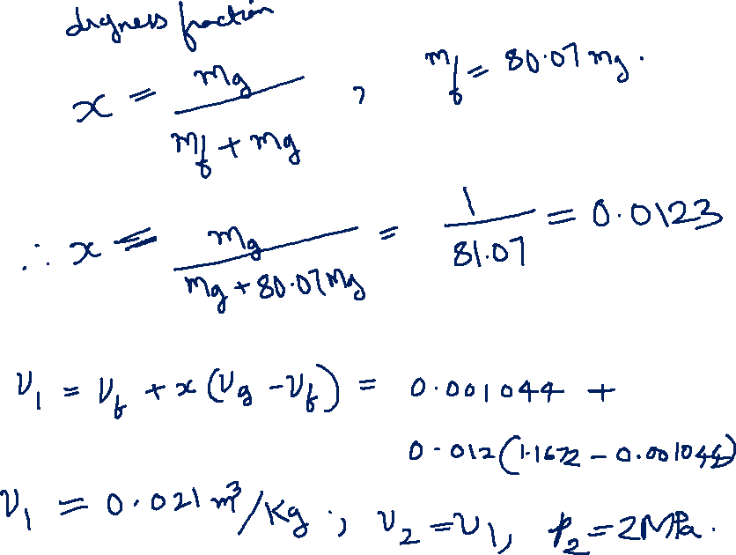

Slide 9
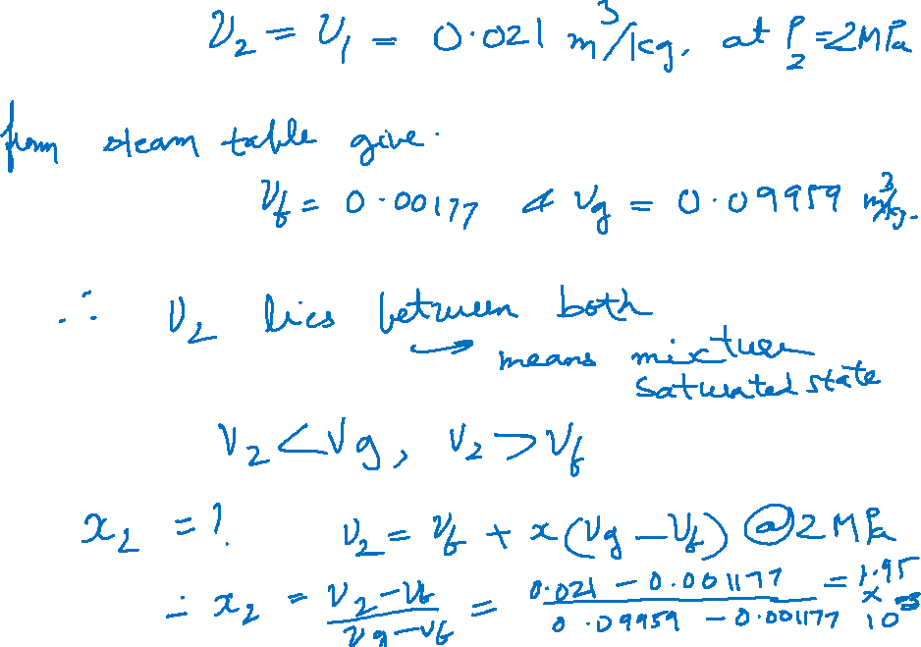


Slide 10
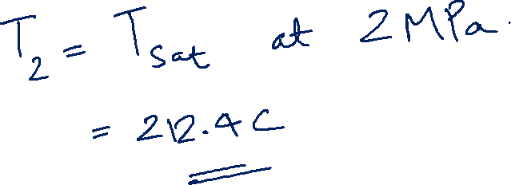

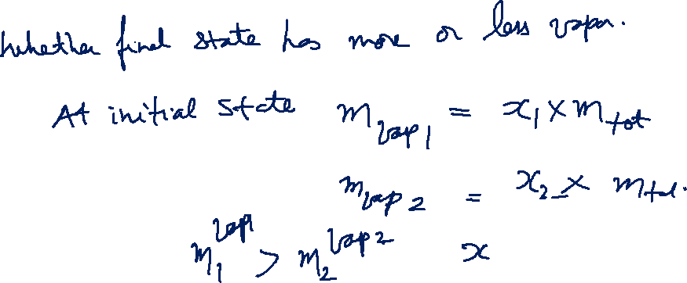

Slide 11
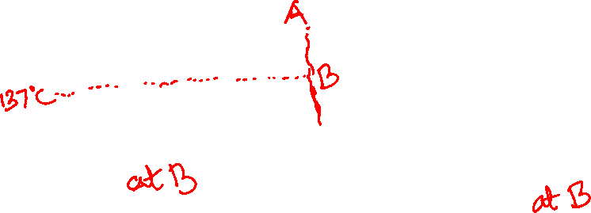
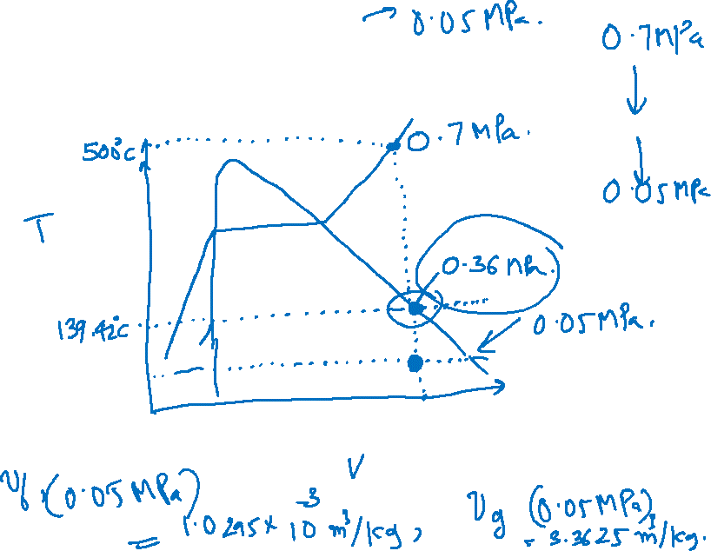

Slide 12
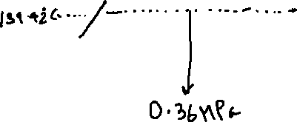

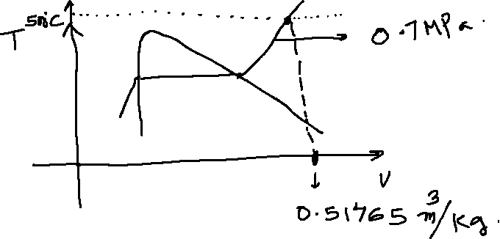
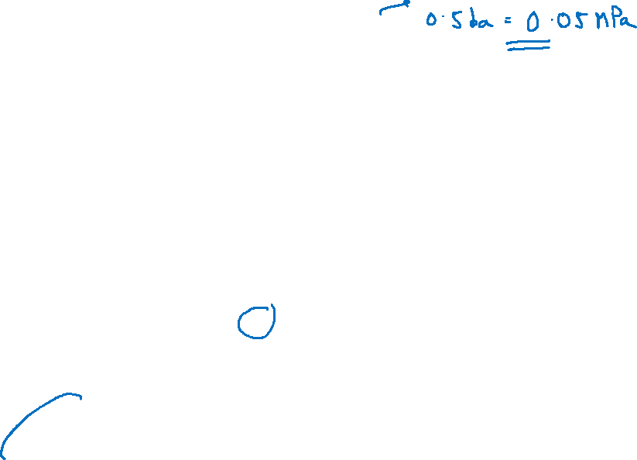
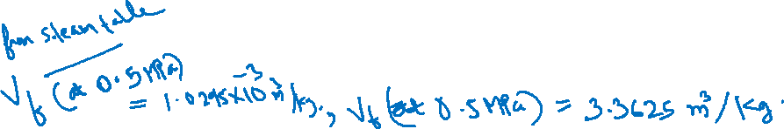

Slide 14
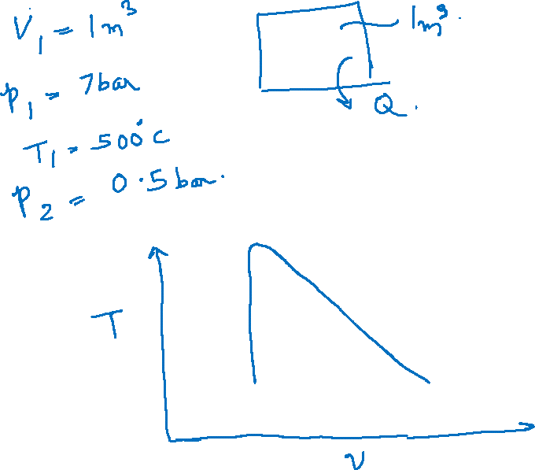

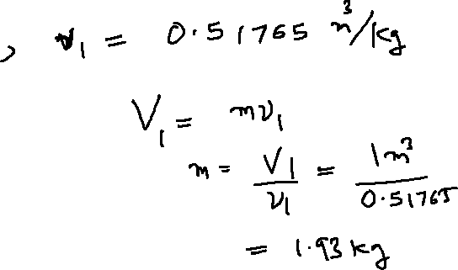


Slide 15
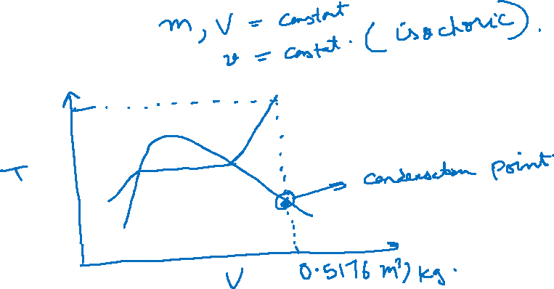
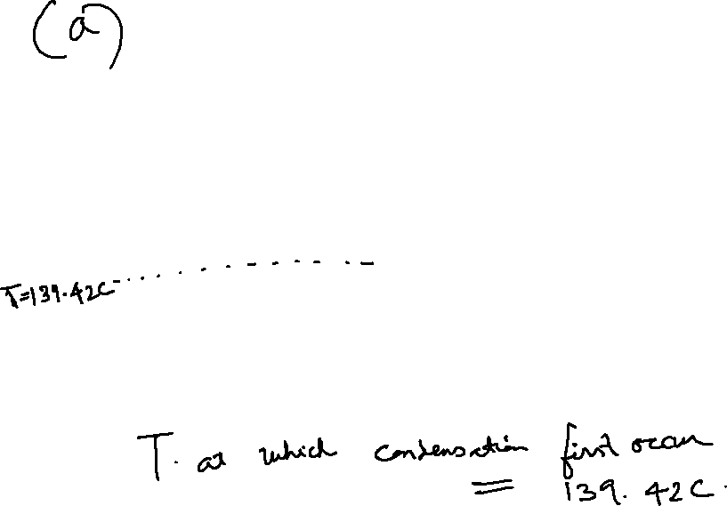

Slide 16
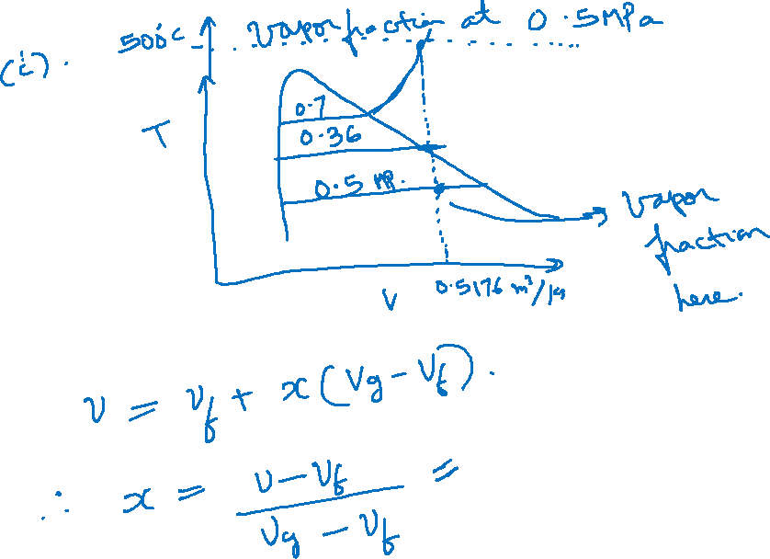

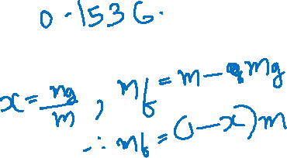


Slide 17
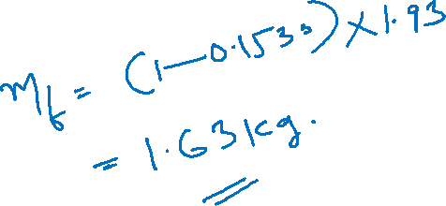
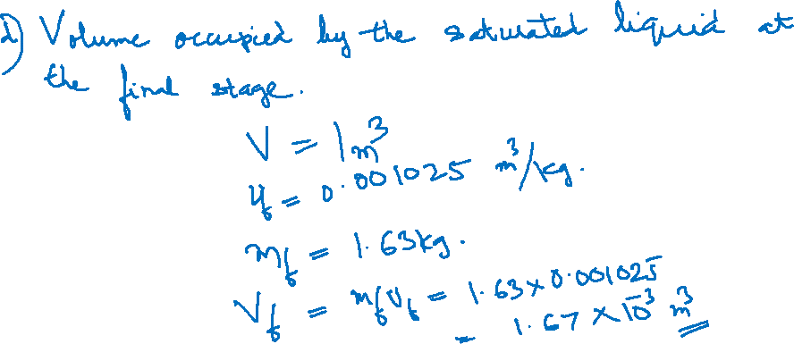

Slide 19
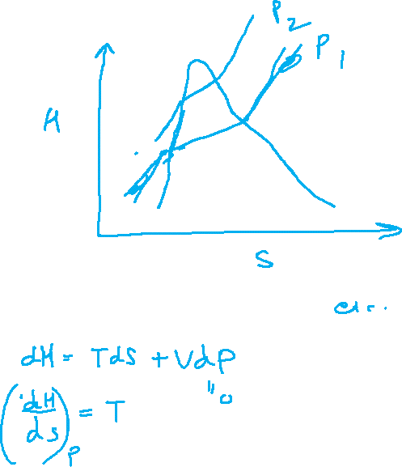
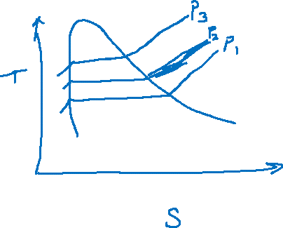

Slide 20
Engineering Problem on Rankine Cycle

Slide 21
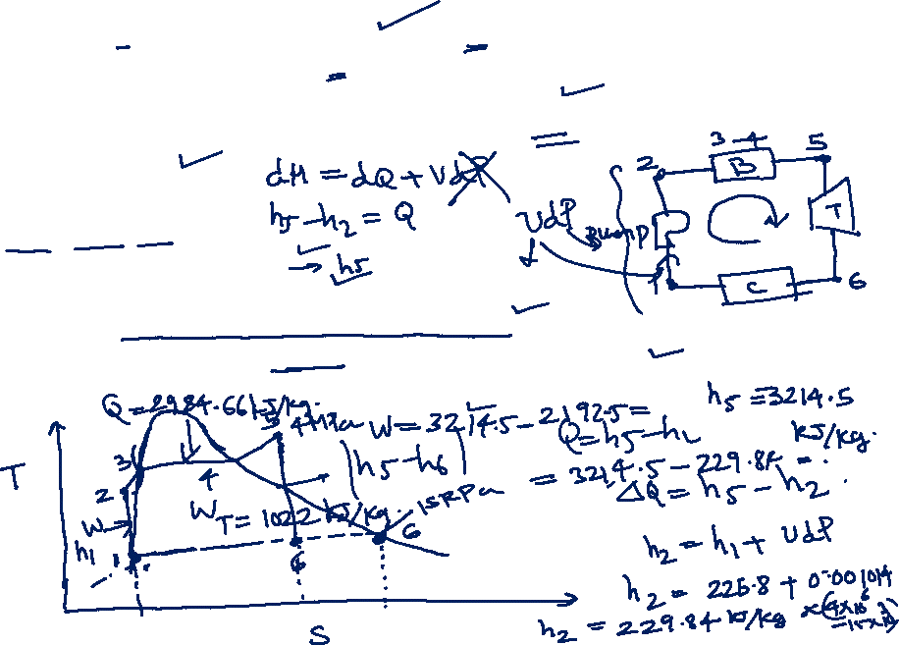
In a steam power plant operating on the Rankine cycle, steam enters the turbine at 4 MPa, 400 ºC (Super heated vapor region) and exits at a pressure of 15 kPa. Then it enters the condenser and exits as saturated water. Next, a pump feeds back the water to the boiler.
Determine the heat supplied to the working fluid in the cycle.
Provided the enthalpy at the entrance of the condenser as 2192.5 kJ/Kg, find the work output of Turbine
From steam table
Enthalpy h =3214.5 kJ/Kg at 400 C
Entropy h= 6.771 Kj/KgK at 400 C (at inlet of turbine)
Entropy of saturated vapor (on saturated vapor line) at 15 kPa = 8.007 kJ/KgK
Enthalpy of saturated liquid (on saturated liquid line) at 15 kPa = 225.8 kJ/Kg
Specific volume of liquid at the entrance of pump at 15 kPa = 0.001014 m³/Kg

Slide 22
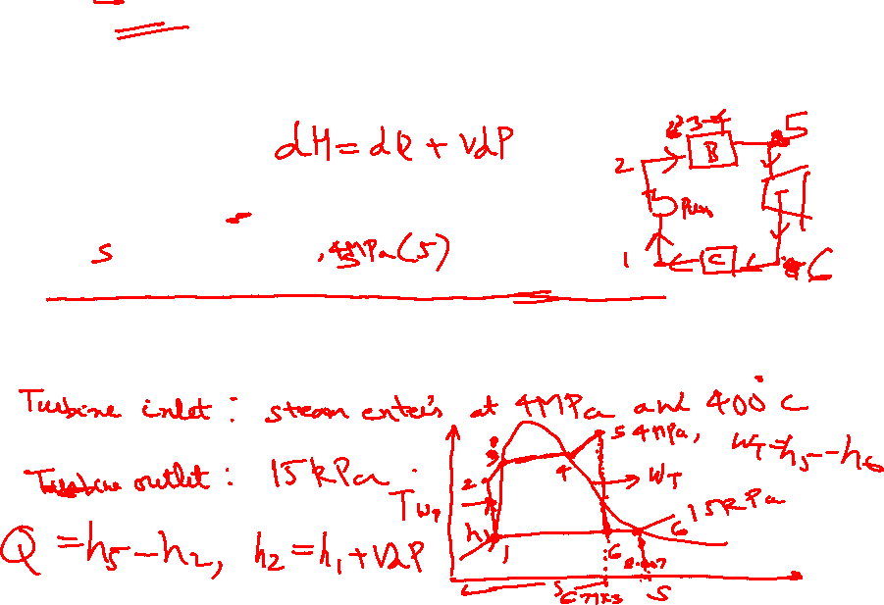
In a steam power plant operating on the Rankine cycle, steam enters the turbine at 4 MPa, 400 ºC (Super heated vapor region) and exits at a pressure of 15 kPa. Then it enters the condenser and exits as saturated water. Next, a pump feeds back the water to the boiler.
Determine the heat supplied to the working fluid in the cycle.
Provided the enthalpy at the entrance of the condenser as 2192.5 kJ/Kg, find the work output of Turbine
From steam table
Enthalpy h =3214.5 kJ/Kg at 400 C
Entropy h= 6.771 Kj/KgK at 400 C (at inlet of turbine)
Entropy of saturated vapor (on saturated vapor line) at 15 kPa = 8.007 kJ/KgK
Enthalpy of saturated liquid (on saturated liquid line) at 15 kPa = 225.8 kJ/Kg
Specific volume of liquid at the entrance of pump at 15 kPa = 0.001014 m³/Kg

Slide 23
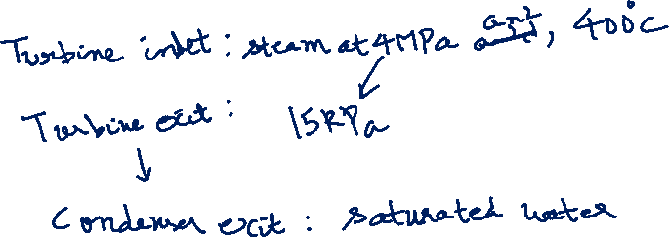
In a steam power plant operating on the Rankine cycle, steam enters the turbine at 4 MPa, 400 ºC (Super heated vapor region) and exits at a pressure of 15 kPa. Then it enters the condenser and exits as saturated water. Next, a pump feeds back the water to the boiler.
Determine the heat supplied to the working fluid in the cycle.
Provided the enthalpy at the entrance of the condenser as 2192.5 kJ/Kg, find the work output of Turbine
From steam table
Enthalpy h =3214.5 kJ/Kg at 400 C
Entropy h= 6.771 Kj/KgK at 400 C (at inlet of turbine)
Entropy of saturated vapor (on saturated vapor line) at 15 kPa = 8.007 kJ/KgK
Enthalpy of saturated liquid (on saturated liquid line) at 15 kPa = 225.8 kJ/Kg
Specific volume of liquid at the entrance of pump at 15 kPa = 0.001014 m³/Kg

Slide 24
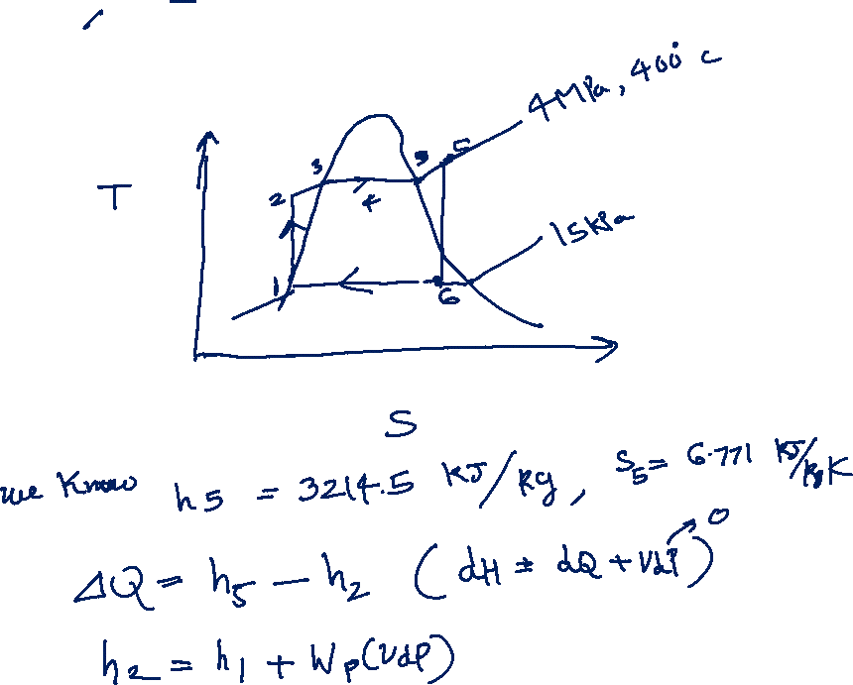

Slide 25
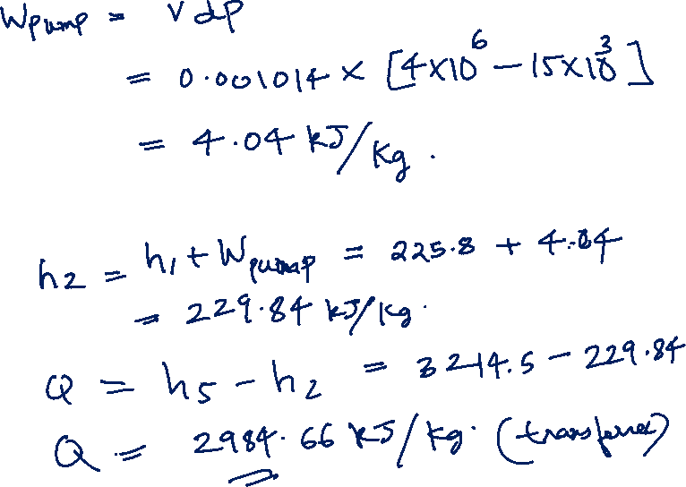

Slide 26
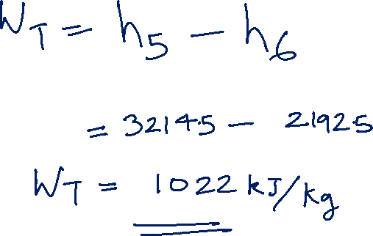

Slide 27
Engineering Problem on Vapor Cycle

Slide 28
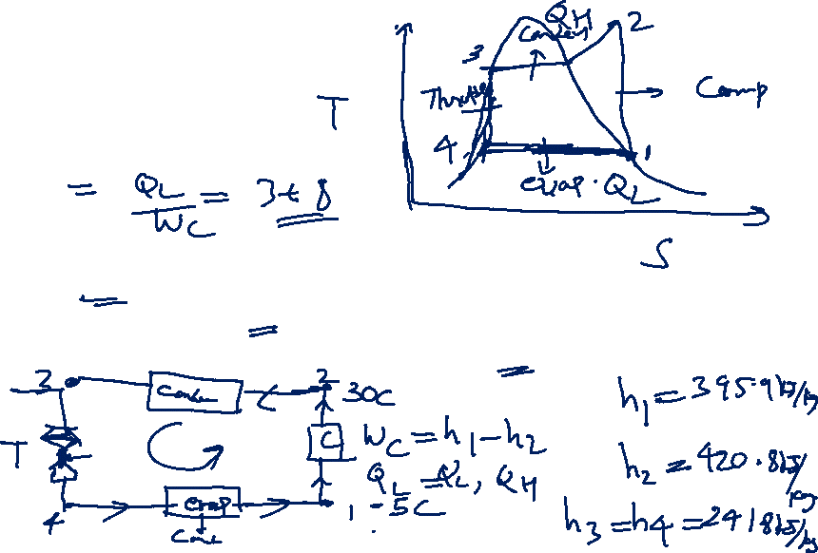
In a vapour compression refrigeration cycle working with refrigerant R-134A, the evaporator and condenser temperatures are -5 C and 30 C respectively. The process follows the T-S diagram shown
Determine
Compression work
Refrigerating effect
Heat rejected in the condenser
COP
From the data sheet of R-134 A, following information are provided
Enthalpy at the inlet of compressor at -5C = 395.9 kJ/Kg
Enthalpy at the inlet of condenser at 30C and 771 kPa = 420.8 kJ/Kg
Enthalpy after throttling and at the inlet of evaporator = 241.8 kJ/Kg

Slide 29
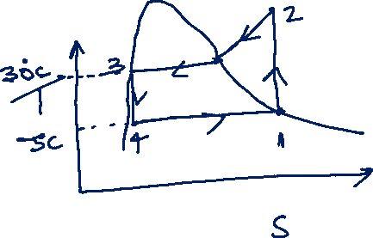
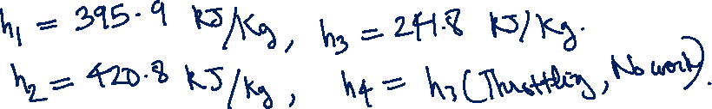
In a vapour compression refrigeration cycle working with refrigerant R-134A, the evaporator and condenser temperatures are -5 C and 30 C respectively. The process follows the T-S diagram shown
Determine
Compression work
Refrigerating effect
Heat rejected in the condenser
COP of refrigerator
From the data sheet of R-134 A, following information are provided
Enthalpy at the inlet of compressor at -5C = 395.9 kJ/Kg
Enthalpy at the inlet of condenser at 30C and 771 kPa = 420.8 kJ/Kg
Enthalpy after throttling and at the inlet of evaporator = 241.8 kJ/Kg

Slide 30
