Slide 1
RECAP
‘ROTATING CYLINDER’

Slide 2
Initial Conditions…
3
2
In the time interval Δt, the principal axes rotate away from the 1, 2, 3 axes.
1
What are the changes in angular momentum in 1,2 and 3 axis?
ΔL₁, ΔL₂ and ΔL₃?

Slide 3
ΔL₁ due to rotation along ‘1’ axis
3
2
1

Slide 4
ΔL₁ due to rotation along ‘2’ axis
3
2
1

Slide 5
ΔL₁ due to rotation along ‘2’ axis
L₃
L₂
This will not contribute!
L₁

Slide 6
ΔL₁ due to rotation along ‘3’ axis
3
2
1

Slide 7
ΔL₁ due to rotation along ‘3’ axis
L₃
L₂
This will not contribute!
L₁

Slide 8
Equation of motion of a Rigid body: Euler’s equation
3
Dividing by and taking the limit
2
1

Slide 9
Equation of motion of a Rigid body: Euler’s equation
3
2
1

Slide 10
Equation of motion of a Rigid body: Euler’s equation
3
2
1
Euler’s Equations of rigid body motion

Slide 11
A MATHEMATICAL APPROACH!

Slide 12
Lab frame Vs Body frame
3
2
1

Slide 13
Euler’s equation: Mathematical approach
L can change due to two reasons
Changes in the body frame
Rotation of the body relative to lab frame

Slide 14
Euler’s equation: Mathematical approach
REARRANGING L.H.S AND R.H.S WE GET EULER’S EQUATIONS

Slide 15
Euler’s equation: Mathematical approach

Slide 16
How Euler’s equations are related to stability?
APPLICATION
Will learn through some Examples………

Slide 17
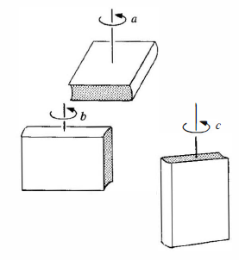
Example1
Stability of a book under rotation through its different axis

Slide 18
A BOOK UNDER ROTATION

Slide 19
Book under rotation….
Book is rotated in one of its axis by applying a torque and quickly released. Lets say it has
A small perturbation is given …..
Stability of motion is analyzed by
Applying Euler’s equation
Guess which of the above configuration will be stable ??

Slide 20
Stability of Rotational motion
1
2
3
Too small……
Since equations 2 and 3 are coupled, we take second derivative of eqn 2 to get equation
of motion

Slide 21
Stability of Rotational motion
Stable
Unstable
Stable
I₁ is largest or smallest
UnStable
I₁ is intermediate

Slide 22
Example2
Stability of a Symmetric Top

Slide 23
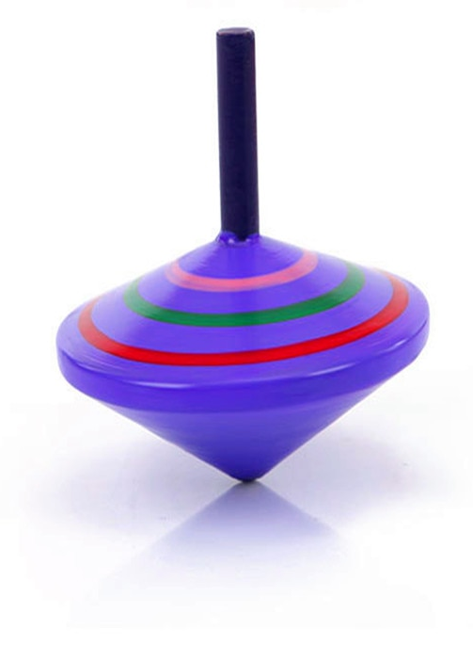
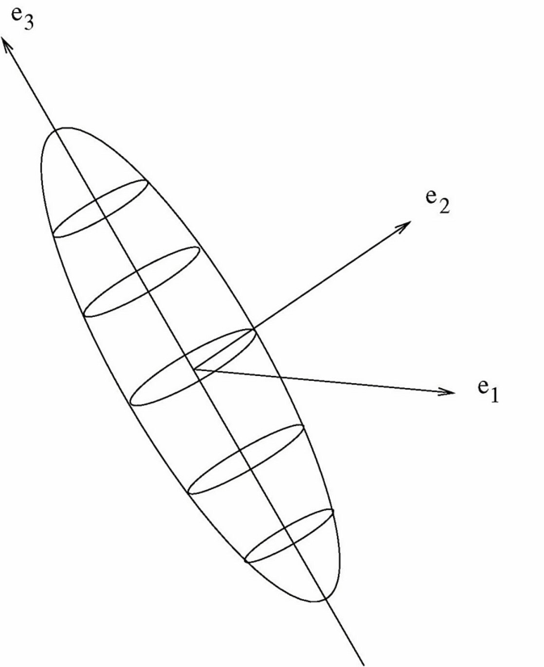
Example2
Stability of a Symmetric Top

Slide 24
Symmetric top

Slide 25
Symmetric top
Define:

Slide 26
Symmetric top (Solution)

Slide 27
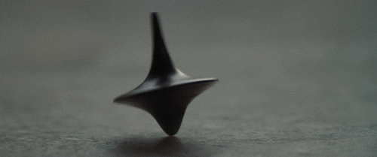

Slide 28
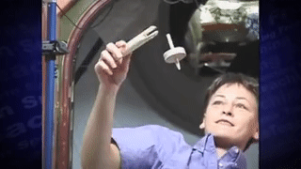

Slide 29
Plot of ω
ω ₃
ω
ω ₂
ω₁

Slide 30
ω₁(t) and ω₂(t) are the components of a circle. Therefore the ω vector traces out a cone around ω₃ (Unit vector) with frequency Ω.
Ω depends on the value of ω₃ and geometry.
Radius of the cone is A, determined by the initial values of ω₁ and ω_{3.}

Slide 31
L₃
L
L₂
L₁

Slide 33
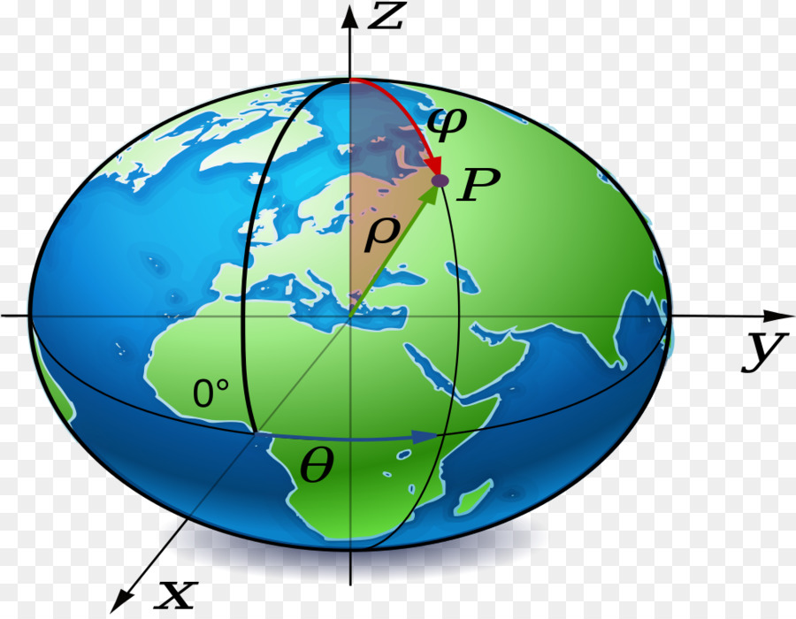
Earth is a spinning top!
Chandler wobble
Chandler wobble

