Slide 1
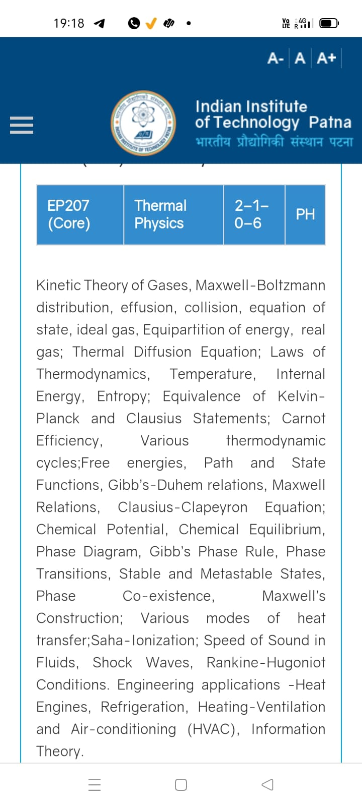
“The final touch”
Season 2, Lecture 39 :
A glimpse on Quantum Technology (not for exam)

Slide 2
Name | L37 | 38
"2201ph34_dolly" <2201ph34_dolly@iitp.ac.in>; | p
"Adhila Aslam" <2201ph01_adhila@iitp.ac.in>; | a
"Aditi Baghel" <2201ph31_aditi@iitp.ac.in>; | p
"Aditya Kumar" <2201ph02_aditya@iitp.ac.in>; | p
"Aditya Singh" <2201ph03_aditya@iitp.ac.in>; | p
"Animesh Sharma" <2201ph05_animesh@iitp.ac.in>; | p
"Arun Mishra" <2201ph06_arun@iitp.ac.in>; | p
"Aryan Raj" <2201ph32_aryan@iitp.ac.in>; | p
"Boda Vishnuwardhan" <2201ph08_boda@iitp.ac.in>; | a
"Chanchal Tolani" <2201ph09_chanchal@iitp.ac.in>; | p
"Gaurav Verma" <2201ph10_gaurav@iitp.ac.in>; | pp

Slide 3
Name | L37 | 38
"Gourav Jha" <2201ph11_gourav@iitp.ac.in>; | a
"Gurinder Dhillon" <2201ph12_gurinder@iitp.ac.in>; | p
"Harsh Joshi" <2201ph13_harsh@iitp.ac.in>; | p
"Himanshu Patel" <2201ph35_himanshu@iitp.ac.in>; | p
"Khushal Yadav" <2201ph14_khushal@iitp.ac.in>; | p
"Krishnakant Chourey" <2201ph15_krishnakant@iitp.ac.in>; | p
"Manas Gupta" <2201ph16_manas@iitp.ac.in>; | p
"Mohit Saini" <2201ph17_mohit@iitp.ac.in>; | p
"Mude Naik" <2201ph18_mude@iitp.ac.in>; | p
"Murari Kumar" <2201ph19_murari@iitp.ac.in>; | a
"Nishant Yadav" <2201ph20_nishant@iitp.ac.in>; | p
"Pranitha Moluguri" <2201ph21_pranitha@iitp.ac.in>; | a

Slide 4
Name | L37 | 38
"Premanandh Sigamala" <2201ph22_premanandh@iitp.ac.in>; | p
"Ruchi Thakur" <2201ph23_ruchi@iitp.ac.in>; | p
"Satyam Sahoo" <2201ph25_satyam@iitp.ac.in>; | a
"Satyam Shandilya" <2201ph24_satyam@iitp.ac.in>; | p
"Shyam Hembram" <2201ph26_shyam@iitp.ac.in>; “ | p
Sougata Saha" <2201ph27_sougata@iitp.ac.in>; | p
"Sumit Rajpoot" <2201ph28_sumit@iitp.ac.in>; | a
"Suprajit Dewanji" <2201ph29_suprajit@iitp.ac.in>; | p
Attendance: 75% mandatory

Slide 5
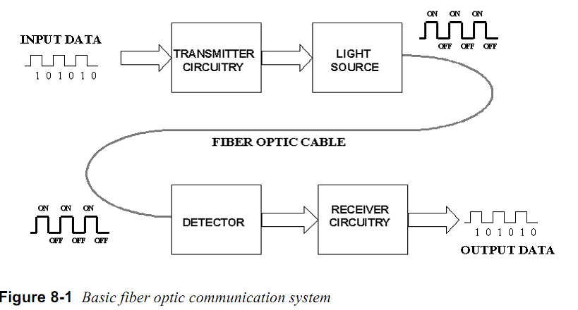
Basic optical communication

Slide 6
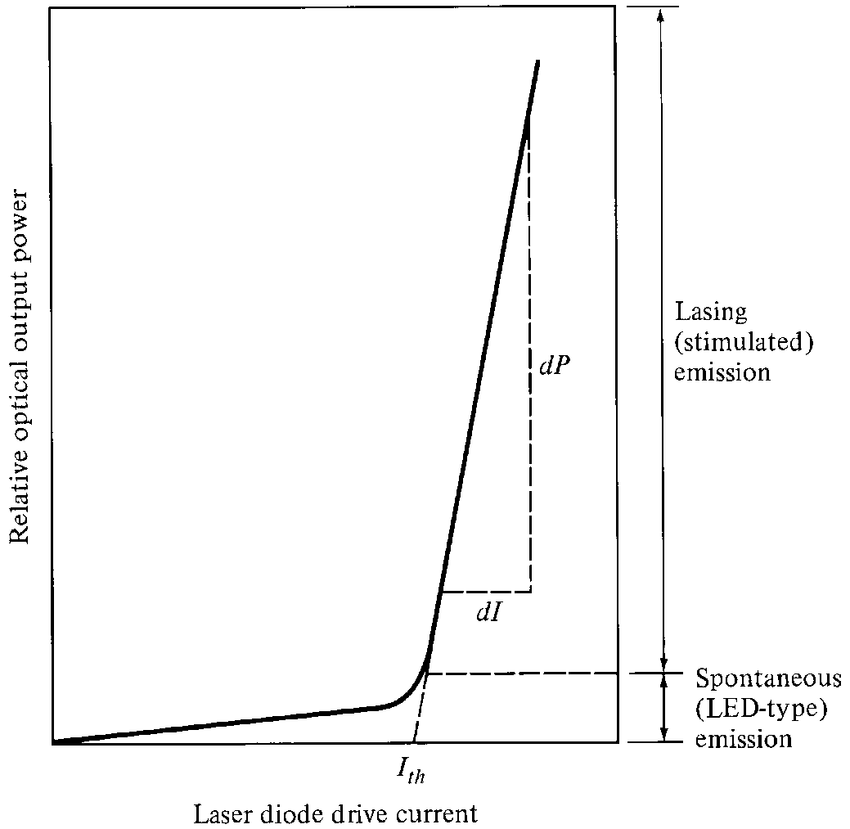
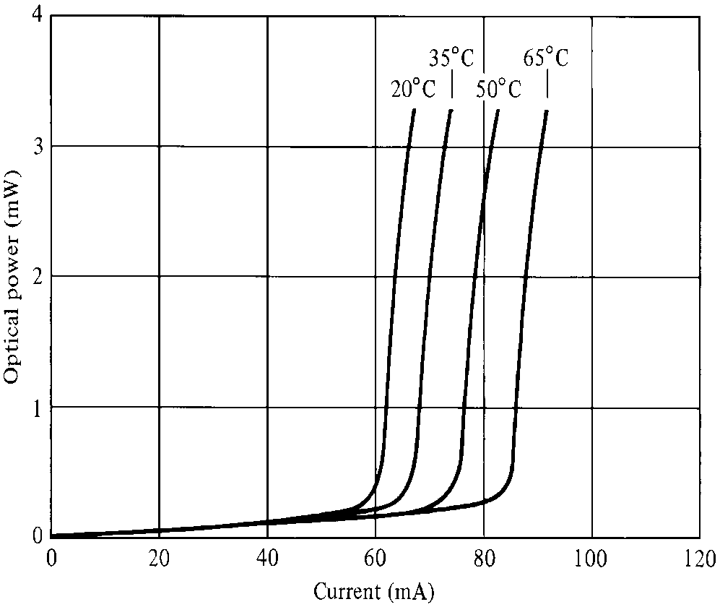
Laser Diode Characteristics
Very good for digital modulation

Slide 7
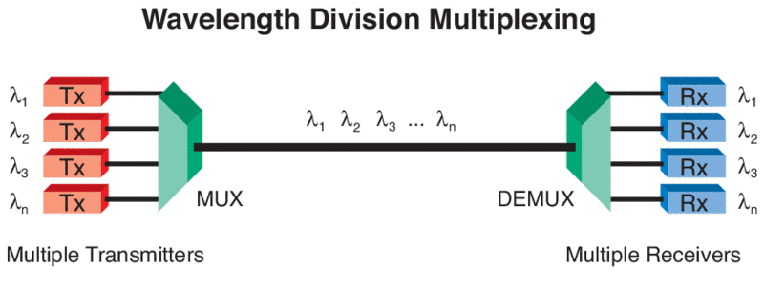
Wavelength Division Multiplexing and utilisation
For broad band communication

Slide 8
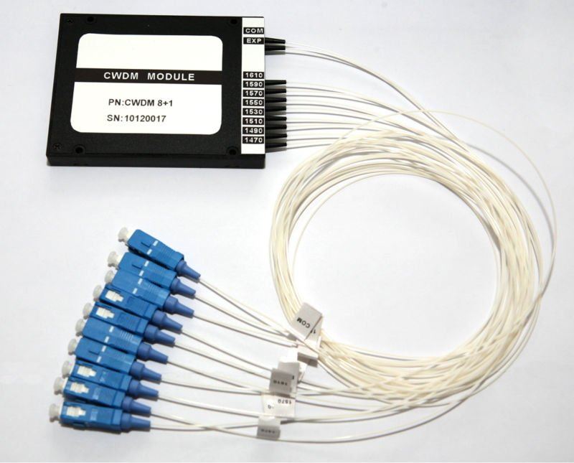
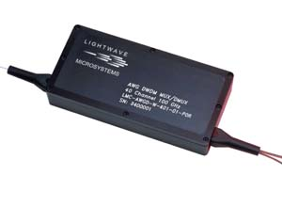
Wavelength Division MUX (Multiplexer)

Slide 9
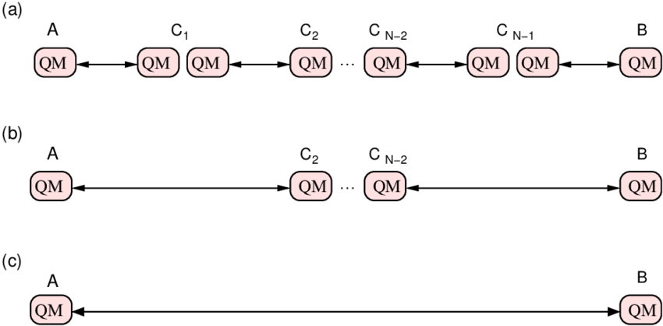

Slide 10
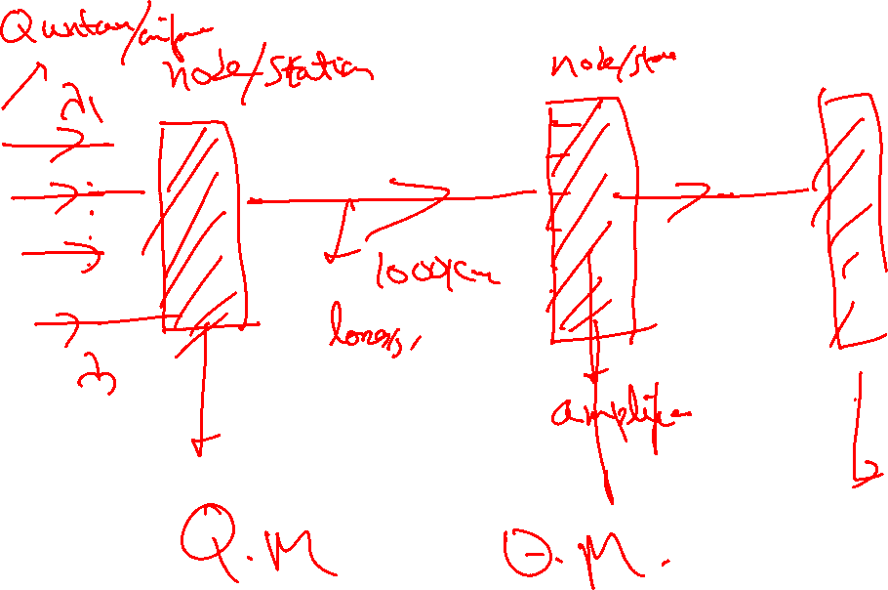

Slide 11
Quantum Memory (QM)
Stationary QuBit
i.e QUANTUM MEMORY
(Eg an atom)
Flying QuBit
(photonic quantum state)
Flying QuBit
(photonic quantum state)
storage
read-out
LIGHT
(Quantum Information)
LIGHT
(Quantum Information)
ATOM + LIGHT
Dressed atomic and light quantum states
RESEARCH
WORK
EIT (Electromagnetically Induced Transparency)

Slide 12
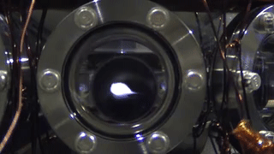
Ultracold atoms and BEC

Slide 13
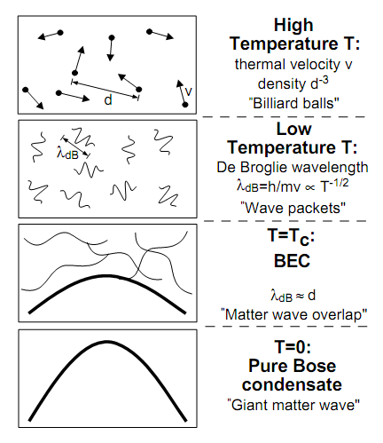
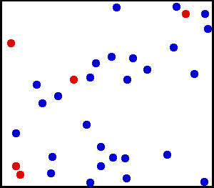

How Cold is Ultra Cold?
Kelvin
Celsius
300
26.8
Room Temperature
Water freezes
250
-23.2
200
-73.2
150
-123.2
100
-173.2
Air liquefies
50
-223.2
≈ 3K Deep space
0
-273.2
Absolute Zero
All motion stops
New state of Matter: Bose –Einstein Condensate
W.Ketterle, Cornell, C.Weimann, MIT
NOBEL PRIZE 2001
Laser Cooling and Evaporative cooling Technique

Slide 14
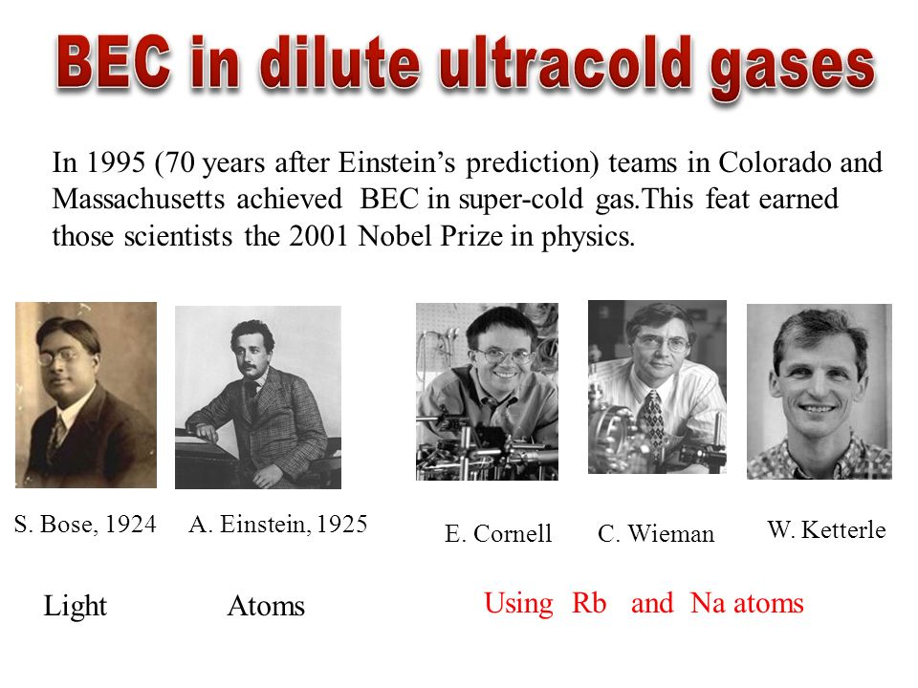
Realized in 1995 at MIT

Slide 15
How this phase transition was achieved?
“Laser Cooling of atoms” using Doppler effect
+
“Evaporative Cooling”

Slide 16
Bose-Einstein condensation
PREDICTION BY BOSE………………
BEC is a phenomena in which, below a critical temperature Tc, a macroscopic number of bosons occupies lowest energy state

Slide 17
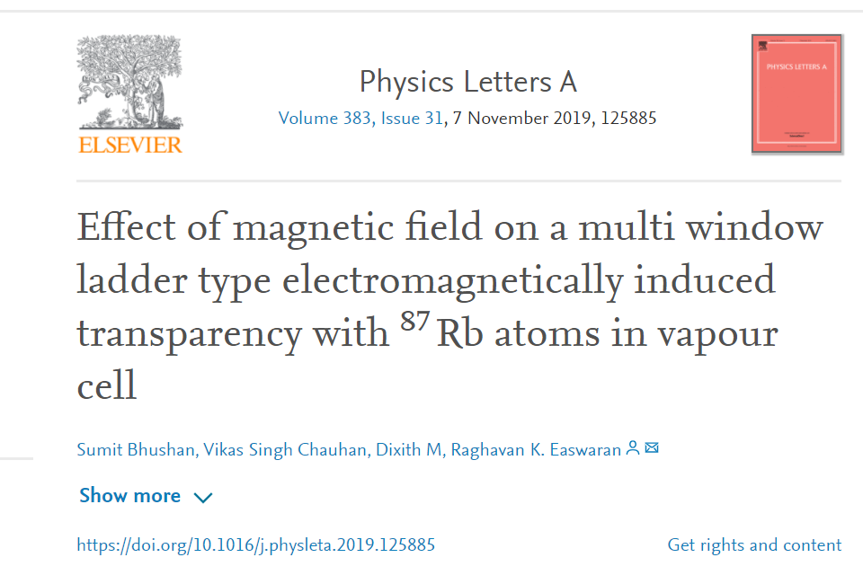
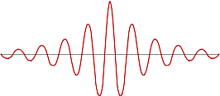
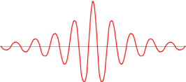
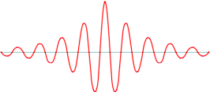
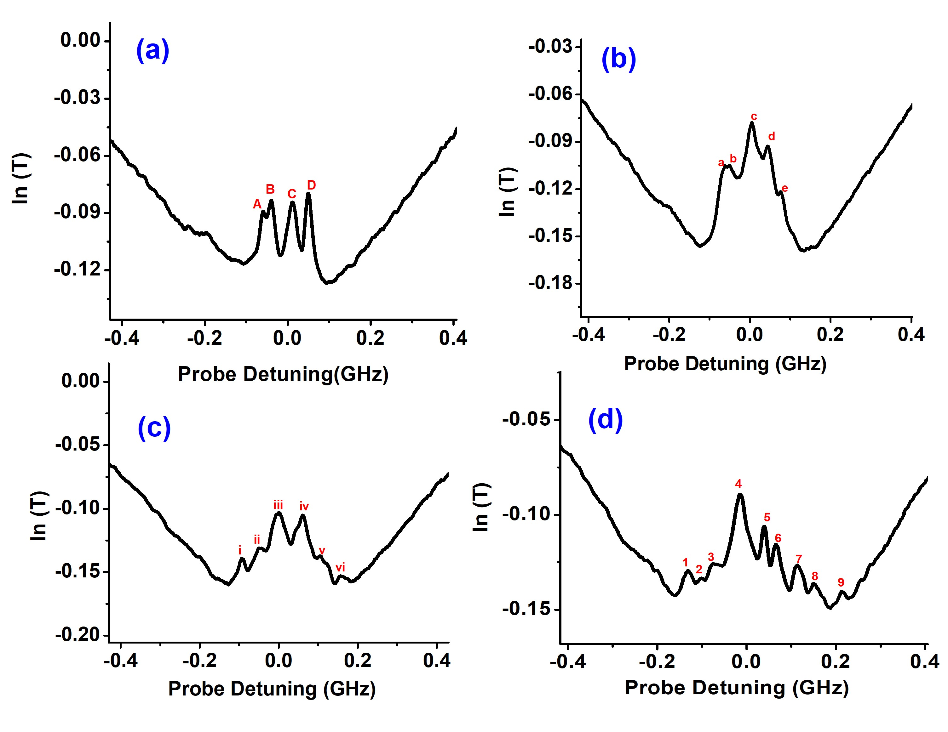
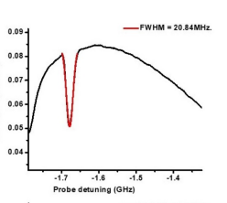
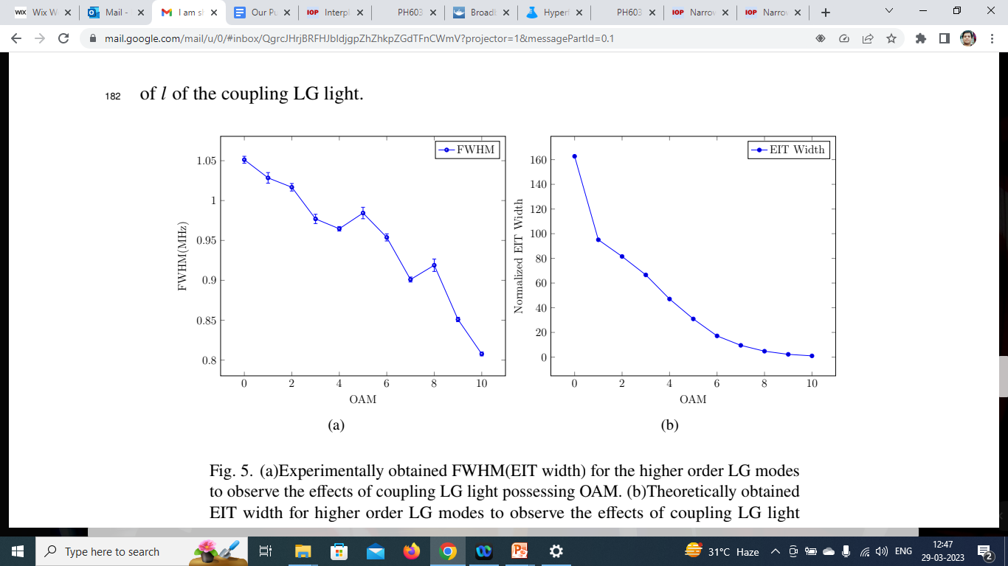
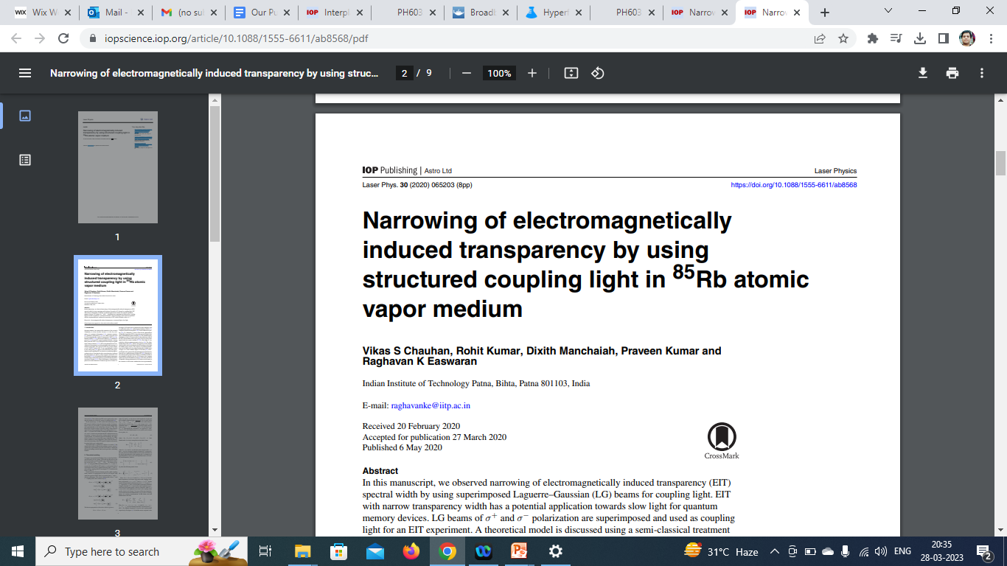
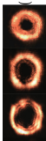
Electromagnetically Induced Transparency (EIT)
Novelty
• Number of EIT transparency peaks in presence of magnetic field is 9 at 18 Gauss.
• Wide scale tunability can be achieved with respect to spectral positions of the peaks.
• EIT based atomic memory is shown to be competent with other multi mode protocols.
1. EIT in Presence of Magnetic field
More number probe pulses can be stored and processed in parallel
Slow light using EIT
Slow light using EIT
Atomic gas sample
Example : Rb atoms
ɑ
Im(χ)
Detuning, δ
1
2
1
2
f₀
n
Re(χ)
.
.
.
.
-4
-2
0
2
4
δ_{p}
Detuning δ
More signals could be stored by applying magnetic field
2. Effects of Structured light
Multiple frequency probe channels for communication
1: Probe, 2: Coupling
Multiple frequency probe pulses could be stored in same Vapor cell using magnetic fields
Multiple frequency or Multi window EIT
Example 2 frequencies,,,,,,it could be more,,,,
We observed narrowing
of EIT spectral
width by
using LG
beams for coupling light.
EIT with narrow transparency width has potential application
towards slow light for quantum memory devices. Very low group velocities could be achieved
Novelty

Slide 18
Research
Electromagnetically Induced Transparency
(EIT) in alkali vapor system (Exp and Theory)
1. Presence of Magnetic field
2. Effects of Structured light
3. EIT in Ultracold atoms
4. EIT in Engineered atoms
Quantum Technology
Slow light
Quantum Memory (QM)
Multiple frequency
EIT windows for
QM
Highly efficient EIT system for QM applications
Novel system for
Performing EIT and its applications
Very Narrow EIT window for ultra slow light
Quantum Memory, Quantum Information, Quantum Computers, Wireless Quantum communication, Quantum Repeaters etc

Slide 19
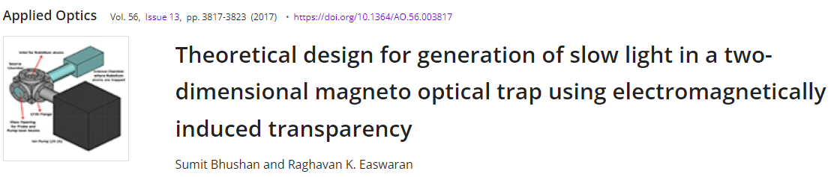
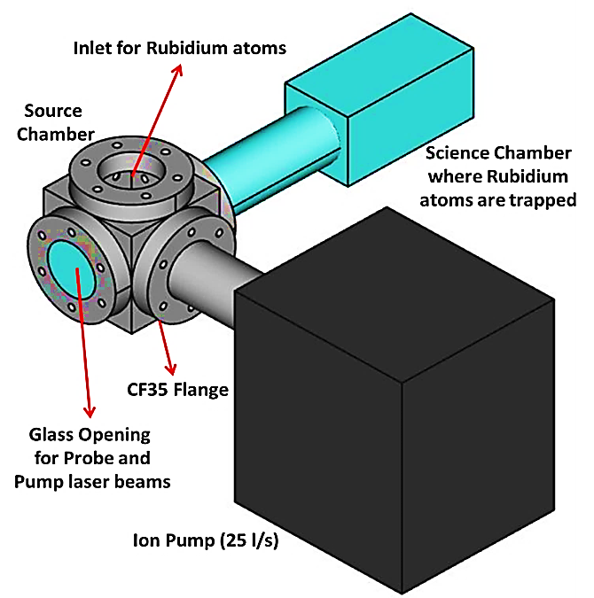
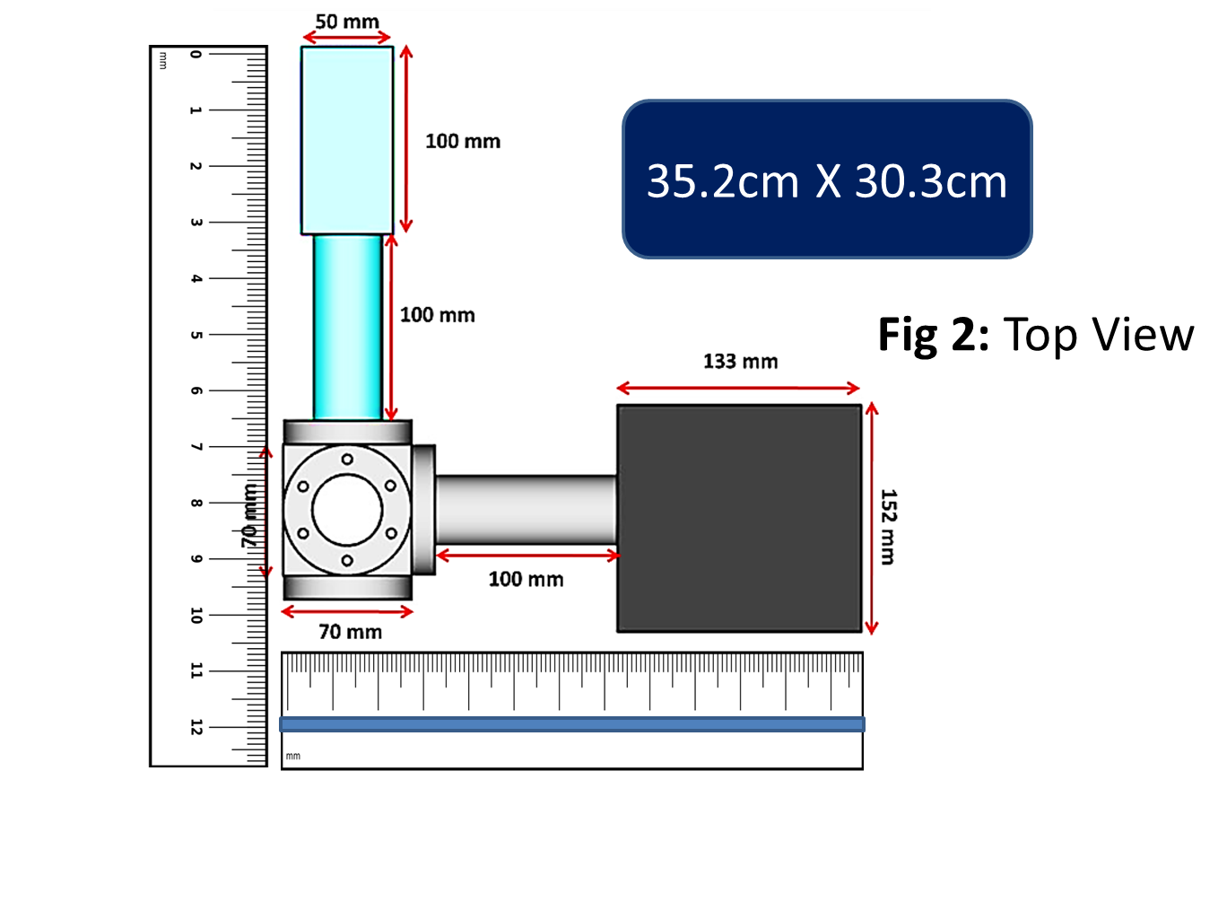
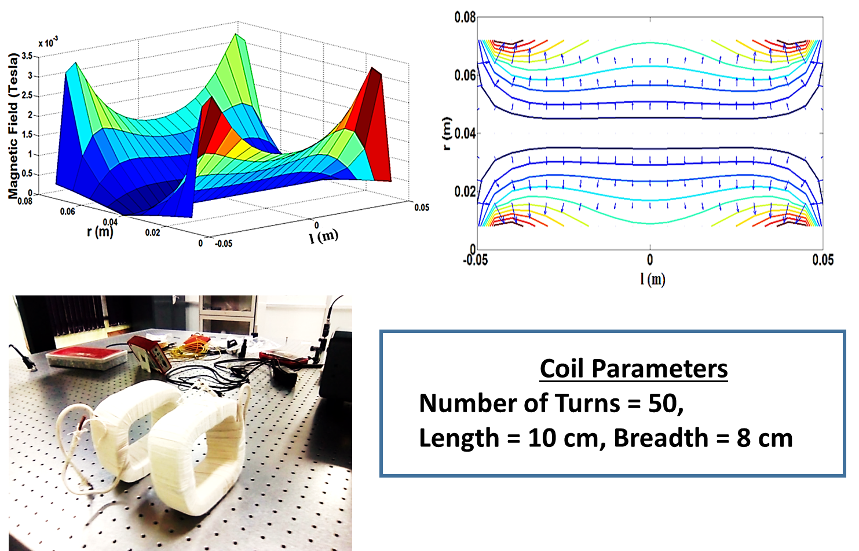
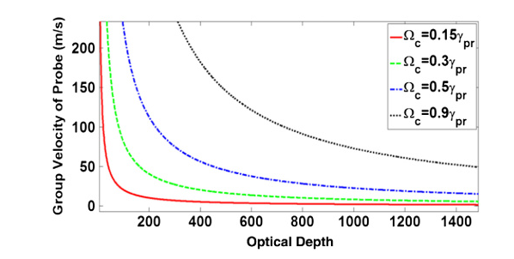
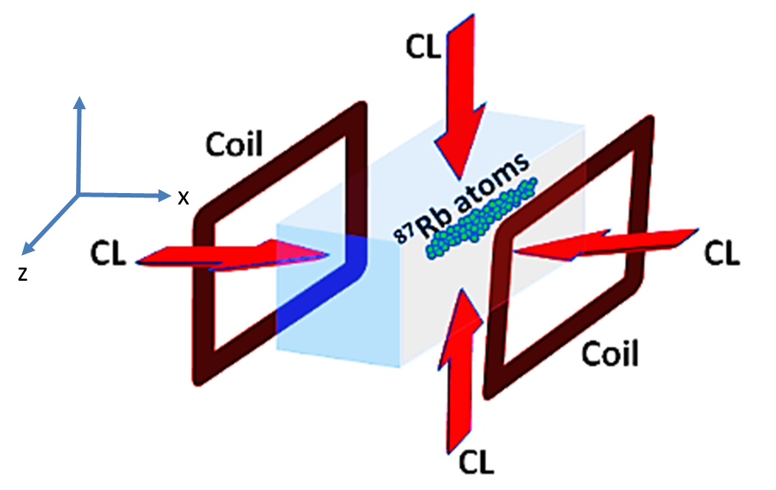
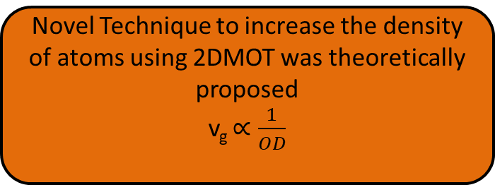
Novel Technique to increase the density of atoms using 2DMOT was theoretically proposed
v_{g} $∝\frac{1}{OD}$
3. EIT in Ultracold atoms
Novelty A novel technique for slow light experiments using EIT in a two-dimensional magneto optical trap. A compact 2D-MOT design efficient for quantum memory applications with adjustable optical depth (OD) is proposed. Based on the estimated OD for setup, we found that light group velocities as low as 1.4 m/s. With our design, it is possible to obtain a delay bandwidth product of 163, which is very high in comparison to previously obtained values.
Ultra low group
Velocities
In 2D Magneto Optical Trap (2D MOT) using EIT

Slide 20
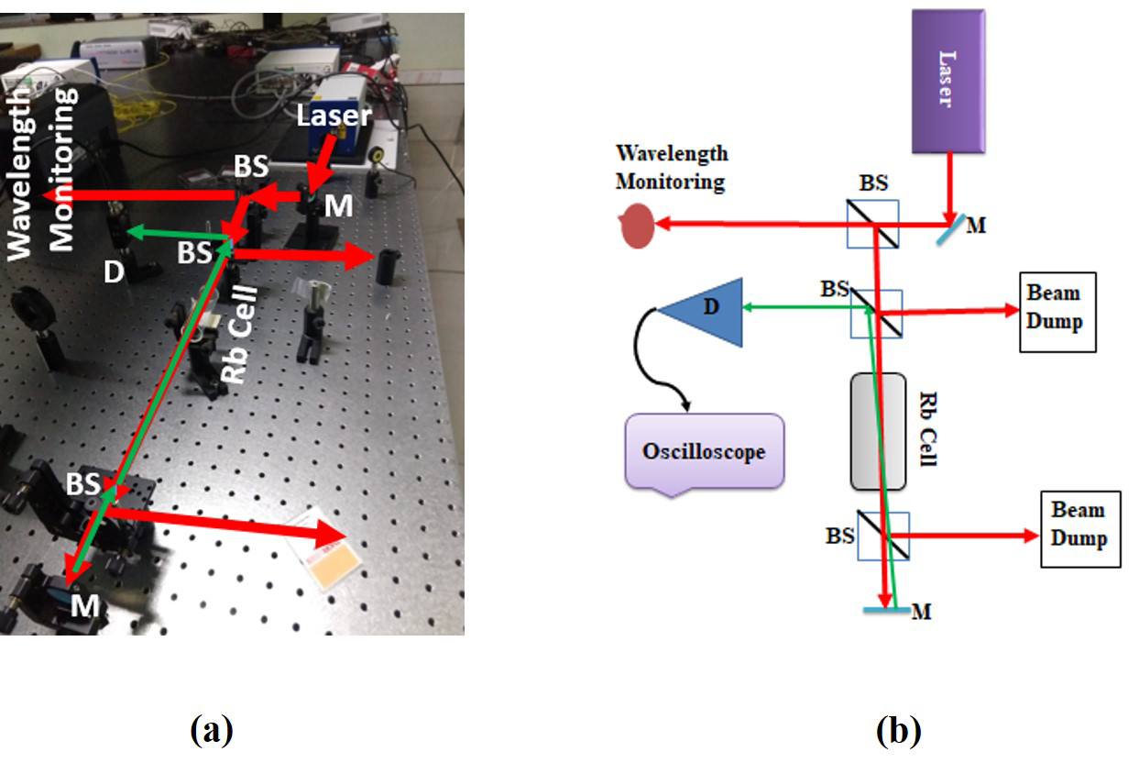
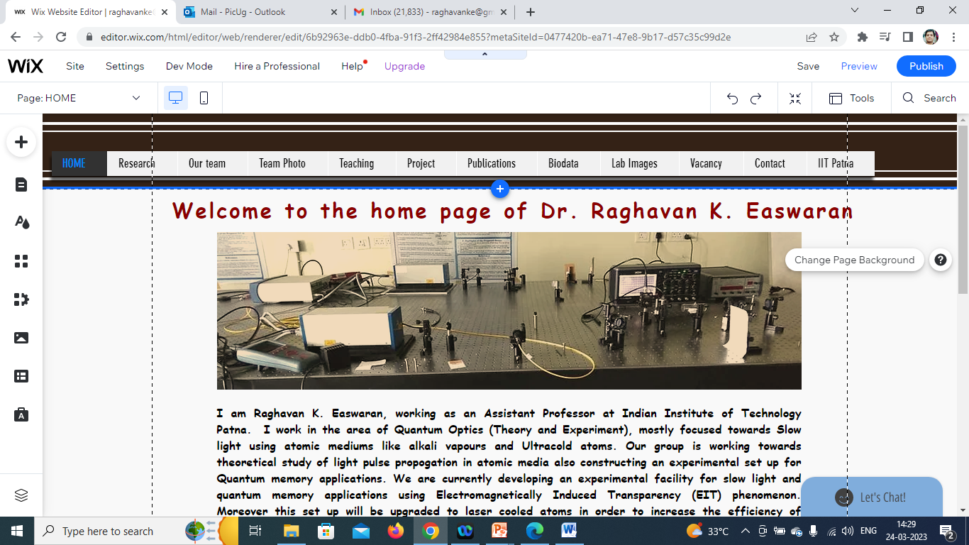
Contributions: Research lab’s developed
Research facilities developed at Optics Lab 1 (18B, Block 4)
1
2
Experimental set up
For saturation absorption
spectroscopy (SAS)
for Rb atoms
Experimental set up
For absorption
spectroscopy
for Rb atoms
3
4
Experimental
set up for
Multi window
EIT
Zeeman spectroscopy
For Rb atoms
5
Experimental
set up for EIT,
using structured
light etc

Slide 21
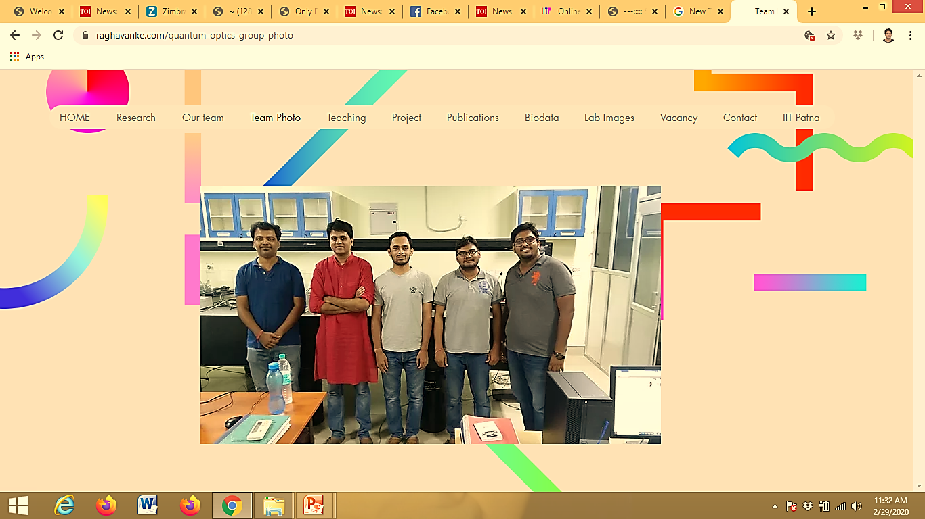
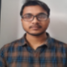


Post Doc @
National Institute of Standards and Technology (NIST)
Maryland
USA
Thesis
PhDs
6
MSc
8
B.Tech/BS Intern
6
M.Tech
1
RA 1
(SERB CRG)
Optics Lab 1
Research outputs
Number of publications after joining IIT Patna = 16 + 4 (under review),
Conference Presentations after joining IIT Patna = 20
Patent = 1 (submitting soon)
Research Projects
Projects as Co-PI with other departments
Projects as PI
1. Title: Theoretical study on encapsulated Rb atom inside a C-60 cage for Quantum Technology
application using Electromagnetically Induced Transparency Protocol
Principal Investigator: Dr. Raghavan K . Easwaran
Duration: 3 years (2023) (Sanctioned)
Value: 26.97 Lakh
Funding Agency: SERB, CRG, DST, Govt of India
2 PhD’s submitting Synopsis
This month
Post Doc @
National Institute of Standards and Technology (NIST)
Maryland
USA
Currently
Joined as
Associate Prof
At KL University
4. Title: Plasma Spraying of rare-earth niobates powder controlling its
stoichiometry and porosity
for the advanced thermal barrier coating applications (GTMAP)
PI: Dr. Anup K. Keshri
Duration: 3 years
Value: 28.2 Lakh
Funding Agency: DST, Govt of India
2.  Title: Electromagnetically Induced Transparency and Slow Light in a Two dimensional
Magneto
Optical Trap (2D MOT)
Principal Investigator: Dr. Raghavan K . Easwaran
Duration: 3 years (Completed)
Value: 28.2 Lakh
Funding Agency: SERB, DST, Govt of India
5. Title: Plasma Sprayed CNT Reinforced Graphene Coated Electrode for
the Super Capacitor Applications : Towards Industralization
PI: Dr. Anup K. Keshri
Duration: 3 years
Value: 72.38 Lakhs Lakh
Funding Agency: DRDO, Govt of India
6 PhDs from my lab
MSc thesis=6+2 (ongoing)=8
3. Title: Study of Electromagnetically Induced Transparency (EIT) in Rb atomic vapour for
Quantum Memory applications in the presence of Structured Light
Co PI: Dr. Raghavan K . Easwaran
Duration: 3 years (accepted as seen in portal)
Value: 30.5 Lakh
Funding Agency: CSIR, Govt of India
Total number of Projects=
4 +1 (accepted) as seen in
Portal of CSIR
Dr. Sumit Bhushan
Dr. Vikas Singh
Post Doc pt
JAPAN

Slide 22
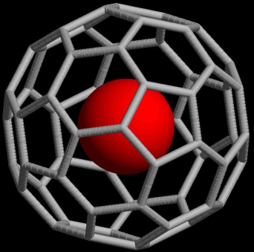
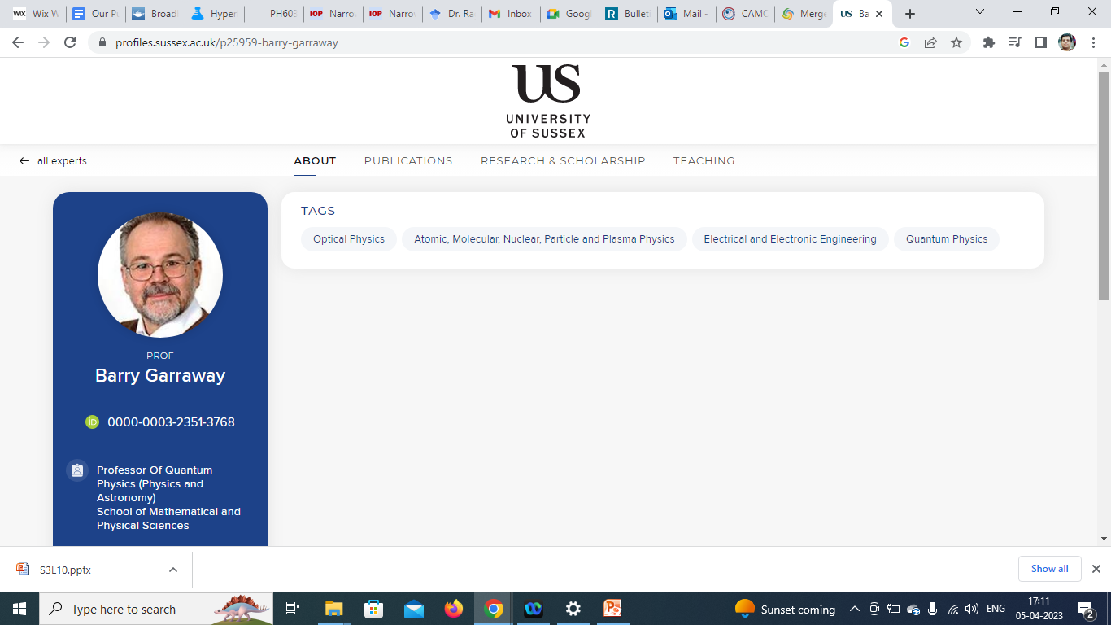
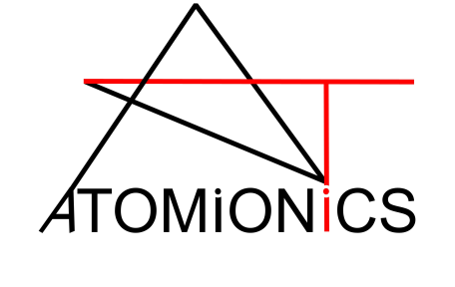
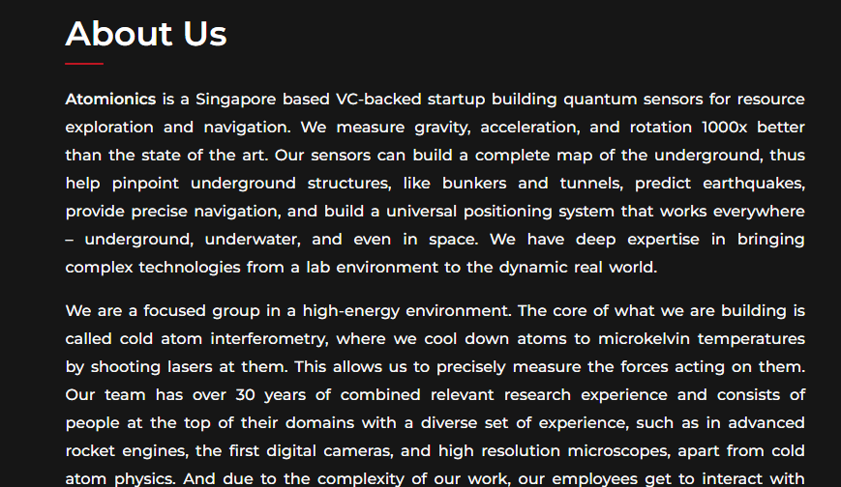
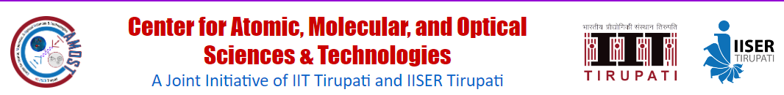
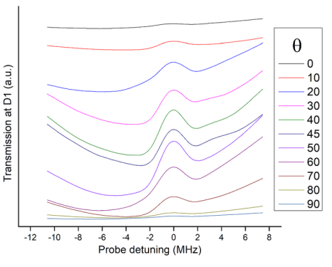
 | Title | Authors | Journal | Year | IF
13 | Numerical investigations on photonic nanojet mediated surface enhanced Raman scattering and fluorescence techniques | Gour M. Das, Anil B. Ringne, Venkata R. Dantham, Raghavan K. Easwaran and Ranjit Laha | Optics Express 25 (17), 19822-19831 | 2017 | 3.894
14 | Magnetic coil design for Two Dimensional Magneto Optical Trap to Realization of Efficient Quantum Memory | Vikas S Chauhan, Sumit Bhushan and Raghavan K Easwaran | AIP Proc 2241 (1), 020012 | 2019 | 0.42
15 | Enhancement of the electromagnetically induced transparency and absorption | Rohit Kumar, Vikas S.Chauhan , Raghavan Easwaran | Probe 20,41 | 2019 | Nil
16 | Towards Ultracold Mixtures of Lithium and Cesium | Asaf Paris-Mandoki, Jonathan Nute, Matt Jones, Raghavan K Easwaran*, Sonali Warriar and Lucia Hackermueller | Bulletin of the American Physical Society, Volume 59, Number 1 | 2014 | 1.6 (IS)
17 | Effect of Higher Order Laguerre-Gaussian modes on Electromagnetically Induced Transparency resonances in ⁸⁷Rb Atomic Vapor Medium | Dixith Manchaiah Raghavan K. Easwaran* et al | Applied Optics (Under review) | 2023 | 1.98
18 | Normal and anomalous dispersion study on probe light propagation in the presence of structured coupling light using Electromagnetically Induced Transparency protocol | Dixith Manchaiah, Rohit Kumar, Mobassir Ahmed, Raghavan K Easwaran | Physica Scripta (Under review) | 2023 | 3.081
19 | Interaction of four level closed loop atomic systems in the presence of two vector beams | Rohit Kumar, Dixith Manchaiah, Raghavan K Easwaran | JOSA B (Under review) | 2023 | 2.058
20 | Temporal response of atoms trapped in optical dipole trap: A primer on quantum computing speed | S. Baral, Raghavan K. Easwaran, J. Jose, Aarthi Ganesan and P. C. Deshmukh | Atoms (Under revision) | 2023 | 1.93
 | Title | Authors | Journal | Year | IF
7 | Theoretical design of Quantum Memory Unit for Under water Quantum Communication Using Electromagnetically Induced Transparency Protocol in ultracold 87 Rb atoms | Vikas S. Chauhan, Dixith M, Sumit Bhushan, Rohit Kumar and Raghavan K .Easwaran* | International Journal of Quantum Information, accepted 21 (3), 110 | 2020 | 1
8 | Narrowing of electromagnetically induced transperancy by using structured coupling light in 85 Rb vapor medium | Vikas S. Chauhan, Rohit Kumar, Dixith M, Praveen Kumar and Raghavan K .Easwaran* | Laser Physics 30 (6), 065203 | 2020 | 1.4
9 | Effect of Magnetic Field on a Multi Window Ladder Type Electromagnetically Induced Transparency System of 87Rb Atoms in Vapour Cell | Sumit Bhushan, Vikas S. Chauhan, Raghavan K. Easwaran* | Physics Letters A, 383 (31), 125885 | 2019 | 2.65
10 | Broadband Quantum Memory Using Electromagnetically Induced Transparency in Atomic Medium | Sumit Bhushan, Vikas S.Chauhan and Raghavan K. Easwaran*, | Journal of Modern Optics, 383 (31), 125885 | 2019 | 1.29
11 | Ultracold Rydberg atoms for efficient storage of terahertz frequency signals using electromagnetically induced transparency | Sumit Bhushan, Vikas S.Chauhan and Raghavan K. Easwaran* | Physics Letters A 382 (48), 3500-3504 | 2018 | 2.65
12 | A novel theoretical design for generation of slow light in two dimensional magneto optical trap using electromagnetically induced transparency | Sumit Bhushan and Raghavan K. Easwaran* | Applied Optics 56 (13), 3817-3823 | 2017 | 1.98
 | Title | Authors | Journal | Year | IF
1 | Transmission and dispersion management of room temperature atomic vapor medium of 85Rb using EIT protocol | Rohit Kumar, Dixith Manchaiah, Raghavan K Easwaran* | EPJ Plus (accepted) | 2023 | 3.76
2 | Interplay of polarizations in a cascade EIT system in the presence of vortex coupling light in 87Rb atomic vapor medium | D Manchaiah, R Kumar, Raghavan K Easwaran* | New Journal of Physics, Volume 25 , 013013 | 2023 | 3.87
3 | A Theoretical Analysis on Quantum Memory Parameters in Ultracold 87Rb and 133Cs Alkali Species using EIT Protocol in the Presence of Structured Light, Quantum Information Processing | Dixith Manchaiah, Rohit Kumar, Raghavan K Easwaran* | Quantum Information Processing 21 (3), 110 | 2022 | 2.0
4 | Theoretical study of a four-level EIT-type system in the presence of structured coupling light for microwave field detection | Rohit Kumar, Dixith Manchaiah, Raghavan K Easwaran* | Applied Optics 61 (36), 10681-10687 | 2022 | 1.98
5 | Measurement of multi-frequency dispersions of Electromagnetically Induced Transparency windows using Spatial Light Modulator in rubidium vapor | Dixith Manchaiah, Praveen Kumar, Rohit Kumar, Sumit Bhushan and Raghavan K.Easwaran* | Optik, 225, 165707 | 2021 | 2.84
6 | Enhancement of electromagnetically induced transparency and absorption signals in 85Rb atomic vapor medium by using a small external magnetic field | Vikas Singh Chauhan, Rohit Kumar, Dixith Manchaiah, and Raghavan K. Easwaran* | JOSA B, 38 (2), 630-637 | 2021 | 2.06
4. EIT in Engineered atoms
Title: Theoretical study on encapsulated Rb atom inside a C-60 cage for Quantum Technology
application using Electromagnetically Induced Transparency Protocol
Principal Investigator: Dr. Raghavan K . Easwaran
Duration: 3 years (2023) (Sanctioned)
Value: 26.97 Lakh
Funding Agency: SERB, CRG, DST, Govt of India
Vision
Research
Professional
Towards Quantum Technology
Ultracold atoms
Engineered atoms
Establishing
Connection with
Atomic/Quantum Optics/Optics
Groups and develop
Satellite unit at Patna
Breadth of my research work
Total number of publications after joining IIT Patna = 16 + 4 (under review)
Develop Experiments towards cutting edge technology
As well as
Fundamental Physics
Outside India
Singapore
Atomionics, a Singapore-based
startup
building quantum sensors and devices
for
navigation and resource exploration
In Collaboration with (Inside India)
 | Title | Authors | Journal | Year | IF | Novelty
 | Transmission and dispersion management of room temperature atomic vapor medium of 85Rb using EIT protocol | Rohit Kumar, Dixith Manchaiah, Raghavan K Easwaran* | EPJ Plus (accepted) | 2023 | 3.76 | Transmission and dispersion spectra of the Rb-85 atomic sample is studied at room temperature. Probe polarization is varied and its effect on the EIT spectrum is observed in two orthogonal components. A transition in the dispersion profile from normal to anomalous in the transmitted signal from PBS is observed while varying the HWP angle.
EIT using Vector beam and other structured beam OAM Transfer
Exp technique for encapsulation of alkali atom
Encapsulated alkali tom in C-60 cage (theory and Exp)
Rydberg EIT sing structured light
THz Quantum Memory for Rydberg EIT
Encapsulated engineered atoms for EIT experiments
THz Quantum Memory for Rydberg EIT
Quantum Memory experiments in cold atoms
Ultracold atoms for Quantum Memory
Quantum Memory unit for Quantum Communication
2DMOT as a source to 3DMOT
BEC, Lower dimensions, quantized vortices
Under water quantum Memory
2DMOT Vacuum set up
2DMOT Optical Alignment
Academic
Collaboration
With IIT Patna
Prof. P C Deshmukh
Dr Jobin Jose, IIT Patna
Dr Utpal Roy, IIT Patna
Mentor, Convenor, Adjunct Professor, IIT Tirupati
Generate funds and resources through Industrial and RnD colloboration
Patent (submitting soon) : 1
“A low cost wave-meter for calibration of Rb spectroscopy”
Generate funds through Industrial and Academic collaboration
Focus towards Institute development
1st year
2nd year
3rd year
4th year
5th year

Slide 23
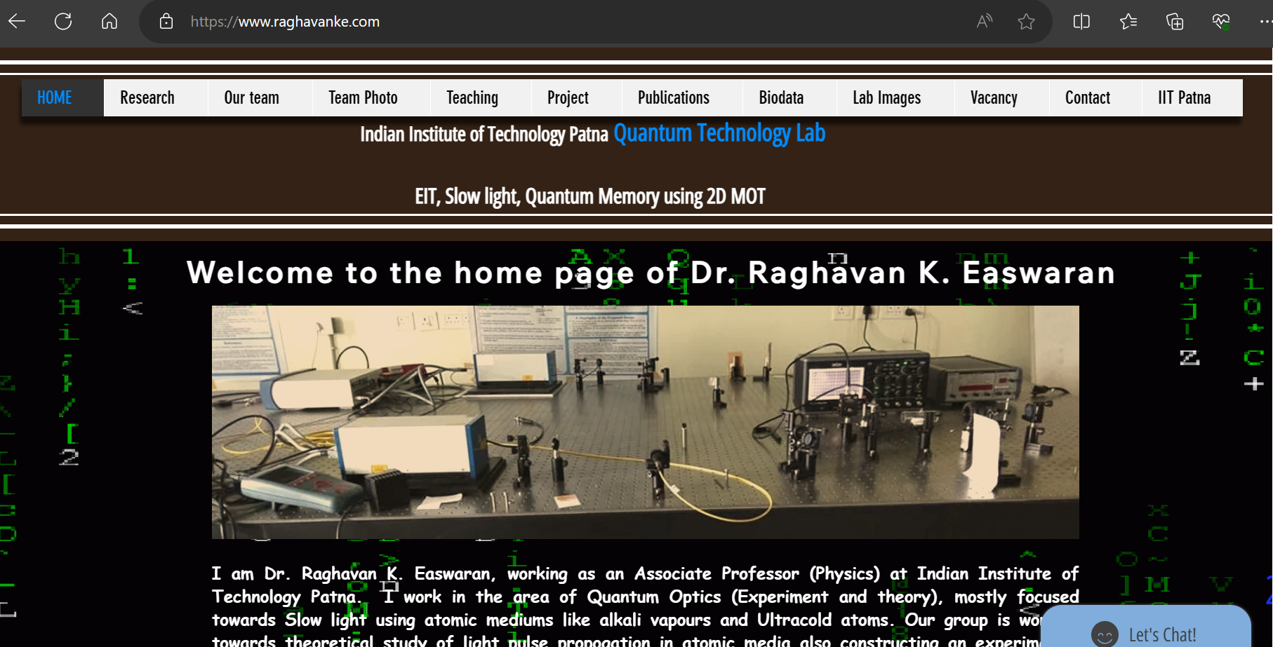

Slide 24
(84) Quantum Computers Animated - YouTube

