Slide 1
PH 603: Physics of Ultracold atoms
Lecture 3

Slide 2
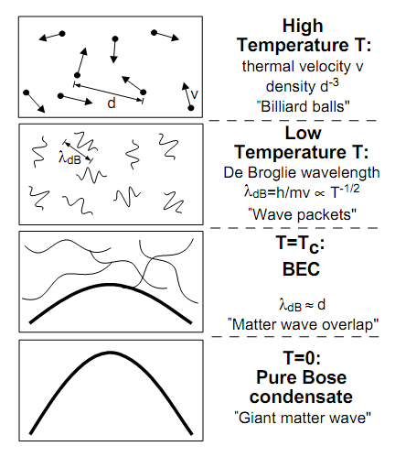
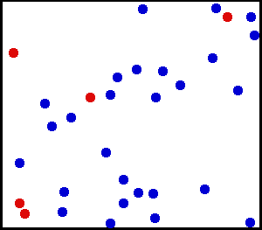
Kelvin
Celsius
300
26.8
Room Temperature
Water freezes
250
-23.2
200
-73.2
150
-123.2
100
-173.2
Air liquefies
50
-223.2
≈ 3K Deep space
0
-273.2
Absolute Zero
All motion stops
New state of Matter: Bose –Einstein Condensate
W.Ketterle, Cornell, C.Weimann, MIT
NOBEL PRIZE 2001
Laser Cooling and Evaporative cooling Technique

Slide 3
Cooling of atoms
v
v
LIGHT interacts with ATOMS
Radiation Pressure from Light
Atom
Stream of Photons

Slide 4
Explanation of Laser cooling using two level atom
and doppler effect
Laser cooling in 1-D
v
e
δ
ν_{L}- kv
ν_{L}+ kv
ν_{L}
ν_{o}
ν_{L}
g

Slide 5
Laser cooling in 3-D

