Slide 1
Thermal gas systems and leading modern engineering applications

Slide 2
Roll No. | Name | L1 | L2 | L3 | L4 | L5 | l6 | l7 | l8 | l9 | l10 | l11 | l12 | l13 | l14
2301PH01 | Aditya Chandra | p | P | p | p | P | p | a | p | a | p | a | p | p | a
2301PH02 | Aditya Mittal | p | P | a | p | P | p | p | p | a | a | a | p | a | a
2301PH03 | Aditya Prakash Gupta | p | P | p | p | P | p | p | p | p | a | p | p | a | p
2301PH04 | Amit Kumar | a | P | p | p | P | p | p | p | p | a | p | a | a | a
2301PH05 | Angaanba Ningthoujam | p | P | p | p | P | p | p | p | p | p | p | p | p | p
2301PH06 | Arunvishal Palanisamy | p | P | p | p | P | p | p | p | p | a | p | a | p | p
2301PH07 | Ashmit Verma | p | P | p | p | P | p | p | p | p | p | p | p | p | p
2301PH08 | Azariah Peter | a | A | p | p | P | p | p | p | a | p | a | p | p | p
2301PH09 | Deveshsingh Kuldeepsingh Tomar | p | P | p | p | P | p | c | c | c | c | c | c | c | c

Slide 3
 |  | L1 | L2 | L3 | L4 | l5 | l6 | l7 | l8 | l9 | l10 | l11 | l12 | l13 | l14
2301PH10 | Muskan Singh | p | P | a | p | P | p | p | p | p | p | p | p | p | p
2301PH11 | Naveen Saini | a | P | p | p | P | p | p | p | p | a | p | p | a | a
2301PH12 | Nishanth Kumaran | p | P | p | a | P | p | a | p | p | a | a | p | a | p
2301PH13 | Nived Krishna M | p | P | p | p | P | p | p | a | a | a | a | p | a | p
2301PH14 | Ratan Deep Prasad | p | P | p | p | P | p | p | p | a | a | a | p | p | p
2301PH15 | Ritesh | p | P | p | p | P | p | c | c | c | c | c | c | c | c
2301PH16 | Shivam Kumar Kannojia | p | P | p | p | P | p | p | a | a | p | a | p | p | p
2301PH17 | Shivang Rayat | p | P | p | p | P | p | p | p | p | p | p | p | a | p
2301PH18 | Yashraj Singh Thakur | p | P | p | p | P | p | p | a | p | p | p | p | a | p
2301PH19 | Aekampreet Singh Dhir | p | P | p | p | P | p | p | p | p | p | p | p | a | a
2301PH20 | Banoth Naveen | a | A | a | a | A | a | a | a | a | p | p | p | p | p

Slide 4
 |  | L1 | L2 | L3 | L4 | l5 | l6 | l7 | l8 | l9 | l10 | l11 | l12 | l13 | l14
2301PH21 | Neerati Pranay | p | P | p | p | P | p | p | p | a | p | a | p | p | p
2301PH22 | Tanish Dhankhar | p | P | p | p | P | p | p | p | p | a | a | p | a | a
2301PH23 | Farhan Farhan | p | P | p | a | P | p | p | p | p | a | p | a | a | p
2301PH24 | Utpal Raj Ambastha | p | P | p | p | P | p | p | p | p | p | p | p | p | p
2301PH25 | Riya Singh | p | P | p | p | P | p | p | p | p | p | a | p | p | p
2301PH26 | Aakarsh Sinha | a | P | p | p | P | p | c | c | c | c | c | c | c | c
2301PH27 | Rahul Katravath | a | A | p | p | P | p | p | p | p | a | p | p | a | p
2301PH28 | Shivani | p | P | p | p | P | p | p | p | p | p | p | p | p | p
2301PH29 | Rakesh Bairwa | p | P | a | p | P | p | p | p | p | a | p | p | a | a
2301PH30 | Nikhil Pratap Singh | a | P | p | p | P | p | p | p | p | p | p | p | p | p
2301PH31 | Sridutt Rugada | a | P | p | p | P | p | p | p | p | p | p | p | p | a
2301PH32 | Anmisha Jadi | p | P | p | p | P | p | p | p | p | p | a | a | p | p
Attendance: 75% mandatory

Slide 5
Thermal gas systems and modern cutting edge engineering technology
Lasers
Metrology: Precise measurement of Energy levels, Time and Frequency standards
Quantum Communication
High precision sensors
Quantum Computers

Slide 7
Engineering applications
Lasers
Metrology: Precise measurement of Energy levels, Time and Frequency standards
Quantum Communication
High precision sensors
Quantum Computers

Slide 11
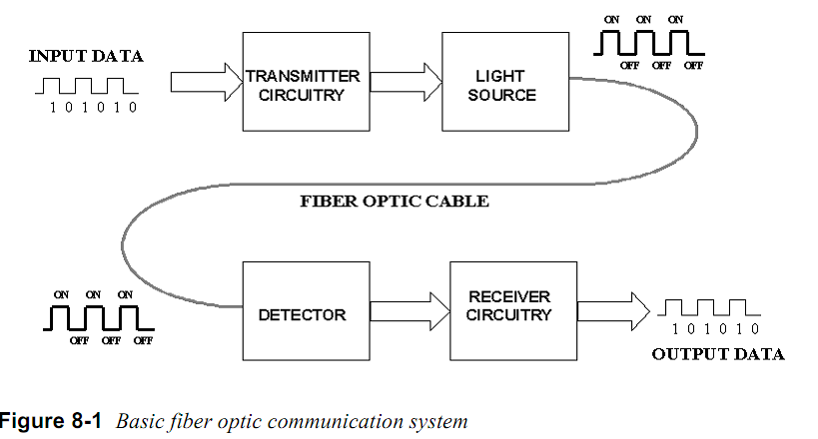
Basic optical communication

Slide 12
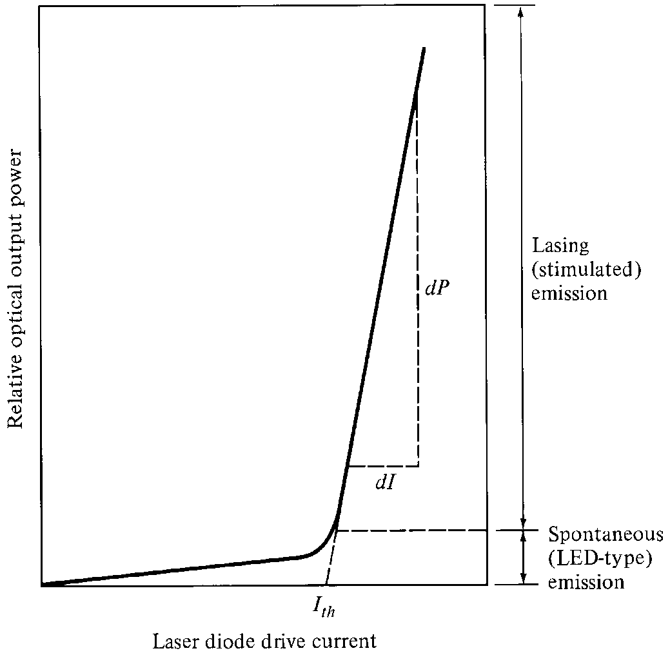
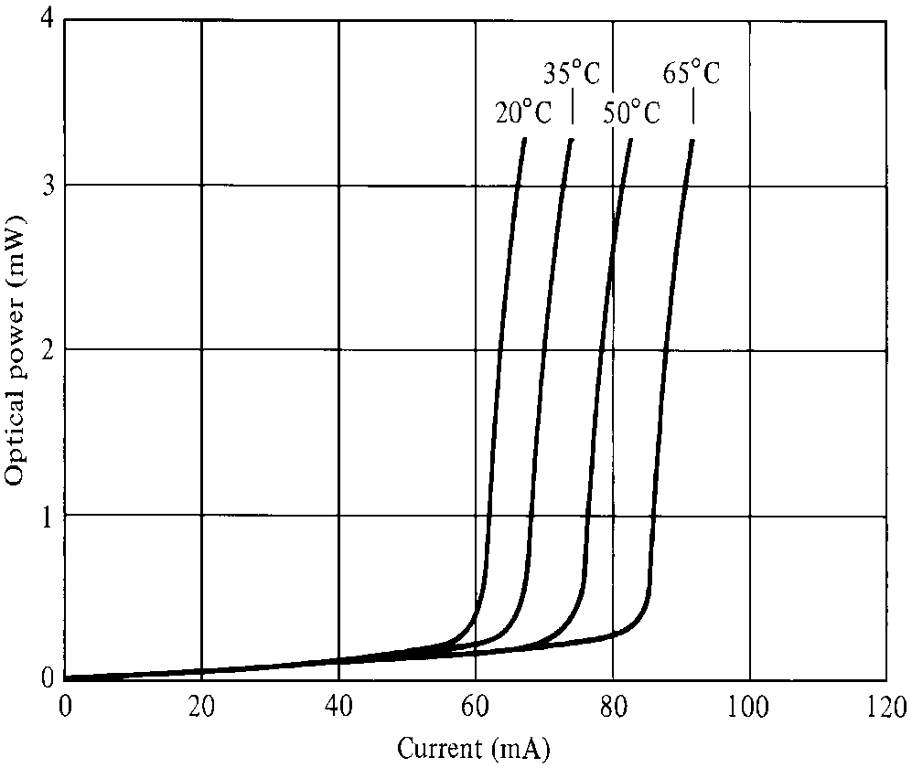
Laser Diode Characteristics
Very good for digital modulation

Slide 13
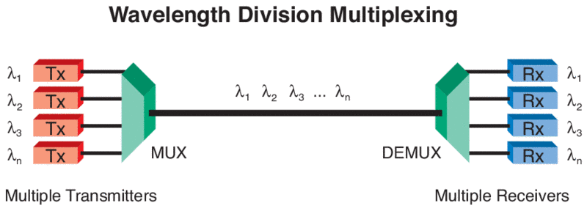
Wavelength Division Multiplexing and utilisation
For broad band communication

Slide 14
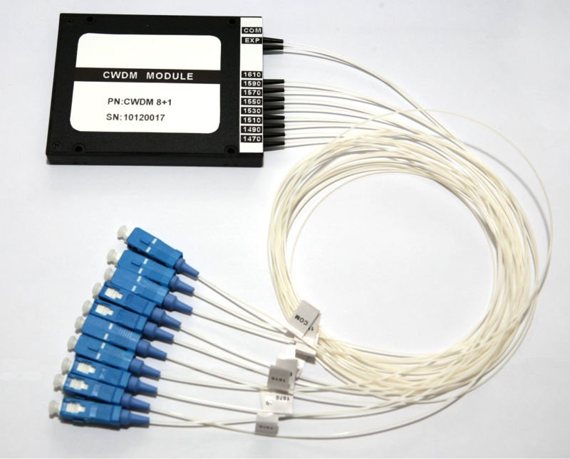
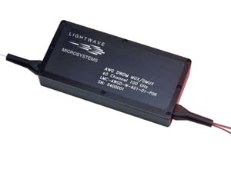
Wavelength Division MUX (Multiplexer)

Slide 15
Quantum Memory (QM)
Stationary QuBit
i.e QUANTUM MEMORY
(Eg an atom)
Flying QuBit
(photonic quantum state)
Flying QuBit
(photonic quantum state)
storage
read-out
LIGHT
(Quantum Information)
LIGHT
(Quantum Information)
ATOM + LIGHT
Dressed atomic and light quantum states
RESEARCH
WORK
EIT (Electromagnetically Induced Transparency)

Slide 16
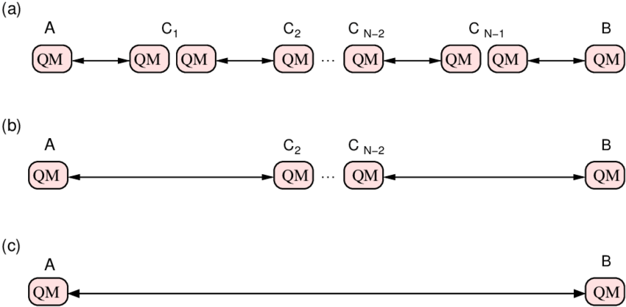

Slide 18
Interesting experiment by Prof. Ashkin and his team
Atom
Stream of Photons
Atoms got deflected by laser beam ………………………..HOW?
Effect was very directional

Slide 19
Resonances in systems
Simple Pendulum
Spring mass system
LCR Systems
ATOMIC SYSTEMS

Slide 20
Possibility of Cooling of atoms by Light?
v
v
LIGHT interacts with ATOMS
Radiation Pressure from Light
Atom
Stream of Photons

Slide 21
Model using 2 level system

Slide 22
Two level atom interacting with Light
Atom
Stream of Photons
What are the possible phenomena’s?
Stimulated Absorption
Stimulated Emission
Spontaneous Emission

Slide 23
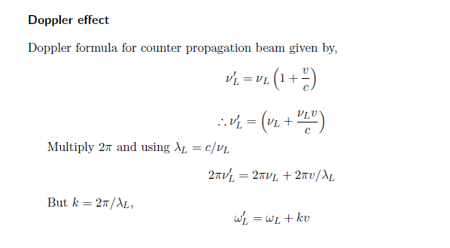
Doppler Effect

Slide 24
Doppler effect in radiation pressure
Laser cooling in 1-D
v
e
δ
ω_{L}- kv
ω_{L}+ kv
ω_{L}
ω_{o}
ω_{L}
g

Slide 25
Atoms decelerate

Slide 26
Laser cooling in 3-D

Slide 27
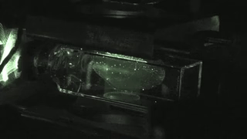

Slide 28
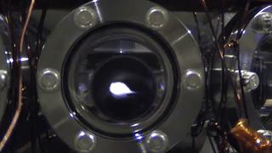

Slide 29
Ultracold atoms and BEC

Slide 30
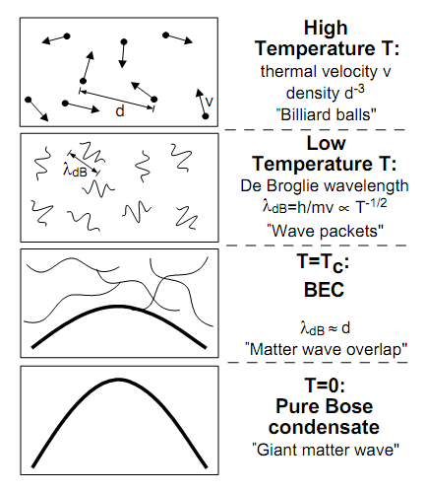
How Cold is Ultra Cold?
Kelvin
Celsius
300
26.8
Room Temperature
Water freezes
250
-23.2
200
-73.2
150
-123.2
100
-173.2
Air liquefies
50
-223.2
≈ 3K Deep space
0
-273.2
Absolute Zero
All motion stops
New state of Matter: Bose –Einstein Condensate
W.Ketterle, Cornell, C.Weimann, MIT
NOBEL PRIZE 2001
Laser Cooling and Evaporative cooling Technique

Slide 31
Realized in 1995 at MIT

Slide 32
Atomic cloud diffusion in Quantum Technology

Slide 33
v
v

Slide 35
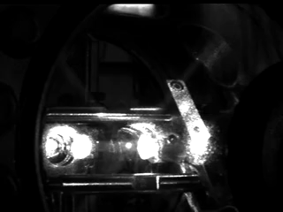

Slide 38
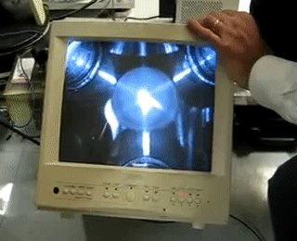

Slide 39
(84) Quantum Computers Animated - YouTube

