Slide 1
Highlights of the course
Co-ordinate Systems
Introduction to Vector Operators
Work , Energy and Conservation laws
Rigid body in motion
Oscillations and Waves
Quantum Physics

Slide 2
EULER’S EQUATION OF MOTION
RECAP OF GEOMETRICAL APPROACH

Slide 3
What is Euler’s Equation about?
Euler’s equation derivation- A geometrical approach
Euler’s equation derivation- A mathematical approach

Slide 4
What is Euler’s equation about?
COMPLETE ANALYSIS FOR STABILITY OF A RIGID BODY IN MOTION
SOLUTION OF EULER’S EQUATION GIVES WHETHER MOTION OF RIGID BODY IS BOUND OR UNBOUND
BOUND MOTION = STABLE
UNBOUND MOTION = UNSTABLE

Slide 5
A thought experiment! To understand and derive Euler equations
A GEOMETRICAL APPROACH…….
‘ROTATION OF A CYLINDER’

Slide 6
Another thought experiment!
Initial Conditions…
3
2
In the time interval Δt, the principal axes rotate away from the 1, 2, 3 axes.
1
What are the changes in angular momentum in 1,2 and 3 axis?
ΔL₁, ΔL₂ and ΔL₃?

Slide 7
ΔL₁ due to rotation along ‘1’ axis
3
2
1

Slide 8
ΔL₁ due to rotation along ‘2’ axis
3
2
1

Slide 9
ΔL₁ due to rotation along ‘2’ axis
L₃
L₂
This will not contribute!
L₁

Slide 10
ΔL₁ due to rotation along ‘3’ axis
3
2
1

Slide 11
ΔL₁ due to rotation along ‘3’ axis
L₃
L₂
This will not contribute!
L₁

Slide 12
Equation of motion of a Rigid body: Euler’s equation
3
Dividing by and taking the limit
2
1

Slide 13
Equation of motion of a Rigid body: Euler’s equation
3
2
1

Slide 14
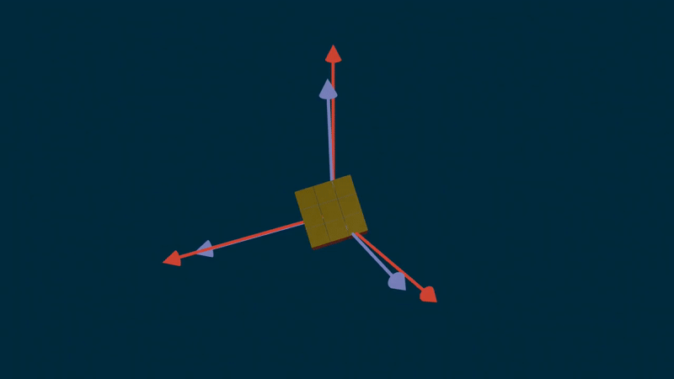

Slide 15
Equation of motion of a Rigid body: Euler’s equation
3
2
1
Euler’s Equations of rigid body motion

Slide 16
A MATHEMATICAL APPROACH!

Slide 17
Lab frame Vs Body frame
3
2
1

Slide 18
Euler’s equation: Mathematical approach
L₁ can change due to two reasons
Changes in the body frame (dotted line)
Rotation of the body relative to lab frame (bold line)
3
2
1

Slide 19
Euler’s equation: Mathematical approach

Slide 20
Euler’s equation: Mathematical approach

Slide 21
How Euler’s equations are related to stability?
APPLICATION
Will learn through some Examples………

Slide 22
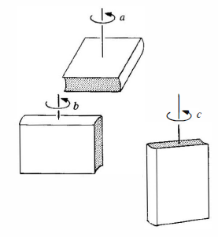
Example1
Stability of a book under rotation through its different axis
Guess which of the above configuration will be stable ??

Slide 23
Stable

Slide 24
Stable

Slide 25
unstable

Slide 26
Book under rotation….
Book is rotated in one of its axis by applying a torque and quickly released. Lets say it has
A small perturbation is given …..
Stability of motion is analyzed by
Applying Euler’s equation
Guess which of the above configuration will be stable ??

Slide 27
Stability of Rotational motion
1
2
3
Too small……
Since equations 2 and 3 are coupled, we take second derivative of eqn 2 to get equation
of motion

Slide 28
Stability of Rotational motion
Stable
Unstable
Stable
I₁ is largest or smallest
UnStable
I₁ is intermediate
Bound (stable)
Unbound (unstable)

Slide 29
Stable

Slide 30
Stable

Slide 31
unstable

Slide 32
Summary of Euler’s Equation
COMPLETE ANALYSIS FOR STABILITY OF A RIGID BODY IN MOTION
SOLUTION OF EULER’S EQUATIONS GIVES WHETHER MOTION OF RIGID BODY IS BOUND OR UNBOUND
BOUND MOTION = STABLE
UNBOUND MOTION = UNSTABLE
STABILITY ANALYSIS FROM EULER’S EQUATIONS ARE VALID FOR SMALL PERTURBATIONS ONLY
Small and negligible
Bound (stable)
Unbound (unstable)

