Slide 1
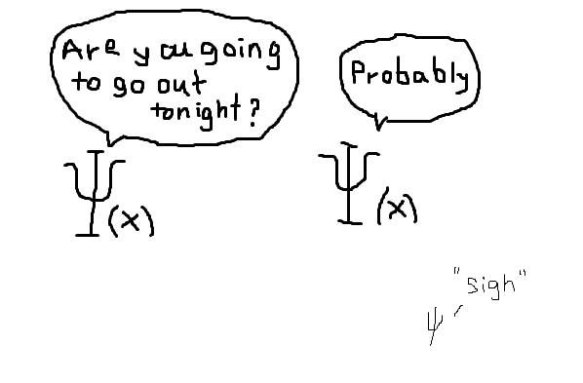
The Final Touch
Quantum Physics

Slide 2
1D Harmonic Oscillator
A short Recap

Slide 3
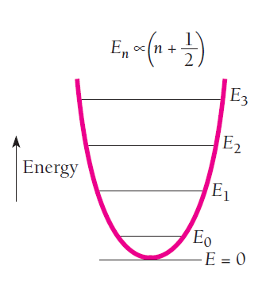

Slide 4
One highly sophisticated application of Harmonic Oscillator, I had worked during my PhD and Research Scientist days.. …..

Slide 5
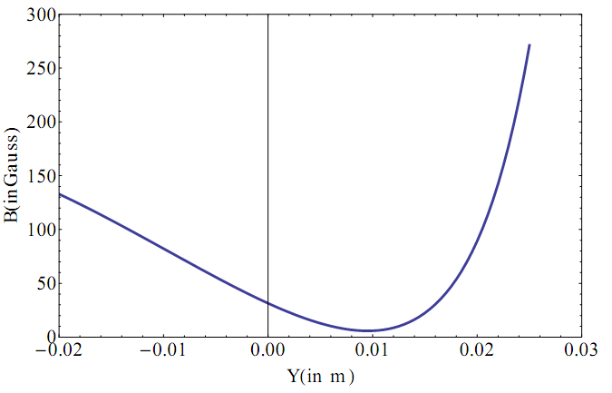
Magnetic trap for atoms?

Slide 7
Quantized levels start appearing…
Once atoms become quantum particle….

Slide 8
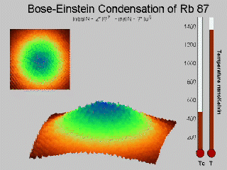
Till how much you do evaporation?

Slide 9
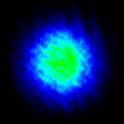
Quantum degeneracy
BEC

Slide 10
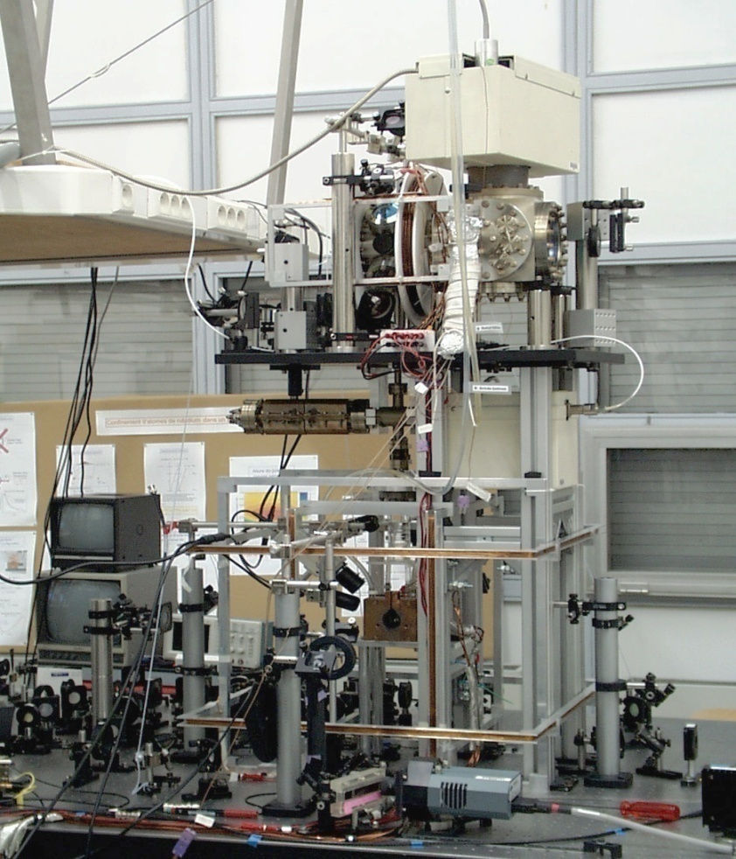
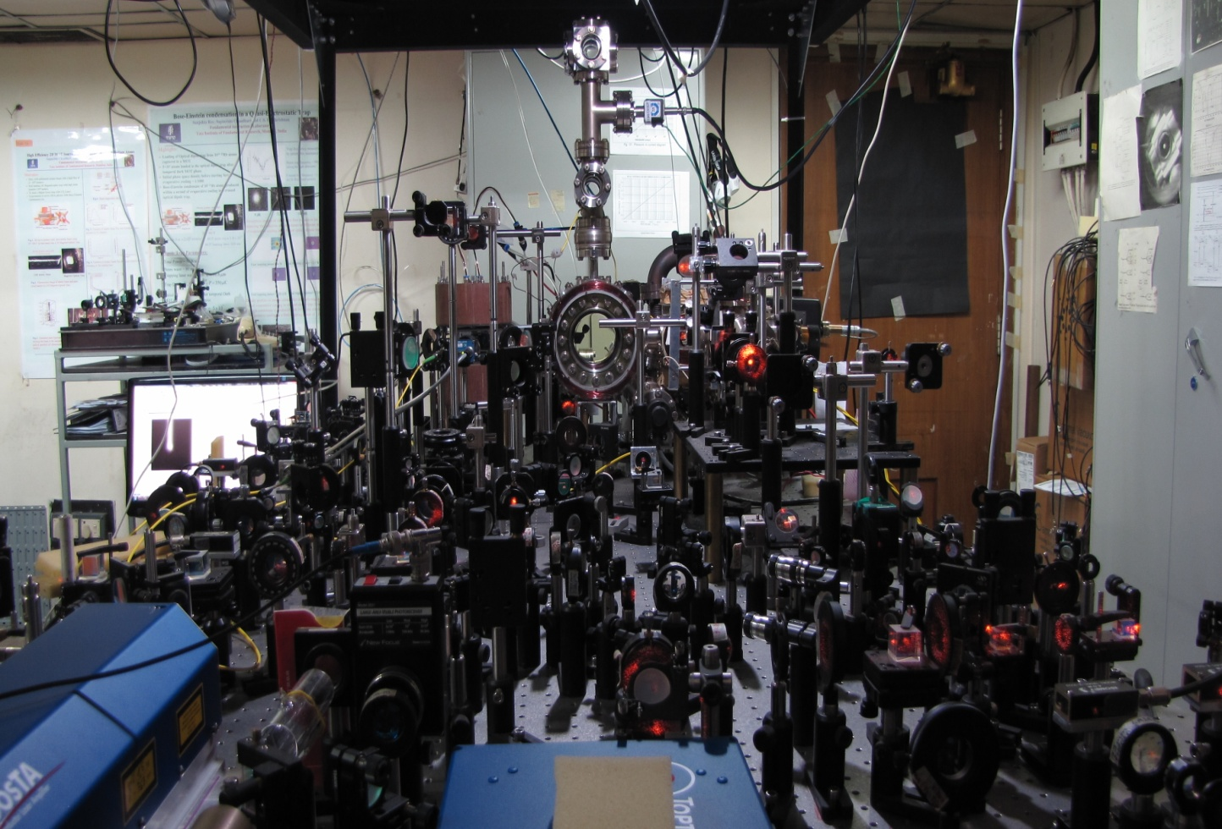
Experimental set ups I worked during my PhD and Research
Scientist days….(2004-2014)
@ Paris, France, @Univ of Nottingham

Slide 11
Captured from some real experiments….

Slide 12
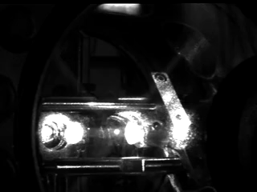

Slide 13
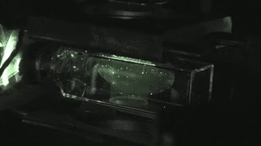

Slide 14
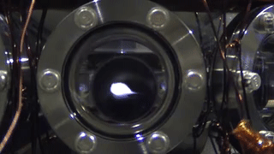

Slide 15
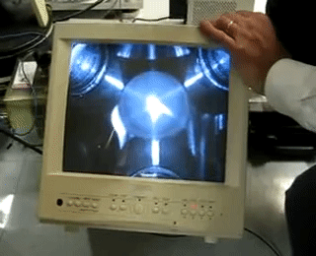

Slide 16
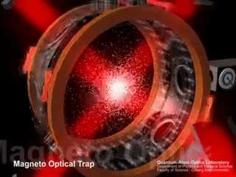

Slide 17
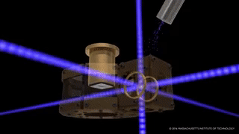

Slide 18
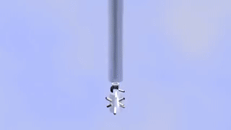

Slide 19
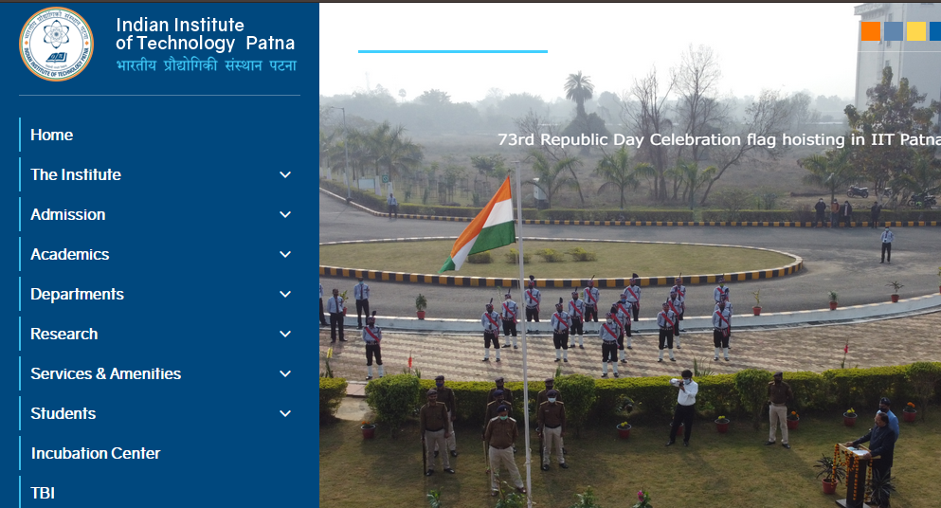
What I do at IIT Patna?

Slide 20
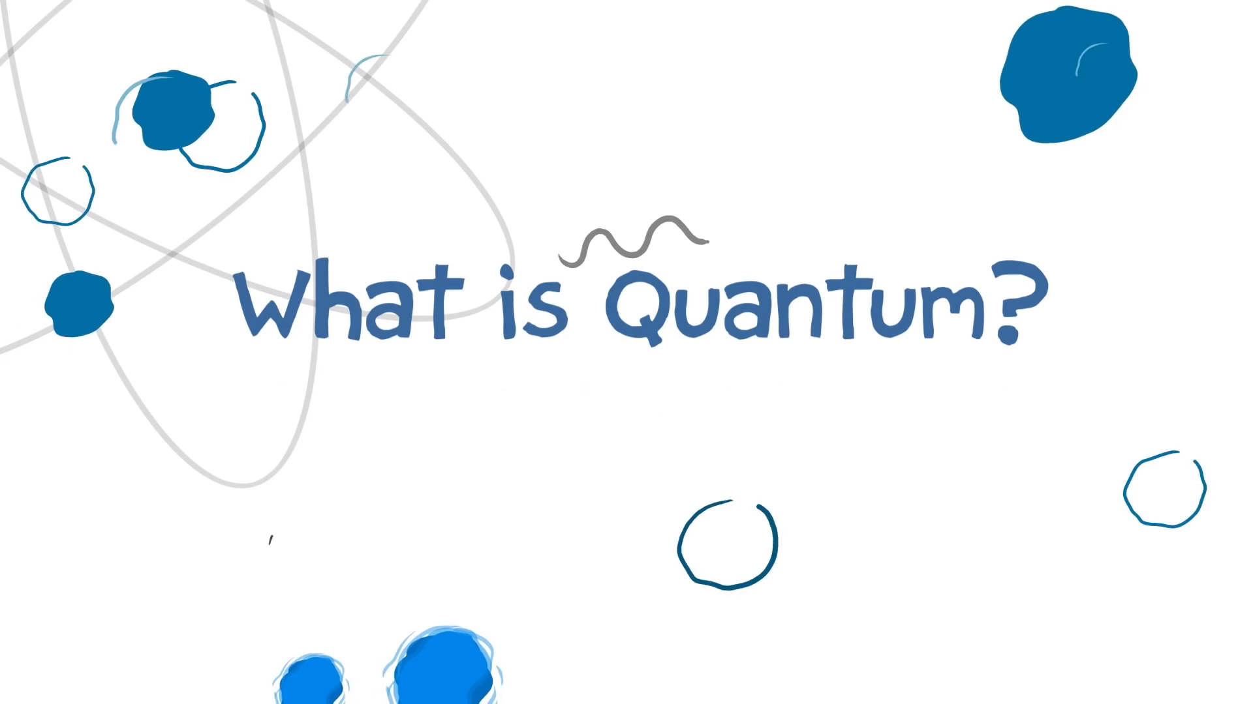

Slide 21
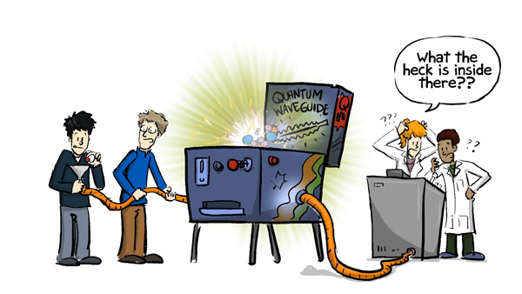
What I do?

Slide 22
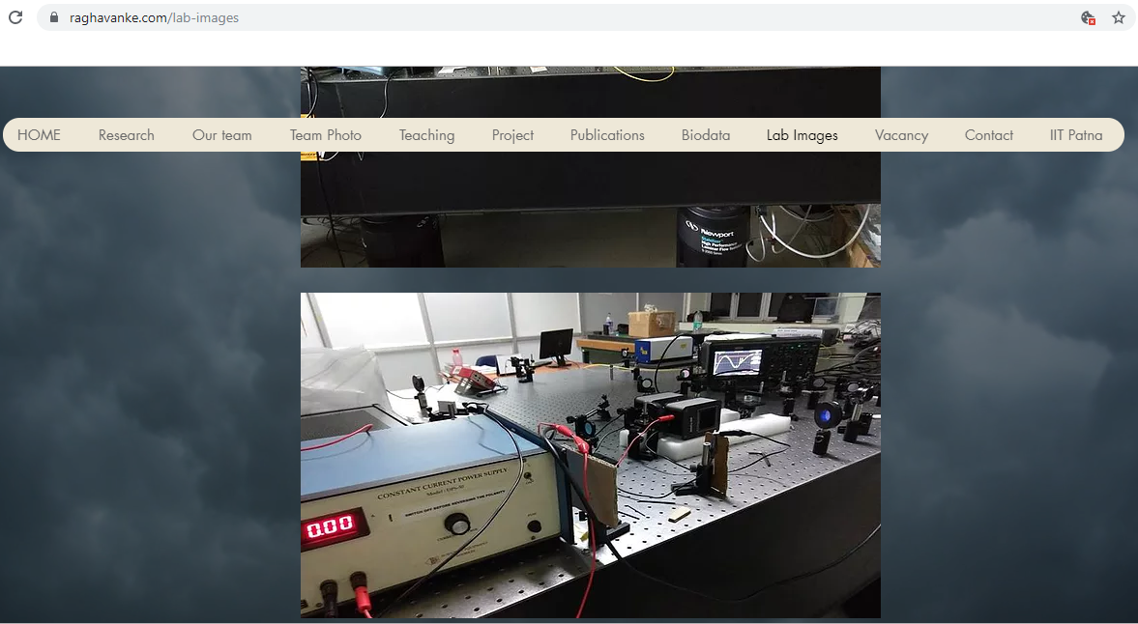
Quantum Physics
Applications every where….
Slow Light, Quantum Optics, Quantum Information in my group at IIT Patna… Block 4, Ground floor Optics1 lab

Slide 24
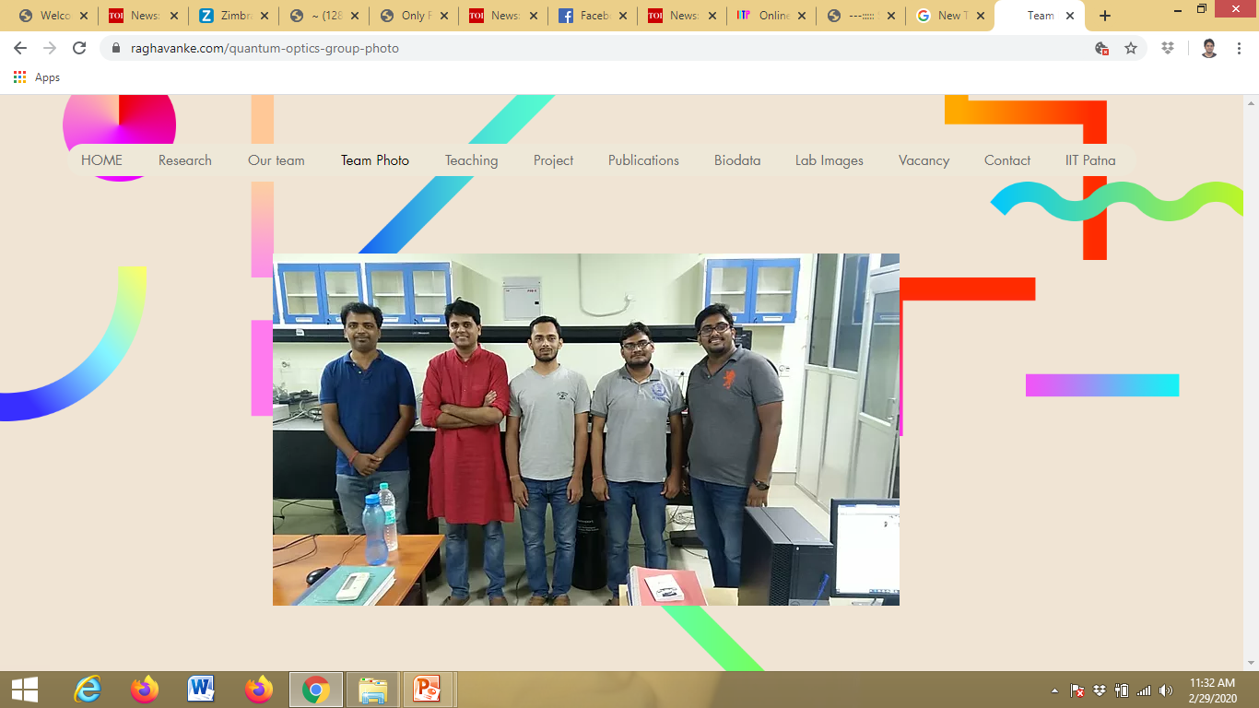
3 PhD’s on going…..
Currently Post Doc @
National Institute of Standards and Technology (NIST)
Maryland
USA
Sumit Bhushan
Vikas – Working @ IMS Japan

Slide 25
Vision: Quantum Technology
Quantum Memory, Slow Light, EIT, Broad Band EIT etc

Slide 26
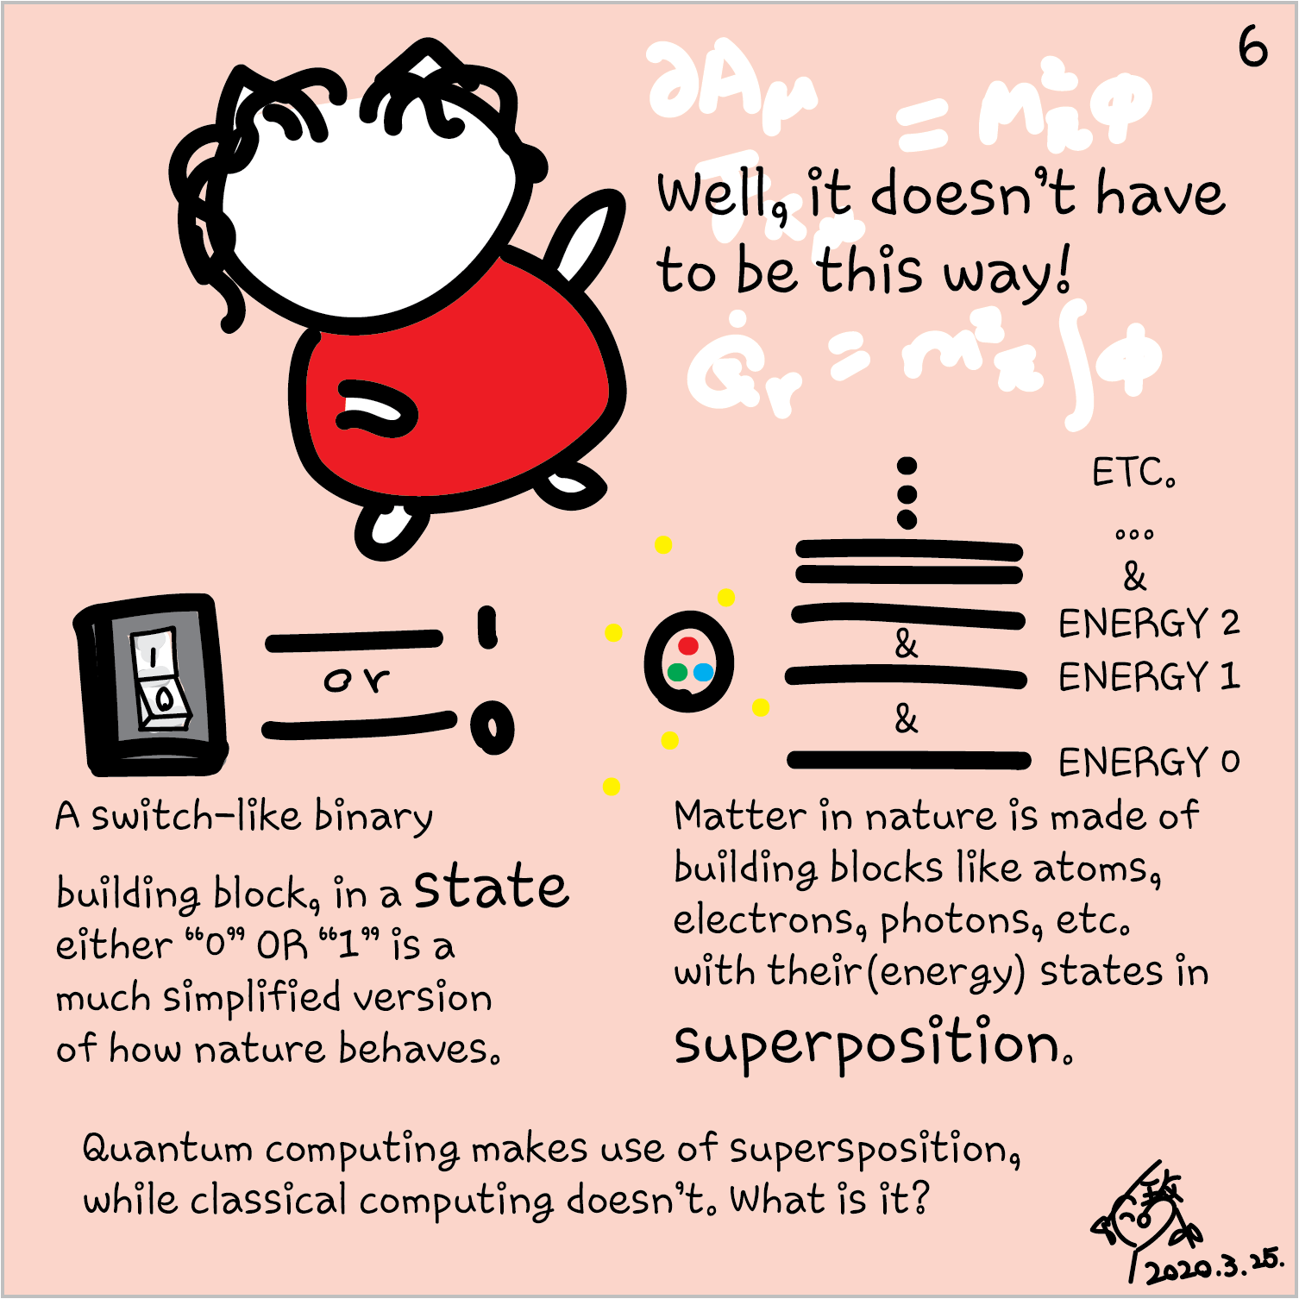

Slide 27
Quantum Memory (QM)
Stationary QuBit
i.e QUANTUM MEMORY
(Eg an atom)
Flying QuBit
(photonic quantum state)
Flying QuBit
(photonic quantum state)
storage
read-out
LIGHT
(Quantum Information)
LIGHT
(Quantum Information)
ATOM + LIGHT
Dressed atomic and light quantum states
RESEARCH
WORK
EIT (Electromagnetically Induced Transparency)

Slide 28
Rb atoms
Input
Pulse
Alkali atomic gas

Slide 29
Rb atoms

Slide 30
Slow Light
Store the information
Quantum Memory

Slide 31
Rb atoms
Retrieved
Pulse
Hau et al. Nature, 397, 594-598, (1999)

Slide 32
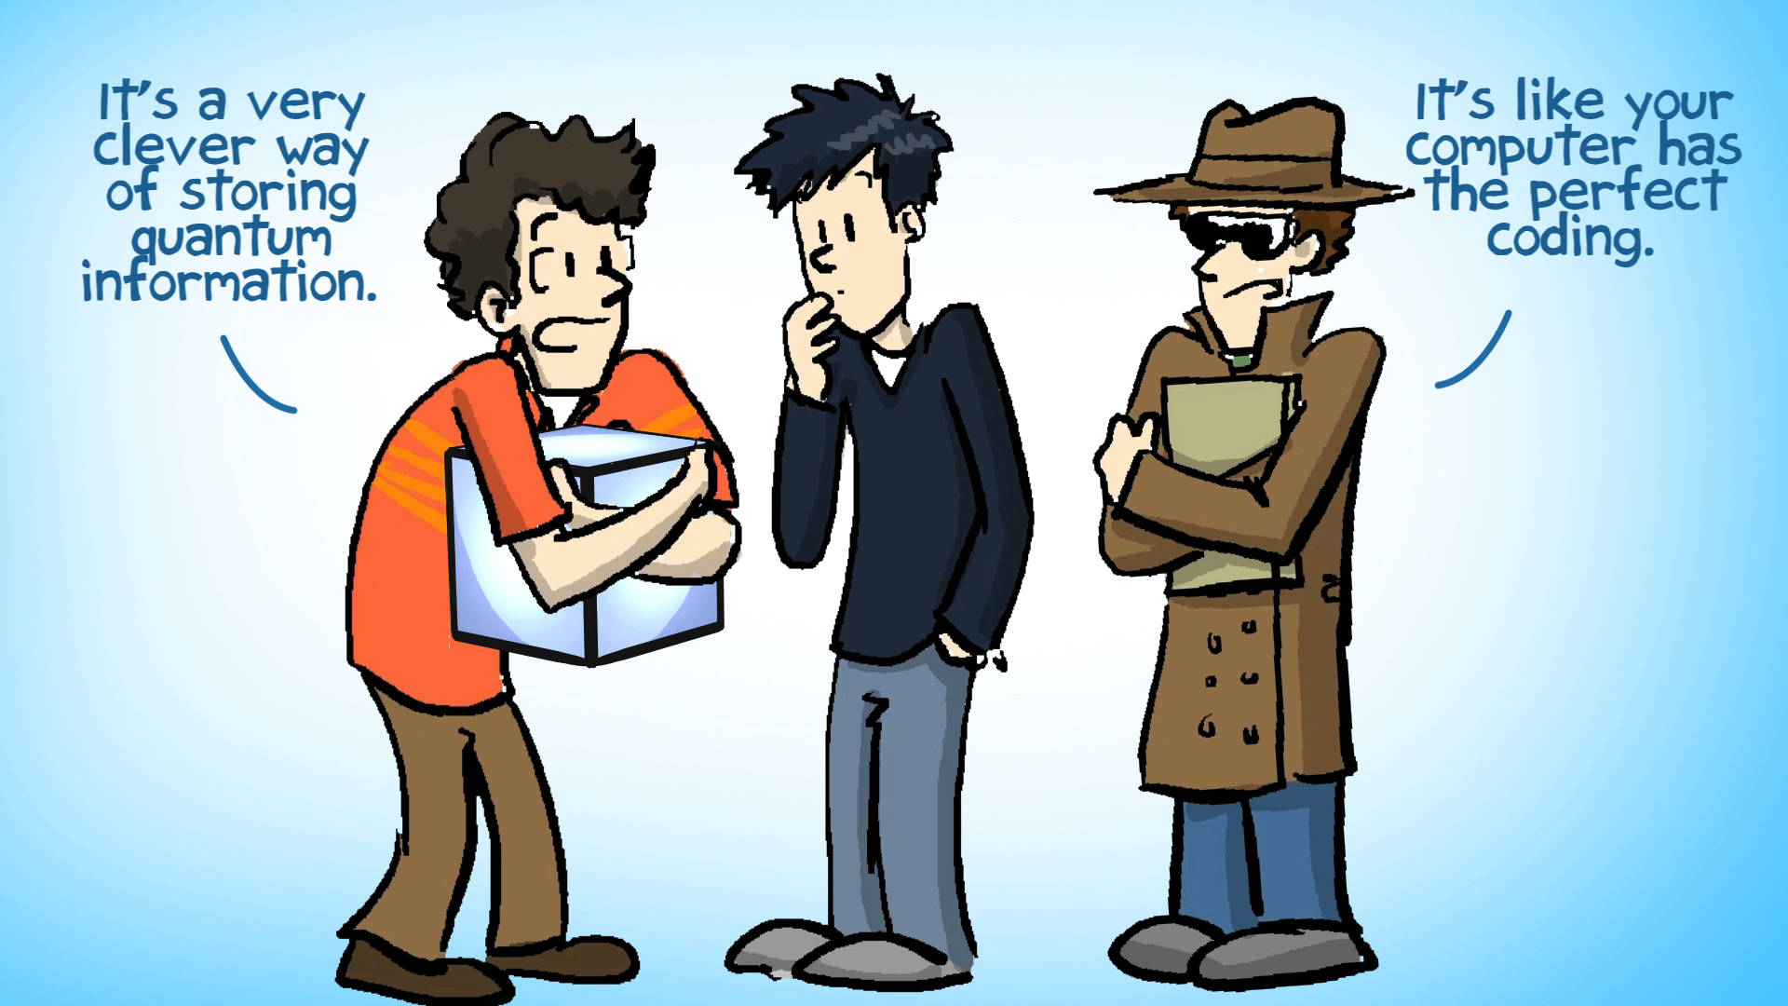

Slide 33
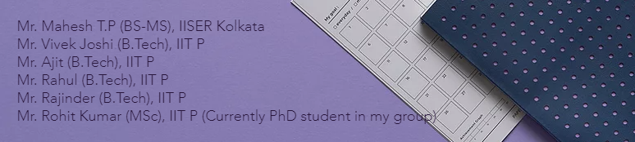
Research Internships

Slide 34
Ending with a Quote……

Slide 35

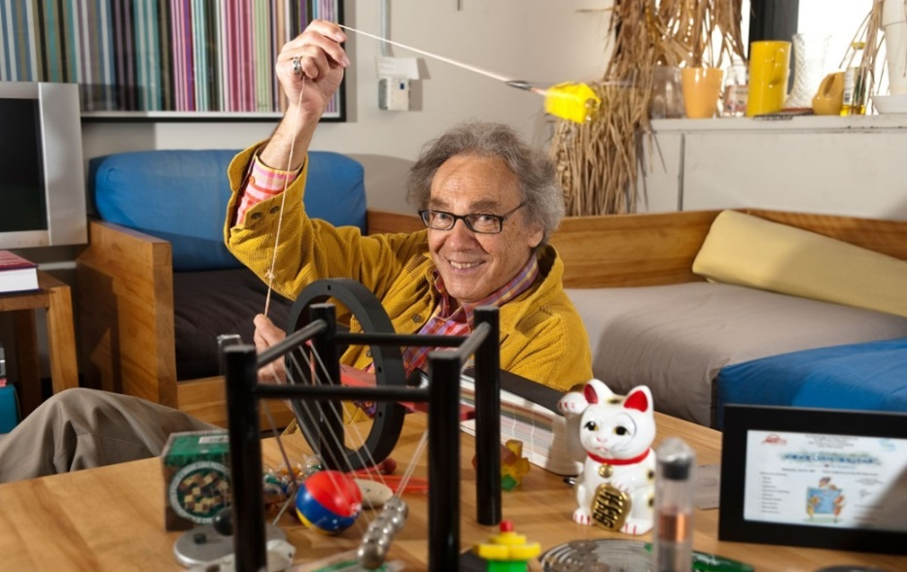
“What counts, I found, is not what you “cover”, in a class, but what you “uncover”
covering subjects in a class can be a boring exercise, and students feel it
uncovering the laws of physics and making them see through the equations, with all its newness and excitement, and students love being part of it.”
― Dr. Walter Lewin, Professor, MIT, USA
Good Luck, All the best!

