Slide 1
RIGID BODY IN MOTION
Chapter 4

Slide 2
Is Moment of Inertia a Scalar? Vector?
Or …. ????
Tensor

Slide 3
Tensor
Tensor represents a physical entity which may be characterized by magnitude and multiple directions simultaneously.
The rank of a tensor is defined by the number of directionality required to describe a component of it.

Slide 4
Tensor
The rank of a tensor is defined by the number of directionality required to describe a component of it.
Temperature, Mass, Potential
‘0’
SCALAR
VECTOR
Force, Velocity, Torque
‘1’

Slide 5
Tensor
Moment of Inertia
‘2’
Torque applied in a given direction need not guarantee angular acceleration also in same direction, rather it can have components in 2 other direction’s simultaneously as well. This is due to coupling between two directions ( example X-Y, X-Z ……etc). This coupling is induced via Moment of Inertia Tensor
The rank of a tensor is defined by the number of directionality required to describe a component of it.
Rank 2 Tensor represents a physical entity which may be characterized by magnitude and bi-directionality.

Slide 6
Rank of a tensor
0 | Scalar
1 | Vector
2 | Tensor of rank 2 (Dyadic)
Higher orders | Higher rank tensors

Slide 7
Note!
Whenever ω is parallel to L, choosing the corresponding direction of rotation as co-ordinate axis will be the principal axes.

Slide 8
Principal Axis
Cumbersome!
Principal axes are the orthogonal axes for
Which [I] is diagonal
Z
X
Y

Slide 9
How to find principal axis????
For simple geometries it is easy to find by intuition but not for any general case
How to find diagonalized MI tensor??
Mathematical approach!

Slide 10
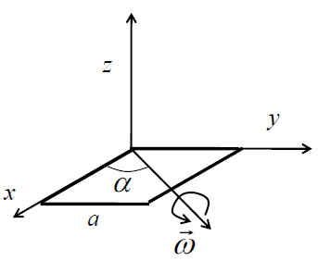
How to find principal axis????
We can write like that when L and ω are parallel

Slide 11
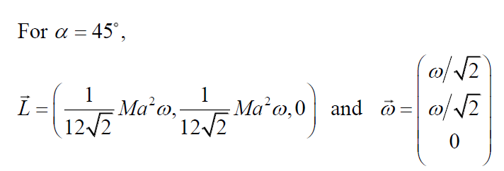
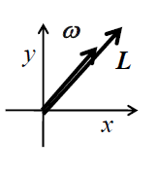
Rotation of a square plate
(b) For what angle L and ω becomes parallel?

Slide 12
Rotation of a square plate
(b) For what angle L and ω becomes parallel?

Slide 13
How to find principal axis????
Unknowns
Step: 1
Find the axis of rotation where L and ω are parallel.
WE IMPOSE THE CONDITION, TO MAKE L AND ω PARALLEL
Find the unknowns ω and λ

Slide 14
How to find principal axis????
Finding the unknowns ω and λ & by Diagonalization of Moment of Inertia Tensor I, we will get the
Full information of Principle axis
THIS WILL BE CLEAR LATER IN AN EXAMPLE

Slide 15
How to find principal axis????
Unknowns
Insert a unit matrix

Slide 16
How to find principal axis????
Insert a unit matrix

Slide 17
How to find principal axis????
Theorem: If [A][x]=0, then [A] is non-invertible. This implies A⁻¹ does not exist
Hence, |A|=0.

Slide 18
How to find principal axis????
Characteristic Equation

Slide 19
How to find principal axis????
Solving characteristic equation result in
λ_{1,} λ₂, λ_{3.}
Substitute
λ_{1,} λ₂, λ₃ separately and solve for ωs

Slide 20
Note!
λ_{1,} λ₂, λ₃ are called the Eigen values which satisfies the equation
[ω]’s are called the Eigen vectors.
For each Eigen values, Eigen vector can be found.

Slide 21
Step2: How to find diagonalized MI tensor??
Whenever ω is parallel to L, choosing the corresponding direction of rotation as co-ordinate axis will be the principal axes
Z
X
By writing eigen values as diagonal elements chooses Moment of Inertia matrix
corresponding to a co-ordinate axis as its rotation axis

Slide 22
Step2: How to find diagonalized MI tensor??
Following Diagonalization Theorem,
Diagonalization ensures the rotation axis is along the coordinate axis (Principal axis)
(Will be taught in MA102)

