Slide 1
L16
Effusion, Laws of Thermodynamics and Engineering application Problems

Slide 2
Kinetic Theory of Gases, Maxwell-Boltzmann distribution, effusion, collision, equation of state, ideal gas, Equipartition of energy, real gas; Thermal Diffusion Equation; Modern cutting edge applications using gas systems (Lasers, Quantum gas, cold gas its applications in engineering);
Laws of Thermodynamics, Temperature, Internal Energy, specific heat, Entropy; Carnot engine, Various thermodynamic cycles; Thermodynamic potentials, Path and State Functions, Gibb’s-Duhem relations, Maxwell Relations;
Clausius-Clapeyron Equation; Chemical Potential, Chemical Equilibrium, Phase Diagram, Gibb’s Phase Rule, Phase Transitions, Stable and Metastable States, Phase Co-existence, Maxwell’s Construction; Various modes of heat transfer; Saha-Ionization; Speed of Sound in Fluids, Shock Waves, Rankine-Hugoniot Conditions.
Engineering applications -Heat Engines, Joule-Thompson effect and applications to cryogenics, Refrigerators, Heating-Ventilation and Air-conditioning (HVAC), Exergy analysis of engineering systems, Information Theory.
Textbooks:
1. R. H. Dittman and M. W. Zemansky, Heat and Thermodynamics, McGraw-Hill College; Subsequent Ed, 1996.
2. Y. A. Cengel, M. A. Boles and M. Kanoglu, Thermodynamics: An Engineering Approach, 9th ed., McGraw Hill, 2019
3. A. F. Rex and C. B. P. Finn, Finn’s Thermal Physics, 4th ed., CRC Press, 2024
References:
Stephen J. Blundell and Katherine M. Blundell, Concepts in Thermal Physics. 3rd ed., Oxford University Press, 2014.
2. C. Kittel, H. Kroemer and W. H. Freeman, Thermal Physics, 2nd ed., 2012

Slide 3
Roll No. | Name | L1 | L2 | L3 | L4 | L5 | l6 | l7 | l8 | l9 | l10 | l11 | l12 | l13 | l14 | l15 | l16
2301PH01 | Aditya Chandra | p | P | p | p | P | p | a | p | a | p | a | p | p | a | p | a
2301PH02 | Aditya Mittal | p | P | a | p | P | p | p | p | a | a | a | p | a | a | p | a
2301PH03 | Aditya Prakash Gupta | p | P | p | p | P | p | p | p | p | a | p | p | a | p | p | a
2301PH04 | Amit Kumar | a | P | p | p | P | p | p | p | p | a | p | a | p | a | p | p
2301PH05 | Angaanba Ningthoujam | p | P | p | p | P | p | p | p | p | p | p | p | p | p | p | a
2301PH06 | Arunvishal Palanisamy | p | P | p | p | P | p | p | p | p | a | p | a | p | p | p | p
2301PH07 | Ashmit Verma | p | P | p | p | P | p | p | p | p | p | p | p | p | p | p | p
2301PH08 | Azariah Peter | a | A | p | p | P | p | p | p | a | p | a | p | p | p | p | a
2301PH09 | Deveshsingh Kuldeepsingh Tomar | p | P | p | p | P | p | c | c | c | c | c | c | c | c | c | c

Slide 4
 |  | L1 | L2 | L3 | L4 | l5 | l6 | l7 | l8 | l9 | l10 | l11 | l12 | l13 | l14 | l15 | l16
2301PH10 | Muskan Singh | p | P | a | p | P | p | p | p | p | p | p | p | p | p | p | p
2301PH11 | Naveen Saini | a | P | p | p | P | p | p | p | p | a | p | p | p | a | p | p
2301PH12 | Nishanth Kumaran | p | P | p | a | P | p | a | p | p | a | a | p | a | p | p | a
2301PH13 | Nived Krishna M | p | P | p | p | P | p | p | a | a | a | a | p | a | p | p | p
2301PH14 | Ratan Deep Prasad | p | P | p | p | P | p | p | p | a | a | a | p | p | p | p | a
2301PH15 | Ritesh | p | P | p | p | P | p | c | c | c | c | c | c | c | c | c | c
2301PH16 | Shivam Kumar Kannojia | p | P | p | p | P | p | p | a | a | p | a | p | p | p | p | a
2301PH17 | Shivang Rayat | p | P | p | p | P | p | p | p | p | p | p | p | a | p | p | a
2301PH18 | Yashraj Singh Thakur | p | P | p | p | P | p | p | a | p | p | p | p | a | p | p | a
2301PH19 | Aekampreet Singh Dhir | p | P | p | p | P | p | p | p | p | p | p | p | a | a | p | p
2301PH20 | Banoth Naveen | a | A | a | a | A | a | a | a | a | p | p | p | p | p | a | a

Slide 5
 |  | L1 | L2 | L3 | L4 | l5 | l6 | l7 | l8 | l9 | l10 | l11 | l12 | l13 | l14 | l15 | l16
2301PH21 | Neerati Pranay | p | P | p | p | P | p | p | p | a | p | a | p | p | p | p | p
2301PH22 | Tanish Dhankhar | p | P | p | p | P | p | p | p | p | a | a | p | a | a | p | a
2301PH23 | Farhan Farhan | p | P | p | a | P | p | p | p | p | a | p | a | a | p | p | p
2301PH24 | Utpal Raj Ambastha | p | P | p | p | P | p | p | p | p | p | p | p | p | p | p | p
2301PH25 | Riya Singh | p | P | p | p | P | p | p | p | p | p | a | p | p | p | p | p
2301PH26 | Aakarsh Sinha | a | P | p | p | P | p | c | c | c | c | c | c | c | c | c | c
2301PH27 | Rahul Katravath | a | A | p | p | P | p | p | p | p | a | p | p | a | p | p | p
2301PH28 | Shivani | p | P | p | p | P | p | p | p | p | p | p | p | p | p | p | p
2301PH29 | Rakesh Bairwa | p | P | a | p | P | p | p | p | p | a | p | p | p | a | p | p
2301PH30 | Nikhil Pratap Singh | a | P | p | p | P | p | p | p | p | p | p | p | p | p | p | p
2301PH31 | Sridutt Rugada | a | P | p | p | P | p | p | p | p | p | p | p | p | a | p | p
2301PH32 | Anmisha Jadi | p | P | p | p | P | p | p | p | p | p | a | a | p | p | p | p
Attendance: 75% mandatory

Slide 6
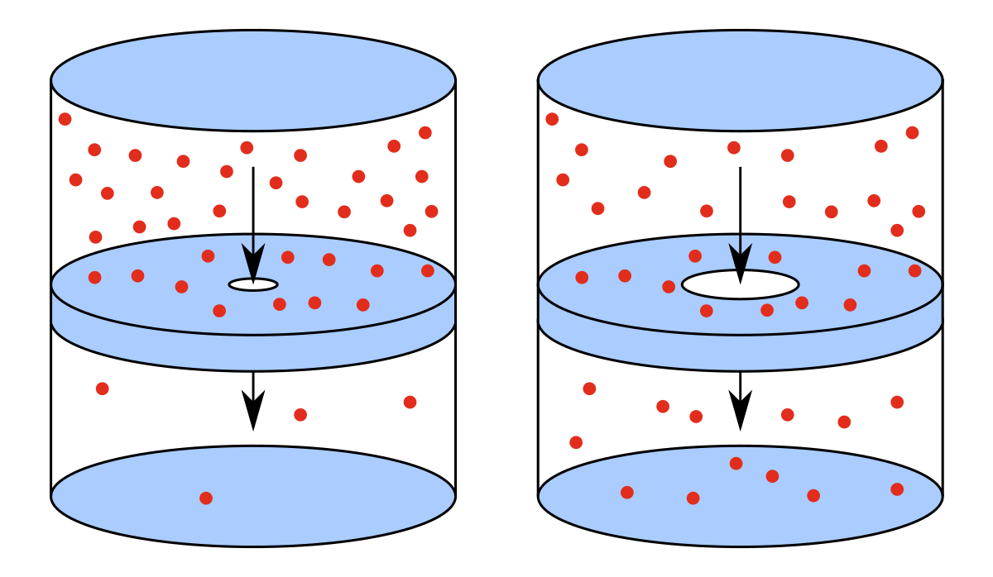
Effusion
Effusion
Diffusion
Effusion occurs through an orifice smaller than the mean free path of the particles in motion

Slide 7
Effusion
Effusion
Effusion occurs through an orifice smaller than the mean free path of the particles in motion

Slide 8
Gas in left chamber is under equilibrium

Slide 9
To maintain gas in left chamber is under equilibrium
Ensures little or no collisions near the opening hence the equilibrium is maintained

Slide 10
Equilibrium is not disturbed
Under the above condition escape of molecules through hole is called as EFFUSION
OR
EFFUSION occurs through an orifice smaller than the mean free path of the particles in motion

Slide 11
Introduction to Thermodynamics
A revision

Slide 12
Macroscopic approach
Does not probe system at molecular level
Thermodynamic variables P,V,T etc
System and rest of universe (reservoir: Infinite heat capacity)
System is separated by a wall

Slide 13
Zeroth Law of Thermodynamics
R. H. Fowler :1931

Slide 14
Statement
If two systems are in thermal equilibrium with a third system then those two are in thermal equilibrium with each other
A
B

Slide 15
Statement
If two systems are in thermal equilibrium with a third system then those two are in thermal equilibrium with each other
B
C

Slide 16
Statement
If two systems are in thermal equilibrium with a third system then those two are in thermal equilibrium with each other
A
C

Slide 17
Statement
Same Temperature
A
C

Slide 18
Statement
No Heat Flow
A
C

Slide 19
B
DIATHERMIC (CONDUCTING)
A
ADIABATIC
(NON
CONDUCTING)
C

Slide 20
B
ADIABATIC
A
DIATHERMIC (CONDUCTING)
C
No heat flow

Slide 21
First Law of Thermodynamics
Law of Conservation of Energy

Slide 22
First Law of Thermodynamics
Law of Conservation of Energy

Slide 23
Statement
Energy is conserved and heat and work are both forms of energy.

Slide 24
“Application engineering” problems
(First Law)
Practice problems

Slide 25
1. “Electric heater + Piston cylinder”

Slide 26
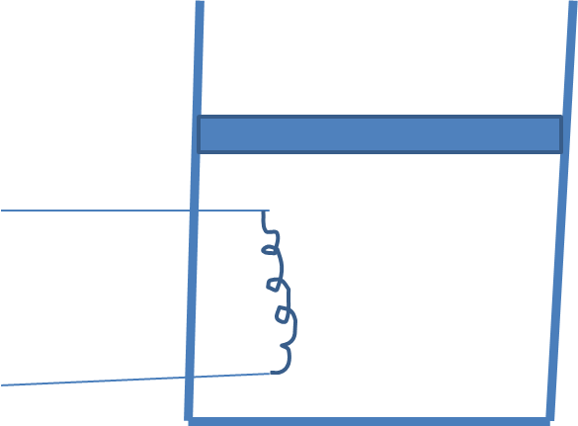

Slide 31
100 kPa

Slide 32
a) Only the air
100 kPa

Slide 33
100 kPa

Slide 34
b) Air and the Piston
100 kPa

Slide 35
$$A gas is contained in a frictionless piston \\ cylinder mechanism at an initial pressure of 1 bar. \\ The diameter of the piston is 10 cm and it rests \\ on stops initially as shown in the figure. The \\ piston weight is such that it requires a pressure \\ of 1.5 bar to be lifted from the stops. The gas is \\ now heated which causes the piston to rise slowly. \\ After a rise of 10cm, the piston touches a linear \\ spring with a stiffness value of 10 N/mm. The \\ heating of the gas is finally stopped when the \\ spring is compressed by 1cm. Determine the \\ work interaction for the gas, piston, spring and \\ the atmosphere. Also sketch the \\ process undergone by the gas on a p−V diagram \\ by mentioning the values of pressure and volumes in different stages$$
Wherever possible$and show the four work interactions mentioned$ $$above by hatching the appropriate areas.$$
stops

Slide 36
$$A gas is contained in a frictionless piston \\ cylinder mechanism at an initial pressure of 1 bar. \\ The diameter of the piston is 10 cm and it rests \\ on stops initially as shown in the figure. The \\ piston weight is such that it requires a pressure \\ of 1.5 bar to be lifted from the stops. The gas is \\ now heated which causes the piston to rise slowly. \\ After a rise of 10cm, the piston touches a linear \\ spring with a stiffness value of 10 N/mm. The \\ heating of the gas is finally stopped when the \\ spring is compressed by 1cm. Determine the \\ work interaction for the gas, piston, spring and \\ the atmosphere. Also sketch the \\ process undergone by the gas on a p−V diagram \\ by mentioning the values of pressure and volumes in different stages$$
Wherever possible$and show the four work interactions mentioned$ $$above by hatching the appropriate areas.$$
stops

Slide 37
stops

Slide 40
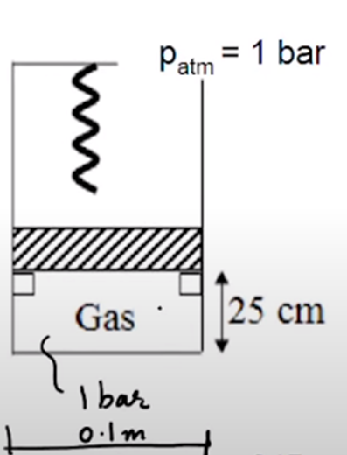

Slide 45
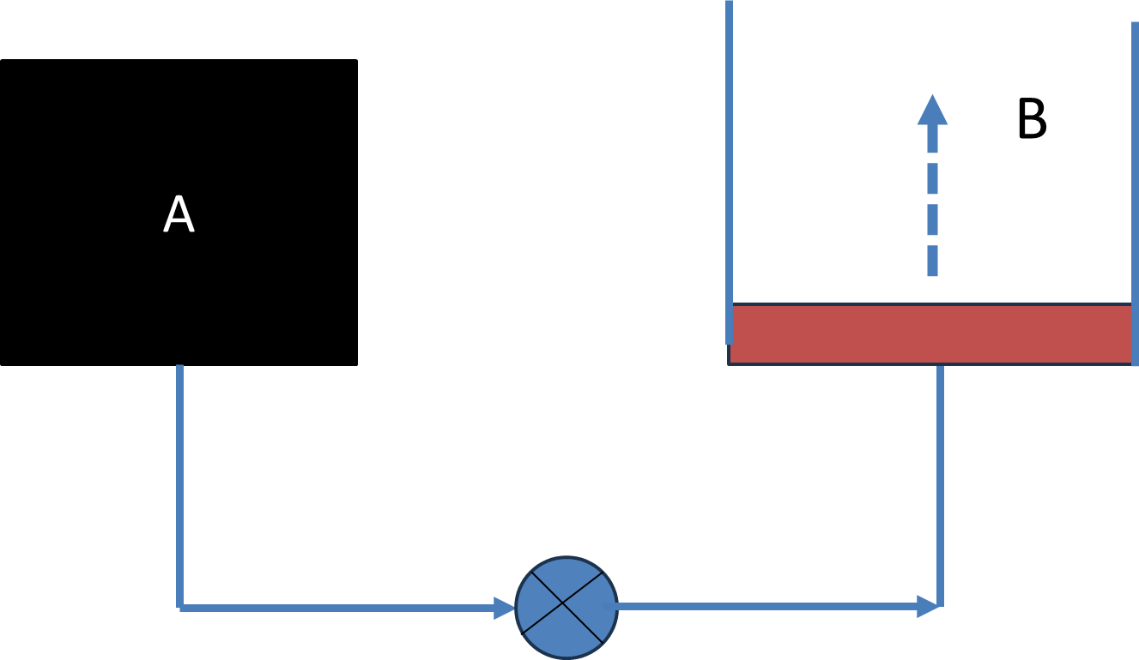
Tank A and a piston-cylinder arrangement B are connected through pipes as shown. The piston is frictionless. Tank A contains Nitrogen at 300 kPa and its volume is 0.4 m³. It requires 150 kPa to lift the piston. As the connecting valve opens, Nitrogen flows into the piston – cylinder arrangement B and attains a steady state after some time. What is the final pressure and work interaction for Nitrogen if the initial and final states are related by pV=C, where p and V represent pressure and volume of the gas and C represents a constant

