Slide 1
Question 1

Slide 2
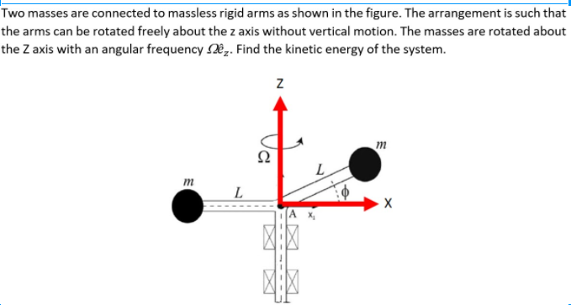
3 Marks

Slide 3
Step 1: Finding MI Matrix [I]
[I] =
1 Mark
Step 2: Finding Angular Momentum [L]
=
1 Mark

Slide 4
Step 3: Finding Kinetic Energy
=
1 Mark
TOTAL = 3 MARKS

Slide 5
Question 2

Slide 6
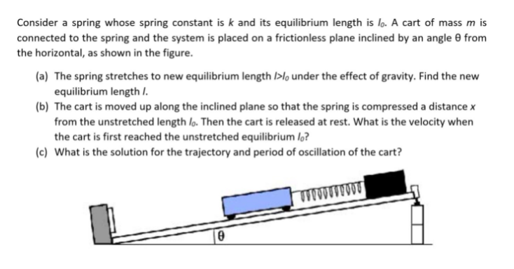
5 MARKS

Slide 7
Step 1: Finding new equilibrium
1 mark

Slide 8
Step 2: Finding velocity
1 mark

Slide 9
Step 3: Finding the solution and time period
3 MARKS
Marks to be given only if the time period is obtained from the solution

Slide 10
Question 3

Slide 11
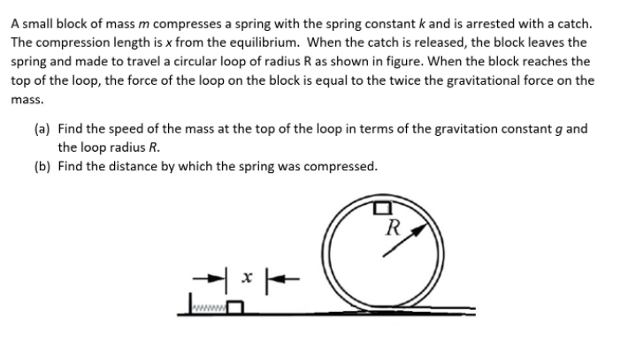
5 MARKS

Slide 12
Step 1: Speed of the mass at the top of loop

Slide 13
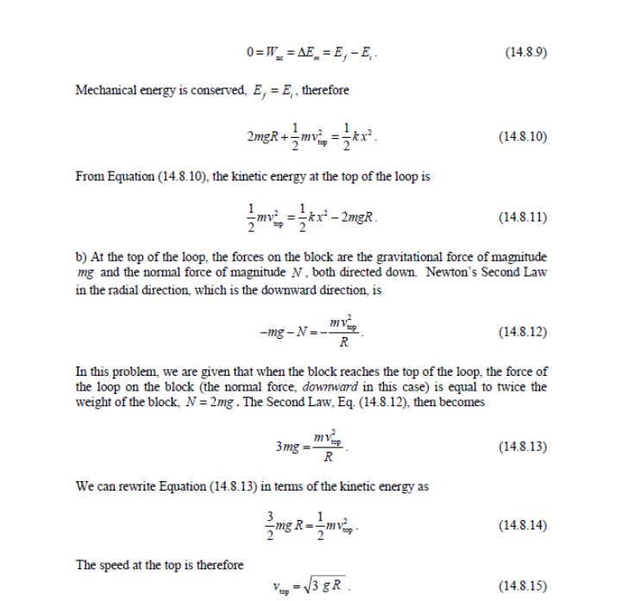
4 marks

Slide 14
Step 2: distance by which spring was compressed
We know
Substituting
We get
1 mark

Slide 15
Question 4

Slide 16
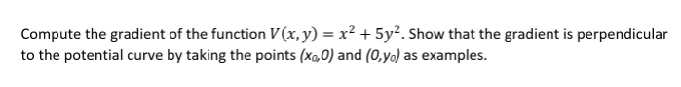
1 Mark
1 Mark

Slide 17
Question 5

Slide 18
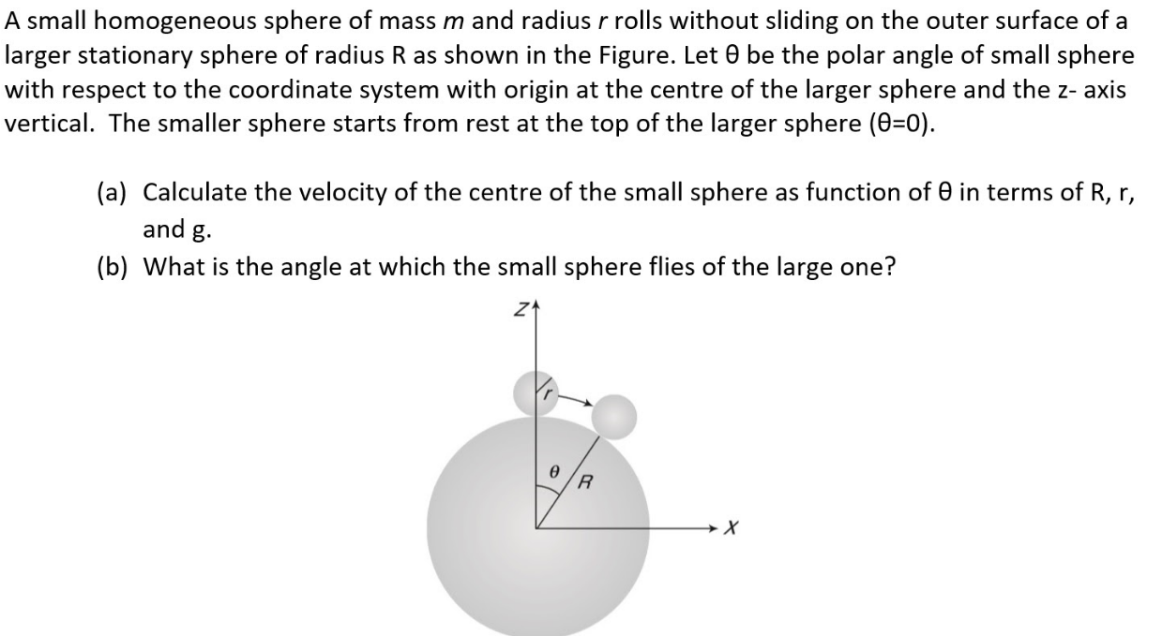
3 marks

Slide 19
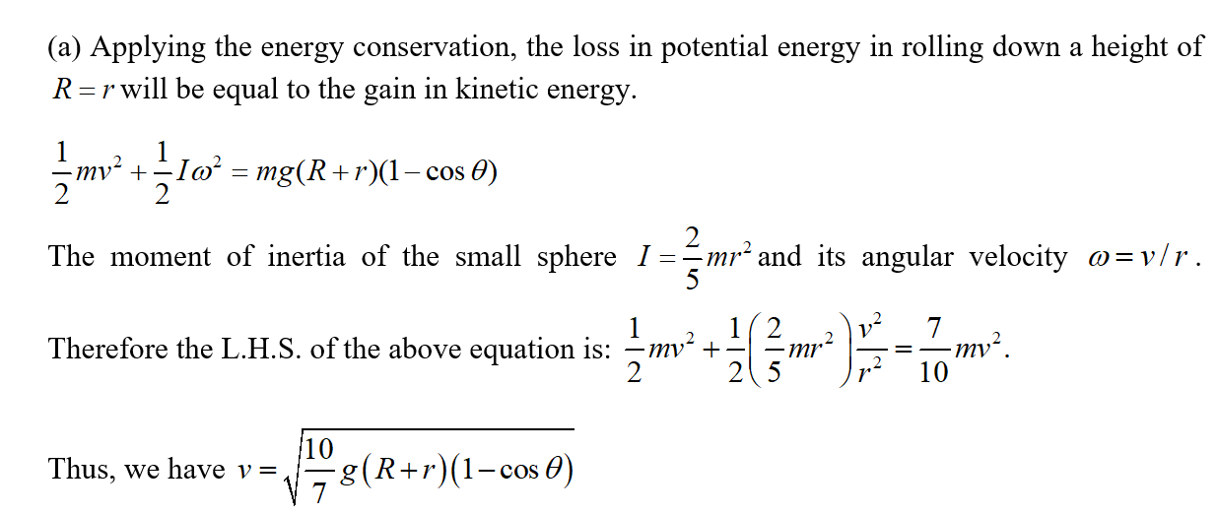
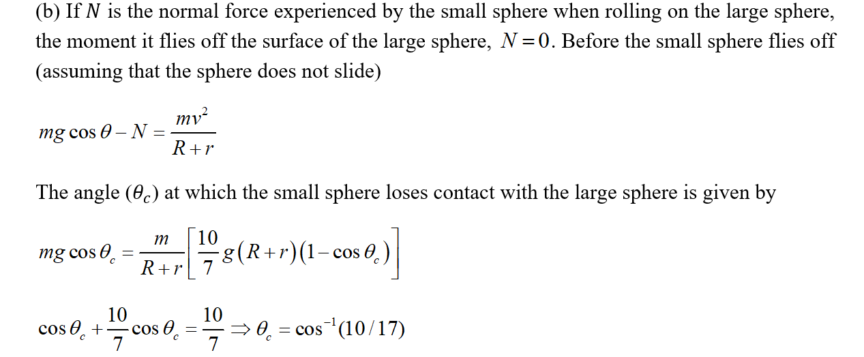
1 marks
2 marks

Slide 20
Question 6

Slide 21
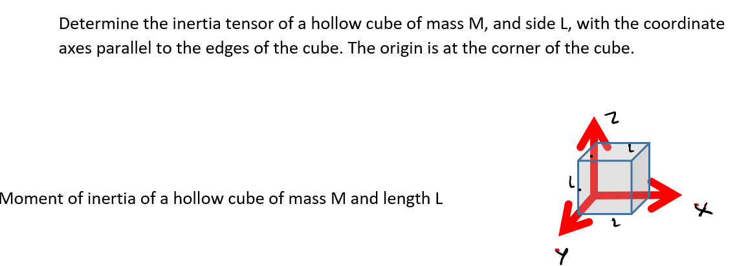
4 marks

Slide 22
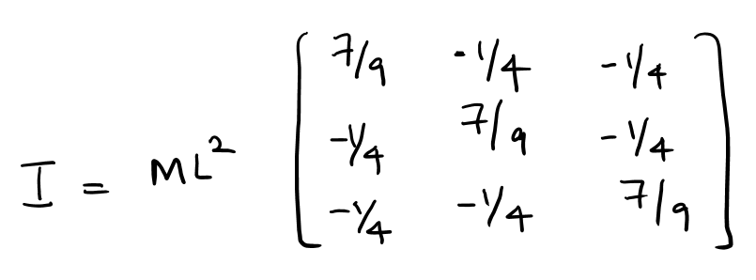
2 marks
2 marks

Slide 23
Question 7

Slide 24
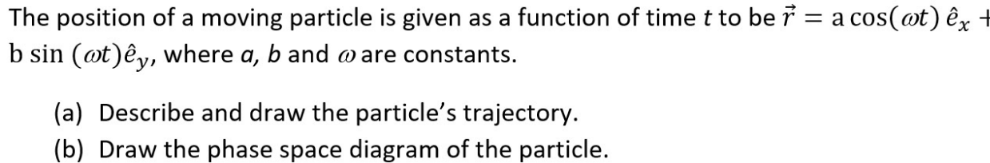
2 marks

Slide 25
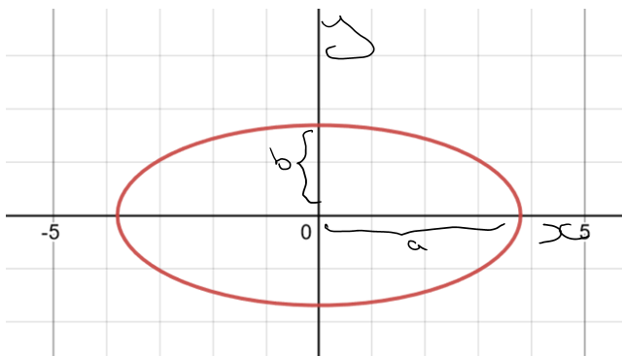
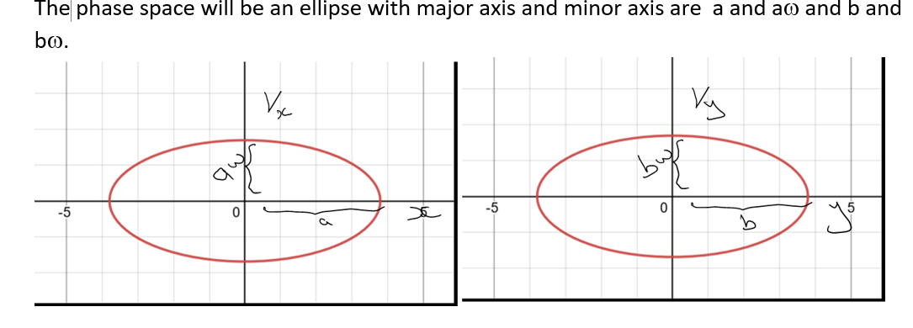
Equation 3 is an ellipse with Major axis as a and minor axis as b
If ellipse is drawn, 0.5 marks
If radii are marked, full marks
1 marks
1 marks

Slide 26
Question 8

Slide 27
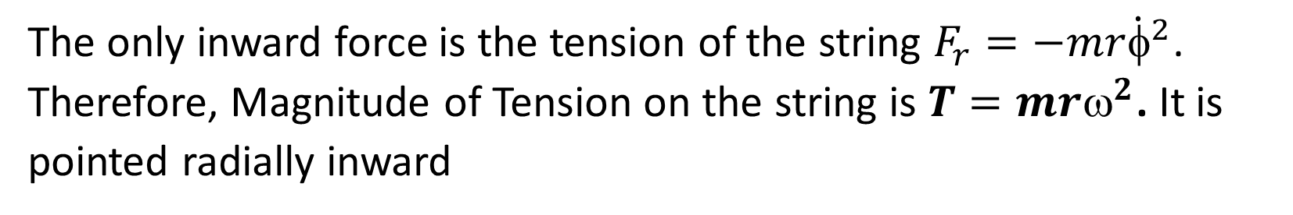
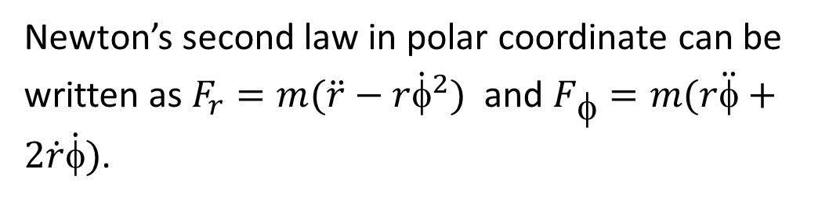
On outer space, where gravity is zero, a person is whirling a mass m on the end of a string of length R in a circle, with constant angular velocity ω. Express the Newton’s second law in polar coordinate system and find the tension in the string.
2 marks
Newton’s second law in polar coordinate can be written as $F_{r}=m(\ddot{r}−r{\dot{φ}}^{2})$ and $F_{φ}=m(r\ddot{φ}+2\dot{r}\dot{φ})$.
1 marks
The only inward force is the tension of the string $F_{r}=−mr{\dot{φ}}^{2}$. Therefore, Magnitude of Tension on the string is $T=mr^{2}$. It is pointed radially inward
1 marks

Slide 28
Question 9

Slide 29
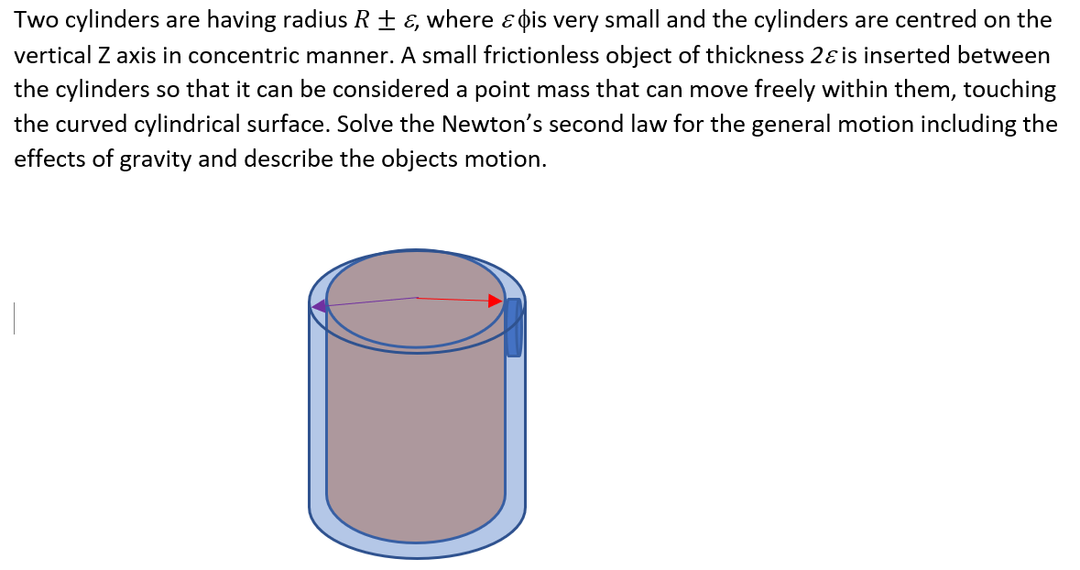
3 marks

Slide 30
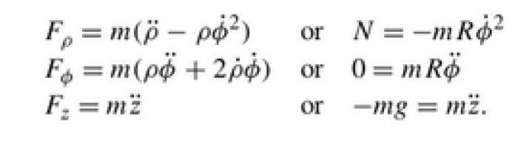
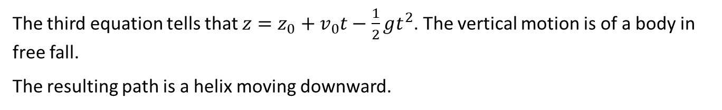
The Newton’s equation of motion in Cylindrical polar coordinates is written as
1 marks
The first equation tells that if N is constant, then the angular velocity $\dot{=ω}$ is constant.
From the second equation, we get $=_{0}+$ωt. This means that the object moves around the cylinder.
1 marks
The third equation tells that $z=z_{0}+v_{0}t−\frac{1}{2}gt^{2}$. The vertical motion is of a body in free fall.
The resulting path is a helix moving downward.
1 marks

Slide 31
Question 10

Slide 32
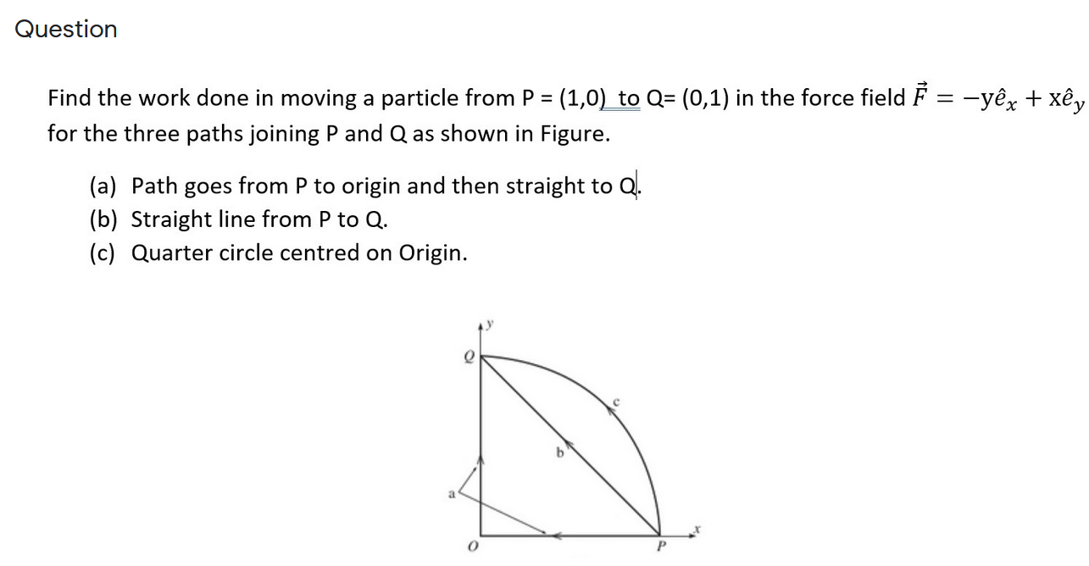
3 marks

Slide 33
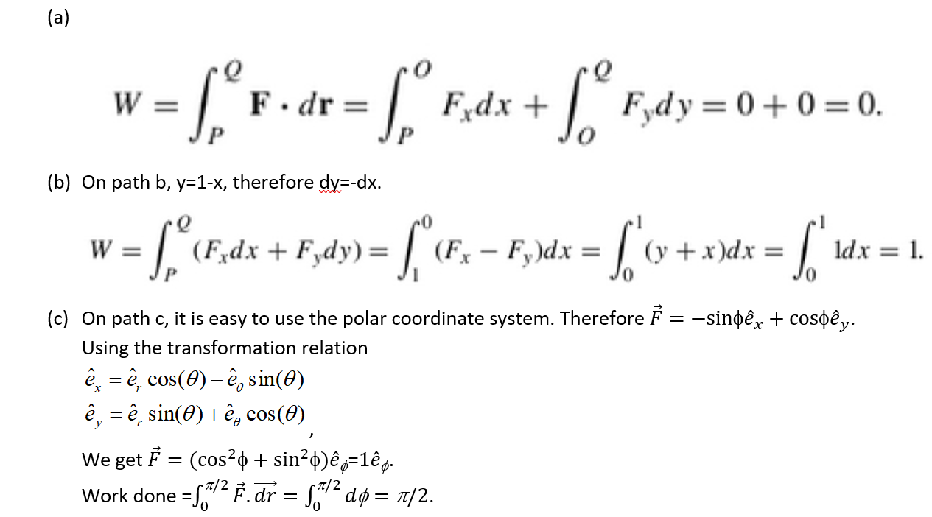
1 marks
1 marks
1 marks

Slide 34
Question 11

Slide 35
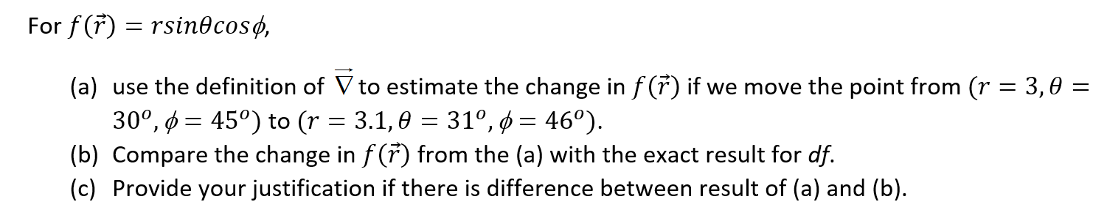
3 marks

Slide 36
(a)
1 marks
(b)
1 marks
(c) The difference between (a) and (b) is due to the reason that the definition of df in terms of Del operator is valid in the limit the change tending to zero. In the present example, we have approximated the expression for discrete change. The difference will be even less if the dr, dθ and dφ are reduced.
1 marks

Slide 37
Question 12

Slide 38
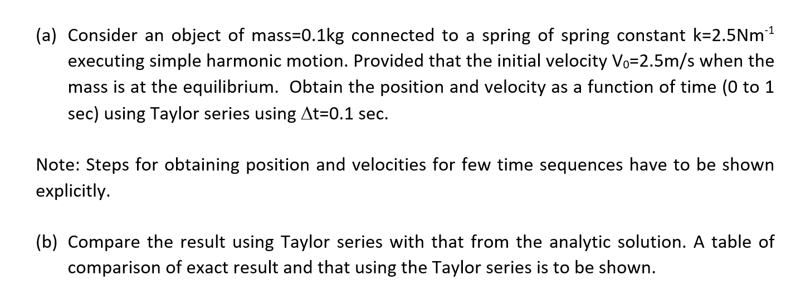
5 marks

Slide 39
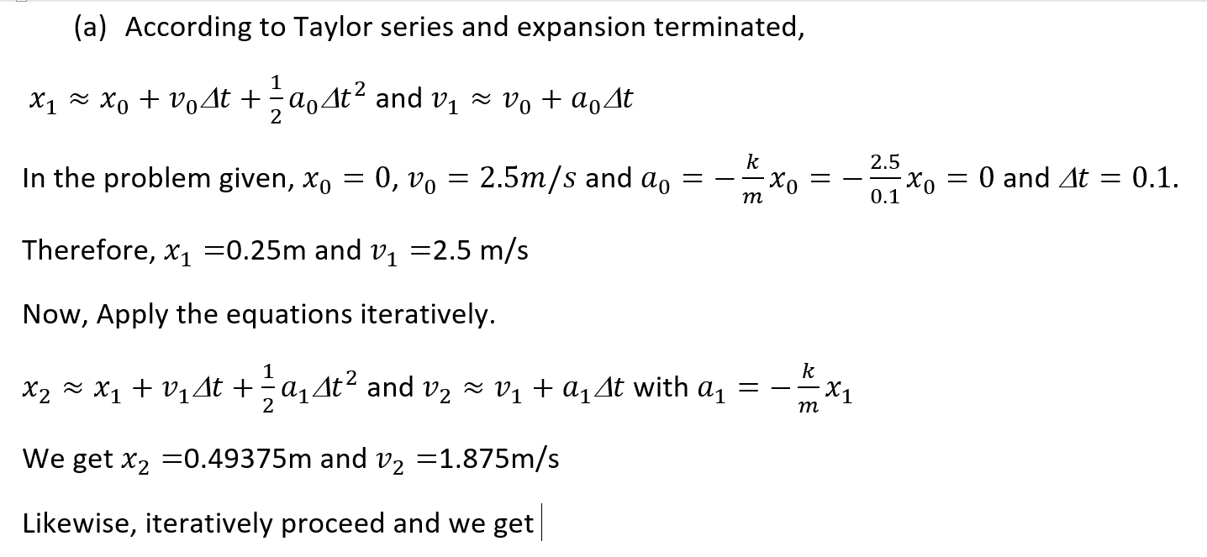
2 marks for explicitly showing the steps
for minimum two points
time | Position | Velocity
0 | 0 | 2.5
0.1 | 0.25 | 2.5
0.2 | 0.46875 | 1.875
0.3 | 0.597656 | 0.703125
0.4 | 0.593262 | -0.791015625
0.5 | 0.440002 | -2.274169922
0.6 | 0.157585 | -3.374176025
0.7 | -0.19953 | -3.768138885
0.8 | -0.5514 | -3.269312382
0.9 | -0.80941 | -1.89080447
1 | -0.89731 | 0.132718049
1 marks for displaying the velocity and
Position till time=1 sec.

Slide 40
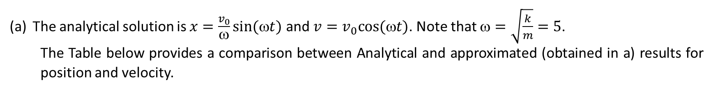
The analytical solution is $x=\frac{v_{0}}{ω}sin⁡(ωt)$ and $v=v_{0}cos⁡(t)$. Note that $=\sqrt{\frac{k}{m}}=5$.
The Table below provides a comparison between Analytical and approximated (obtained in a) results for position and velocity.
X_Taylor | X_Analytical
0 | 0
0.25 | 0.239713
0.46875 | 0.420735
0.597656 | 0.498747
0.593262 | 0.454649
0.440002 | 0.299236
0.157585 | 0.07056
-0.19953 | -0.17539
-0.5514 | -0.3784
-0.80941 | -0.48877
-0.89731 | -0.47946
V_Taylor | V_Analytical
2.5 | 2.5
2.5 | 2.193956405
1.875 | 1.350755765
0.703125 | 0.176843004
-0.791015625 | -1.040367091
-2.274169922 | -2.002859039
-3.374176025 | -2.474981242
-3.768138885 | -2.341141718
-3.269312382 | -1.634109052
-1.89080447 | -0.526989499
0.132718049 | 0.709155464
2 marks for showing the comparison with exact result

